Slide 1
CONFERENCE WB6 EUROPEAN TRANSPORT CORRIDOR
Albanian Railways (HSH) in Panel 2 on INCREASING CONVERGENCE
WITH EU: INSTITUTIONAL, NORMATIVE AND GOOD GOVERNANCE
How the restructuring of Albania Railways Company is advancing ?
What are the plans ?

Slide 2
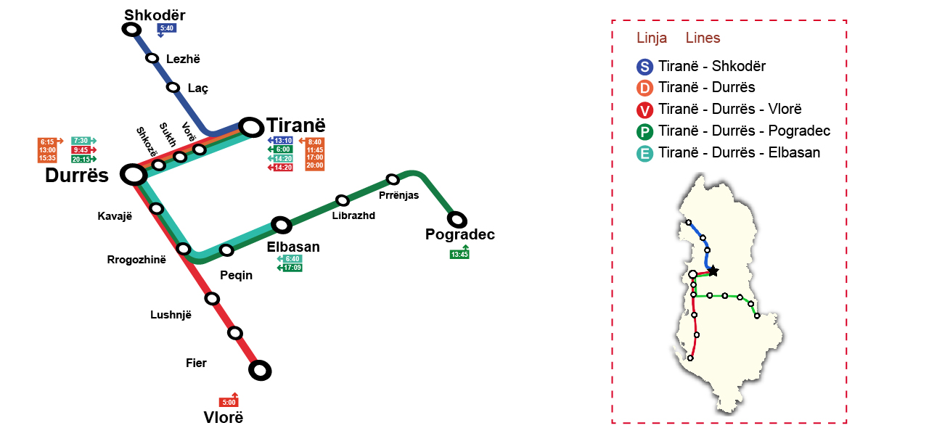
How the restructuring of the Albania Railways Company is advancing ? What are the plans ?
SAGOV Priorities during life span to access finance of projects
Promoting the South Adriatic connectivity networks
Singling out respective challenges in transport
Providing an exchange of best practices in the region
Coming up with concrete examples of integrated governance
Policy-making of strategic connectivity projects in this region
Providing innovative tools and procedures
Using by all stakeholders to improvement
Planning, implementation and monitoring of CBC connectivity

Slide 3
How the restructuring of the Albania Railways Company is advancing ? What are the plans ?
The Beneficiaries to the EU funds are involved in critical infrastructure
How the EU program interact with the national initiatives of the HSH?
Participating in the Transport Community Permanent Secretariat TCT
Reporting and monitoring Chapter 14 “Transport” and Ch.21 “TEN-T”
Partnership with the CSO and the Main infrastructure manager in AL
How can improve cooperation for better efficiency at higher impact?
Rail strategy reform currently implementing in the view of the 4th RP
Law 90/2021 on the separation of the Albanian railways, is into force

Slide 4
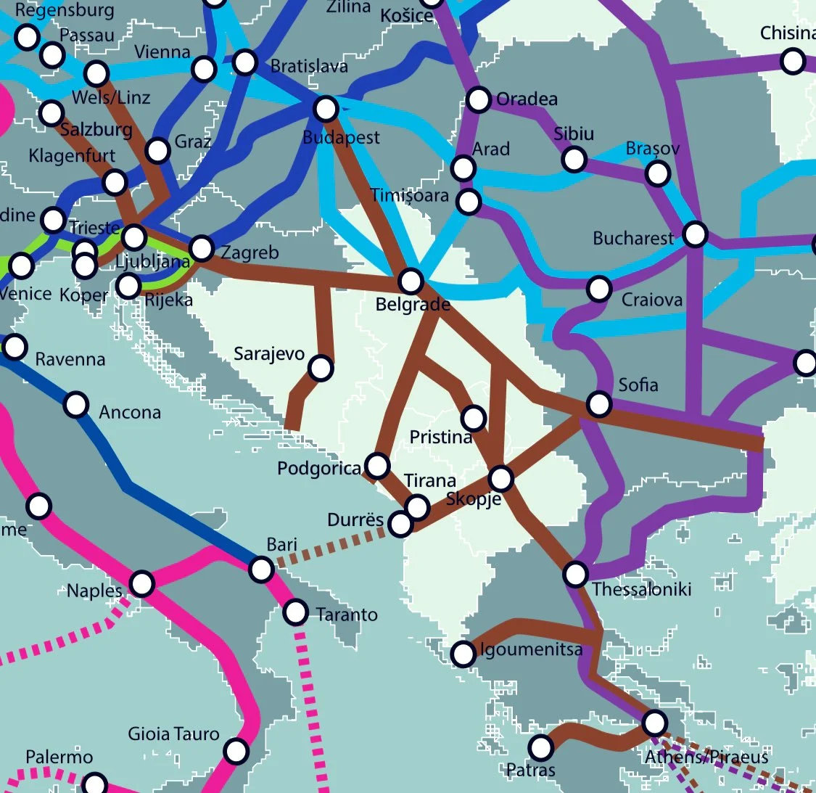
How the restructuring of the Albania Railways Company is advancing ? What are the plans ?
The Law No 90/2021 of 1.07.2021
The HSH is splitting into 4 SOEs
Main Infrastructure Manager
Passengers operator company
Freight Railway Undertaking
Entity in charge of maintenance
The rail reform is progressing
The M & R plans are in place
The IFIs, the EBRD and the EIB

Slide 5
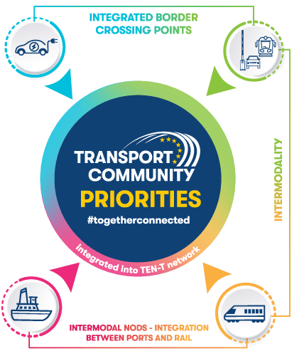
How the restructuring of the Albania Railways Company is advancing ? What are the plans ?
The separation the Albanian Railway
Stipulates the separation of the HSH
Unbundling operations from the IM
The main infrastructure manager (IM)
The plans are prepared with the IFIs
The EBRD and the EU technical EU TA
The maintenance planning 55 mln €
Durres-Tirana – Rinas 90.45 mln euros
Vora-Hani Hotit border to MNE 280 mln

Slide 6
How the restructuring of the Albania Railways Company is advancing ? What are the plans ?
The rail traffic data are as follows:
Rail traffic data (2015 – September 2022)
A | Freight transport |  | 2015 | 2016 | 2017 | 2018 | 2019 | 2020 | 2021 | 2022
 | Volumes | 000 tonnes | 197.77 | 86.84 | 211.59 | 269.53 | 707.88 | 628.54 | 631.90 | 423.11
 | " " | 000 tkm | 23,124.50 | 10,105.82 | 31,904.18 | 27,981.25 | 42,936.40 | 26,039.03 | 25,115.12 | 14,965.53
B | Passenger transport |  | 2015 | 2016 | 2017 | 2018 | 2019 | 2020 | 2021 | 2022
 | Volumes | 000 passengers | 189.71 | 88.69 | 65.98 | 75.88 | 59.79 | 17.95 | 24.02 | 10.13
 | " " | 000 pkm | 6,990 | 3,162 | 2,443 | 2,721.02 | 2,056.20 | 592.80 | 812 | 419

Slide 7
How the restructuring of the Albania Railways Company is advancing ? What are the plans ?
The audit report is prepared to be proposed to the governing board
The IM is independent from the transport operations as in the 4th RP
The RUs are to be set up under 3 new host companies from the MFE
The independence of the Main infrastructure manager IM is a must
Infrastructure development strategy is being prepared with the TA
Semi mechanized machineries and equipment (17 pieces) planned
The TAC scheme is under the adoption of the MIE and the MFE (2022)
The PSO is also promoted under the new level of charging for access

Slide 8
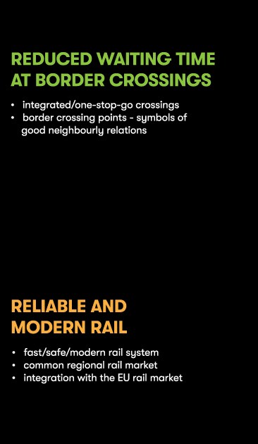
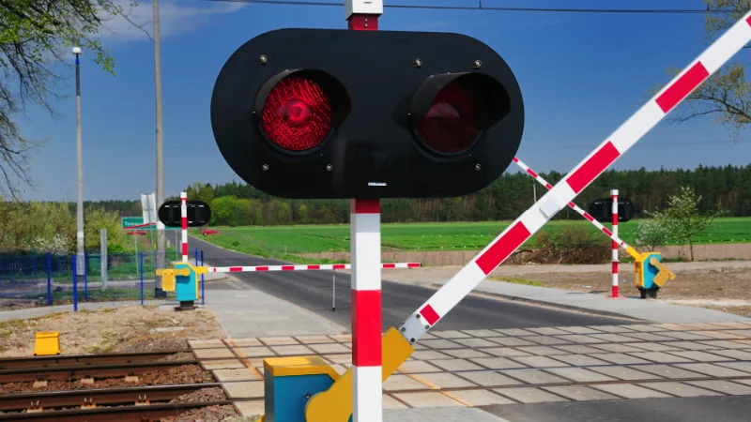
The national campaign on the level crossings

Slide 9
How the restructuring of the Albania Railways Company is advancing ? What are the plans ?
The right of the owner of the new companies is exercised by the MFE
Competent authority for the MAIC ministry responsible for economy
Registration of host companies is done according to the Railway Code
Legal provisions stipulate among others that Infrastructure manager
Measures, improves and monitors the operational performance
Allocate infrastructure capacities and boost railway safety culture
Guarantees the well governing of asset management plan systems
Conclude a multi-year contract for the TSI of railway infrastructure

Slide 10
Regional and national campaign on safety
ENI ELEZI, MBA IUKB, HSH MIE
Eneida.elezi@gmail.com and eneida.elezi@hekurudha.al

