Slide 1

CONFERENCE ON CRITICALITY OF WB6 NODES AND LINKS
WB6 EUROPEAN TRANSPORT CORRIDOR WESTERN GATE
State of Play of the main railway sections in Albania that are part of / connected to Corridor VIII.
20 DECEMBER 2022
VENUE: ALEKSANDËR MOISIU UNIVERSITY, DURRËS

Slide 2
POLICY FRAMEWORK AND STRATEGIC FRAMEWORK
Strategy of Transport 2021 – 2026;
ANTP 3;
Law 142/2016 dated 22.12.2016 "Railway Code of the Republic of Albania“;
The four laws for the establishment of 3 independent Railway Authorities and the separation of the Albanian Railway.

Slide 3
INSTITUTIONAL FRAMEWORK
Ministry of Infrastructure and Energy;
Directorate of Railway Inspection;
Albanian Railways S.A. (HSH); AND
"Albrail" ltd Concessionary company

Slide 4
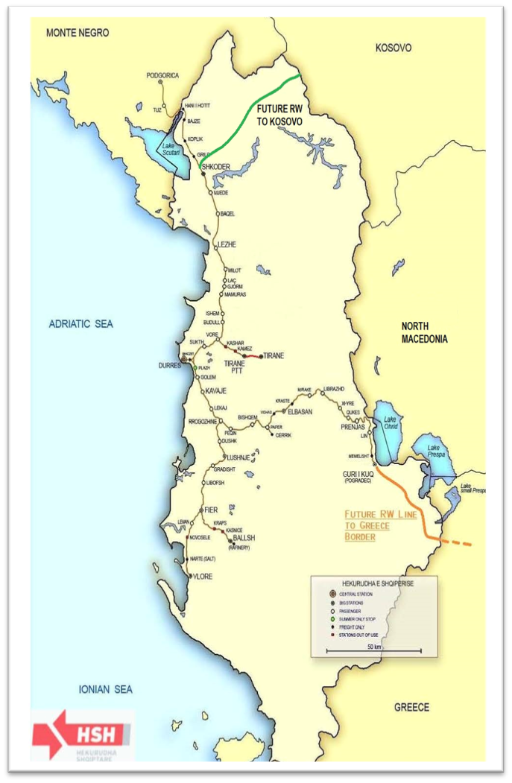
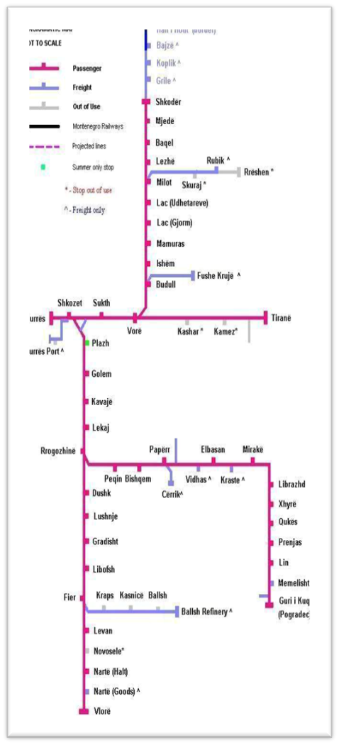
Current status regarding the railway infrastructure in Albania - Overall national railway infrastructure Map

Slide 5
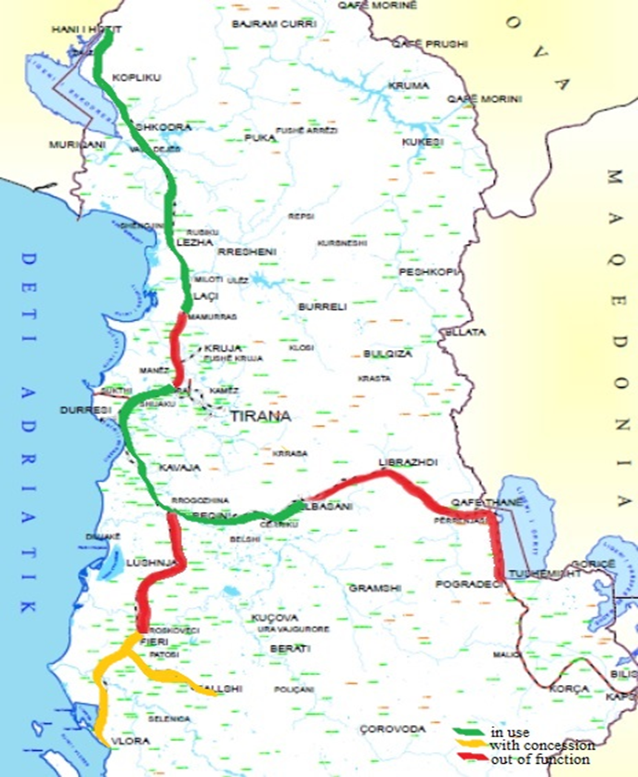
Current status regarding the railway infrastructure in Albania - Overall national railway infrastructure Map
Length of the Albanian Railway Network: 420.5 km
Status: 351.6 km are administered by HSH sh.a 100% state;
68.3 km managed by the concessionaire private company ALBRAIL shpk;
153.8 km or 36.5% currently out of service.
The total allocated budget for the “Rail Transport" Program in the Mid-term Budget Program 2023-2025 is:
Year 2023: 400,000,000 All
Year 2024: 400,000,000 All
Year 2025: 400,000,000 All

Slide 6

Transport Strategy and Key Indicator for 2030
  Key Monitoring Indicators for 2030 objectives:
Increase in the annual volume of road transport of goods (%) 30
Increase in the annual volume of road transport of passengers (%) 40
Increase in the annual volume of rail freight transport (%), about 40
Increase in the annual volume of rail passenger transport (%), about 30
Increase in the annual Passenger transport by ferry (%) 25
Container traffic in Port of Durrës-Porto Romano, till 292,000 TEU per year
High growth of annual international air passenger traffic – up to 9 million passengers
  Priority interventions/projects to address the weaknesses:
  Blue Highway (Adriatic – Ionian Corridor)
  Corridor VIII multimodal (Road and Rail)
  New Railway connection with Kosovo and Greece;
  Ports / Port of Durrës - Porto Romano; Vlora Tri Port and Vlora Touristic Port;
  Airports / Vlora Airport

Slide 7
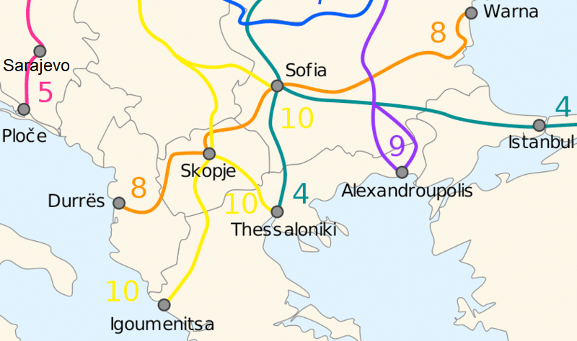
  Priority interventions/projects to address the weaknesses (Railway)
  Corridor VIII multimodal (Railway)
  Railway with a length of 154 km , capital cost of 314.5 millions euro. ENPV = 332.7million euro; EIRR = 11.4 % for full compliance with TEN-T.
  The Benefits:
    alternative transport corridor that meets the security factor as it passes through NATO member countries and part of WB6.
    Freight transport by railway it will have a lower cost, reduces travel time.
    Diverted passenger traffic is 35%,
    Generated passenger traffic 6 %;
    Diverted freight traffic is 64%,
    Generated freight is traffic: 6.3 %;

Slide 8
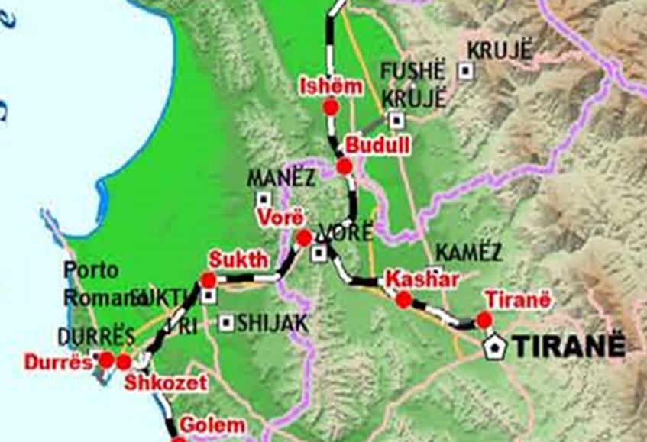
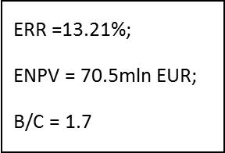
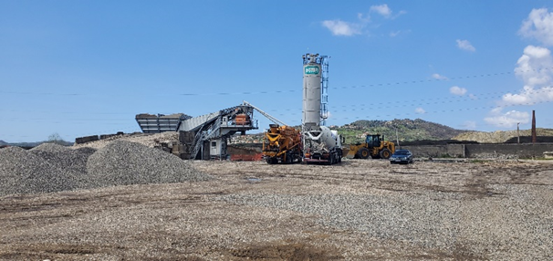
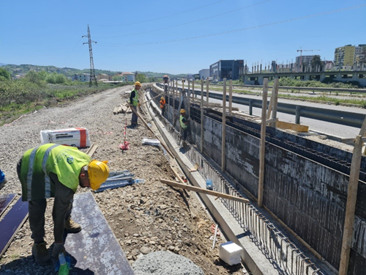
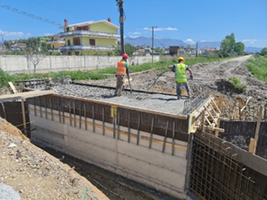
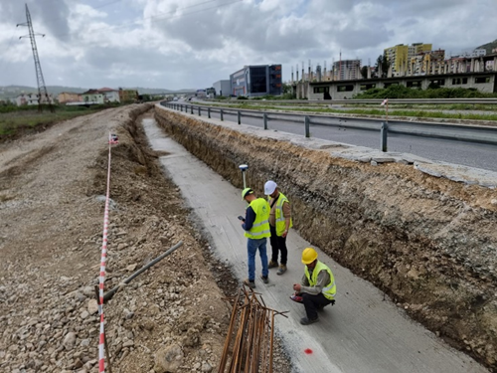
  Priority interventions/projects to address the weaknesses (Railway)
  Corridor VIII multimodal (Railway)
  Railway Tirana – Durres, Core Network Western Balkans
  Project of the Rehabilitation of the railway line Tirana – Durrës, length 38 km and the construction of the railway line to the International Airport of Tirana, 4 km long.
  Total cost: 90.5 million Euros;
  The construction is ongoing, and foreseen to be finalized at 2024.

Slide 9
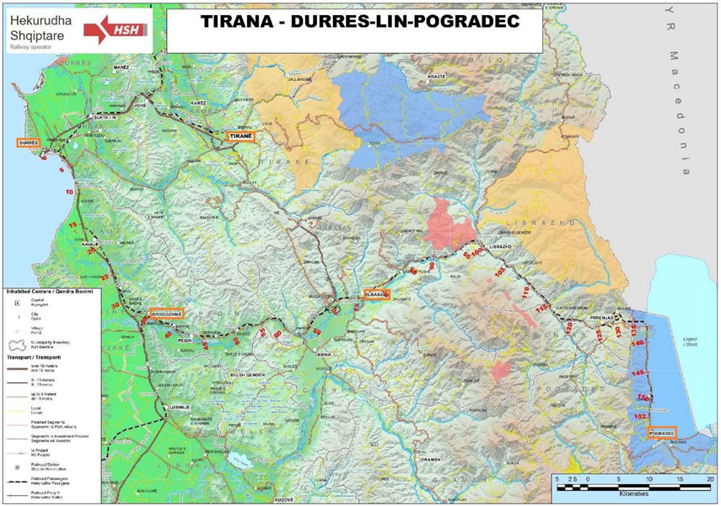
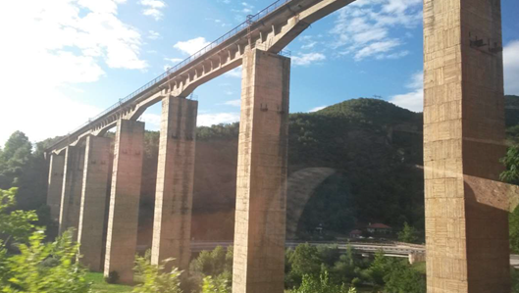
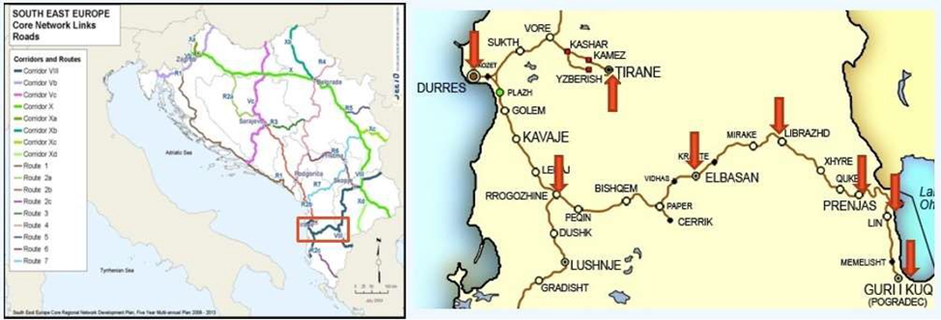
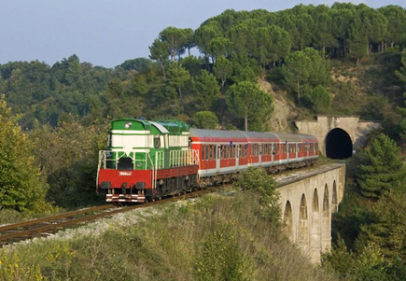
  Priority interventions/projects to address the weaknesses (Railway)
  Corridor VIII multimodal (Railway approx. 156 km)
  The Rehabilitation of the Durrës – Rrogozhina railway (approx. 40km). The costs for the construction of works for this mature project is approx. 77.5 Million of Euro. For the investment of this project Albanian has applied under WBIF.
  Rehabilitation of Rrogozhine–Pogradeci–Lini railway and the construction of a railway link between Lini and the border of North Macedonia, approx. 116km, (the project is under preparation – estimated cost 320 million of Euro).

Slide 10
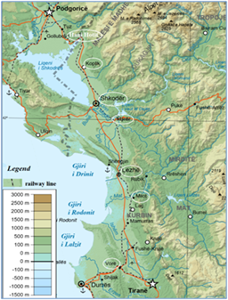
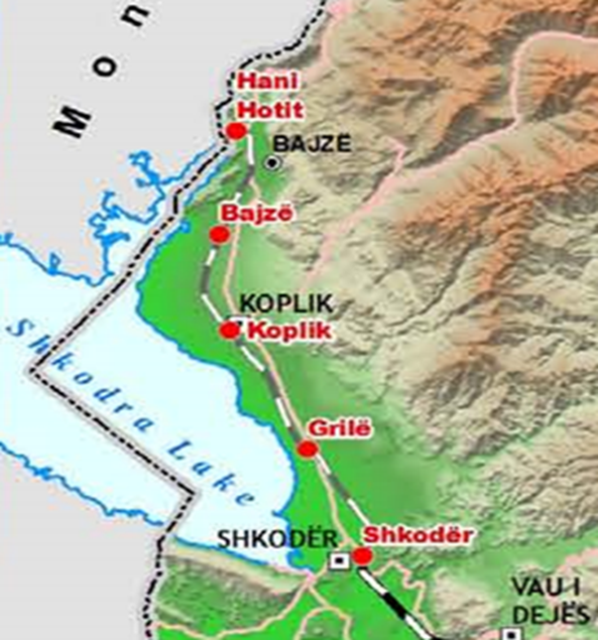
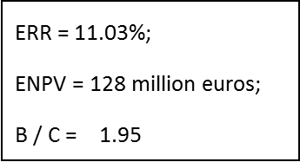
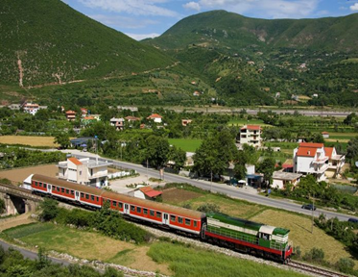
  Priority interventions/projects to address the weaknesses (Railway)
  Railway Connection with Montenegro
  Project of the Rehabilitation of the railway line Vora – Hani i Hotit (approx.. 120 km)
  Total cost: 267 million Euros;
  The financing of this project is secured with a co-financing of WBIF, EBRD, EIB and GoA.

Slide 11
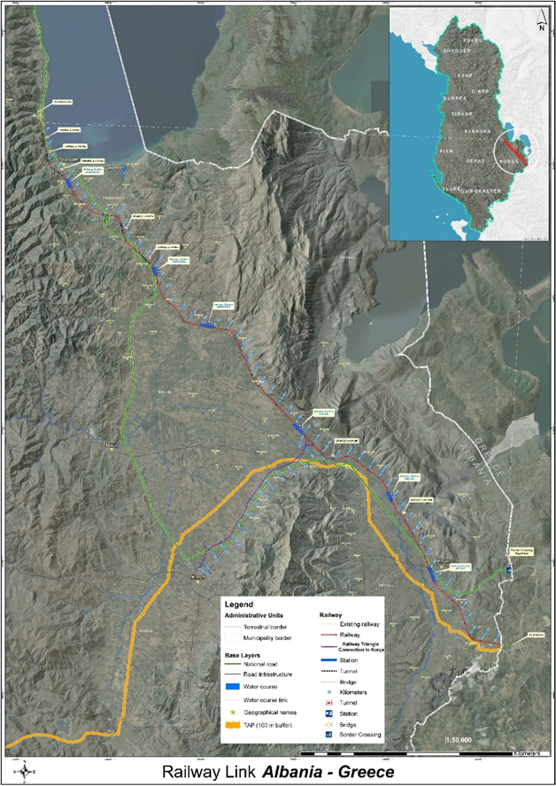
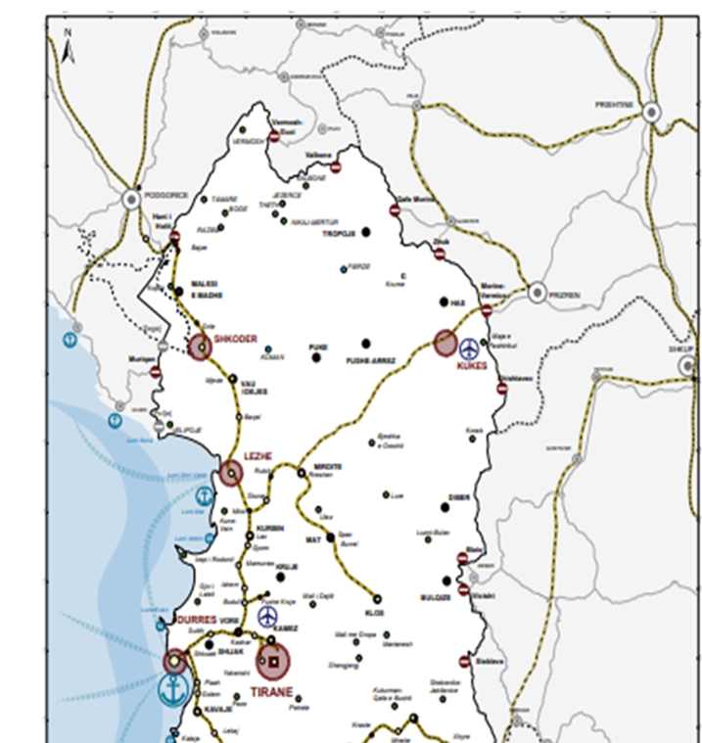
  Priority interventions/projects to address the weaknesses (Railway)
  New railway connection with Kosovo (approx. 100 km)
  New railway connection with Greece (Pogradec – Korca – Greece) (approx. 60km)
  Benefits:
  Establish an interoperable railway infrastructure connected to neighboring countries;
  Facilitate trade and economic links with EU Member States;
  Lower commodity prices for the end consumer;
  Enable the conjuncture of economic development to change,
  in orientation to the most profitable industries that provide wages of European standards.

Slide 12
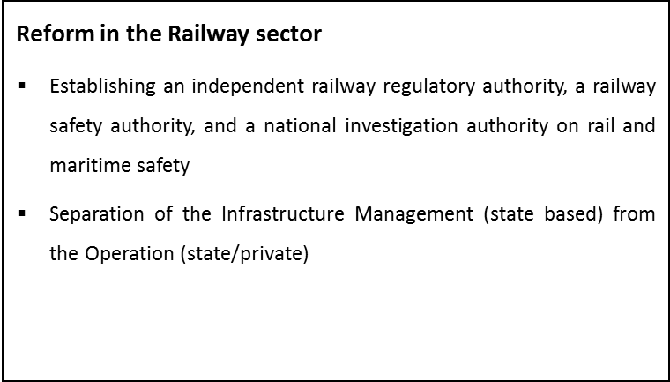
  In the future - Free Market and Competitiveness in Transport
  Adopted the EU Rules for the free market and fair competitiveness in in all kind of transport including the rail/intermodal one.
  Until 2030 electrified rail network in compliance with TEN-T EU networks
  New fleet of EU standard rolling stocks, lower cost of transport and environmental friendly, more competitive in the EU Market and fairer as well.
  Better technologies in all transport modes, e-transport instruments in transportation process, better accessibility to the touristic area and lower cost, will provide better and fairer competition in the region and EU either.

Slide 13
THANK YOU!
Zana Josa, MBA
Ministry of Infrastructure and Energy
e-mail : zana.joca@infrastruktura.gov.al

