Slide 1
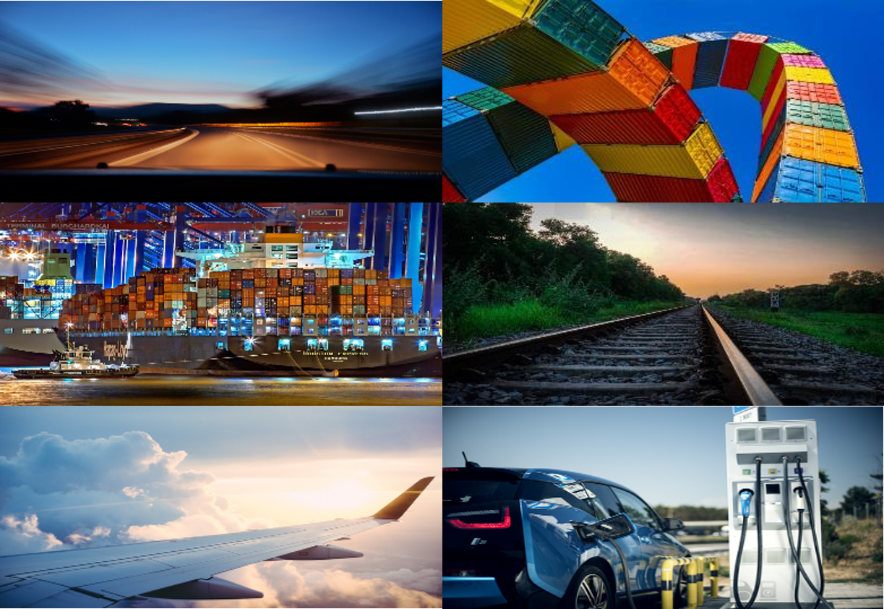
On our way:
Transport in the EU Climate Bank
EIB Transport Lending Policy 2022
"Criticality of WB6 nodes and links: WB6 European Transport Corridor Western Gate”
20 December 2022

Slide 2
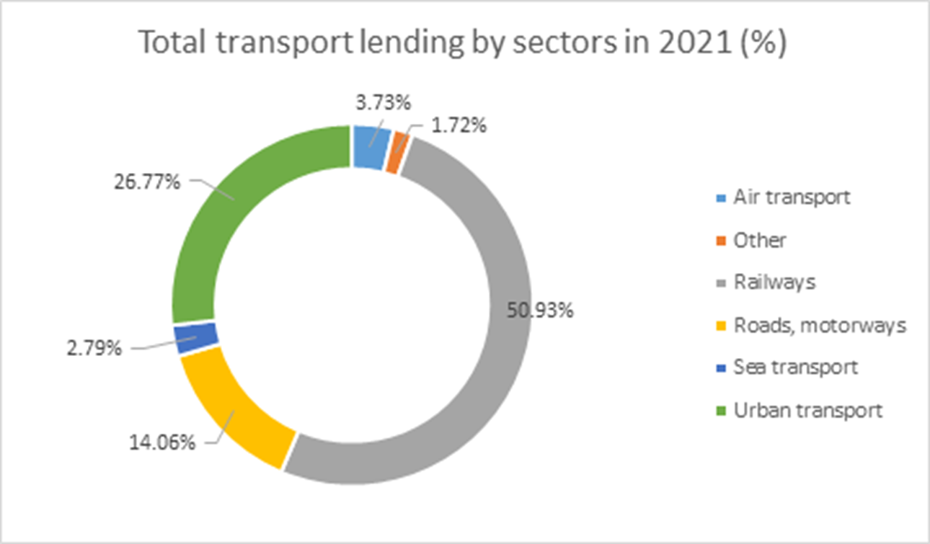
Context
Transport has been by far the single largest sector of EIB activity since its foundation in 1958.
In the last ten years, in the period 2012-2021, transport lending averaged some EUR 11 billion per year and about 18% of overall lending. 80% of transport lending was within the EU.
Notes:
Source: https://op.europa.eu/en/publication-detail/-/publication/f656ef8e-3e0e-11ed-92ed-01aa75ed71a1

Slide 3
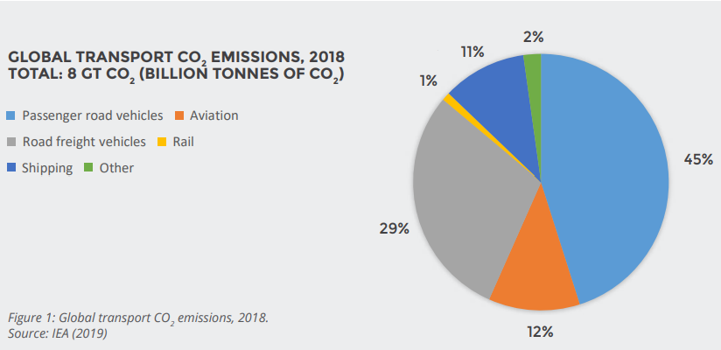
Transport: GHG emissions per mode
Notes:
Source: https://www.wemeanbusinesscoalition.org/wp-content/uploads/2021/05/Shape-And-Pace-Of-Change-In-The-Transport-Transition-1.pdf

Slide 4

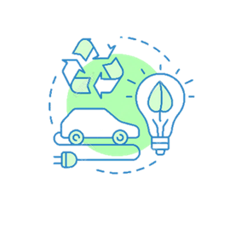
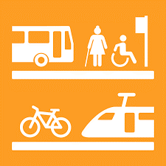

Context
Transport Lending Policy 2011
Transport in Climate Bank Roadmap
EC’s Sustainable and Smart Mobility Strategy
Transport Lending Policy 2022

Slide 5

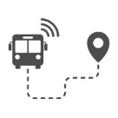

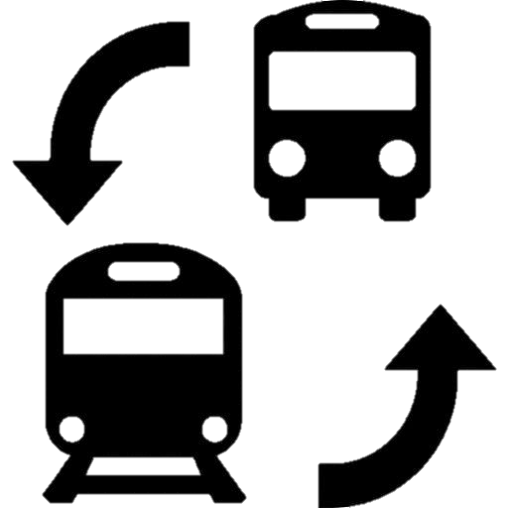






EIB CBR 2021-2025 – Eligible Investments
Infrastructure
Mobile Assets
Active, Zero Emission mobility
Zero direct emission
“Substantial contribution”
– criterion of EU Taxonomy (TEG Proposal)
Traffic management
(ITS, ERTMS, RMS, ATM)
Rail & public transport
Retrofits with environmental, safety benefits
Inland Waterways, ports
Powered solely by advanced biofuels, or synthetic fuels
Road safety, rehabilitation;
capacity expansion under conditions
Airport safety, security, greening
Overriding public interest

Slide 6

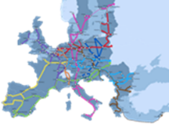
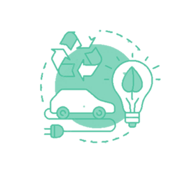

Transport Lending Policy 2022: Framework for sustainable mobility (SAGE)
 | SAFE - A safe system that prevents unnecessary loss of life, and protects users from attack, discrimination or harassment.
 | ACCESSIBLE - An affordable and accessible network available to all who can benefit from the opportunities it provides.
 | GREEN - A clean, resilient and carbon neutral system that does no significant harm to the environment
 | EFFICIENT - A smart and efficient system utilising technology to minimise resources, optimise use and prevent congestion.

Slide 7

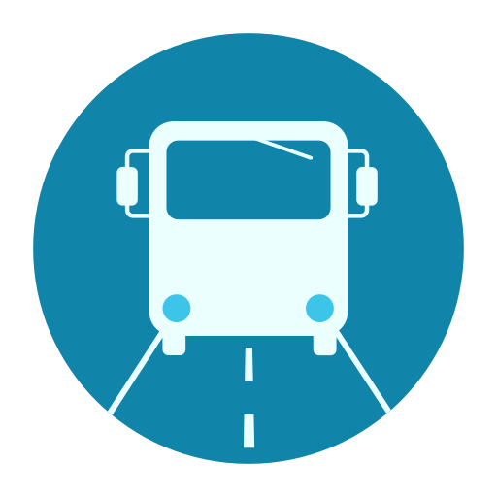


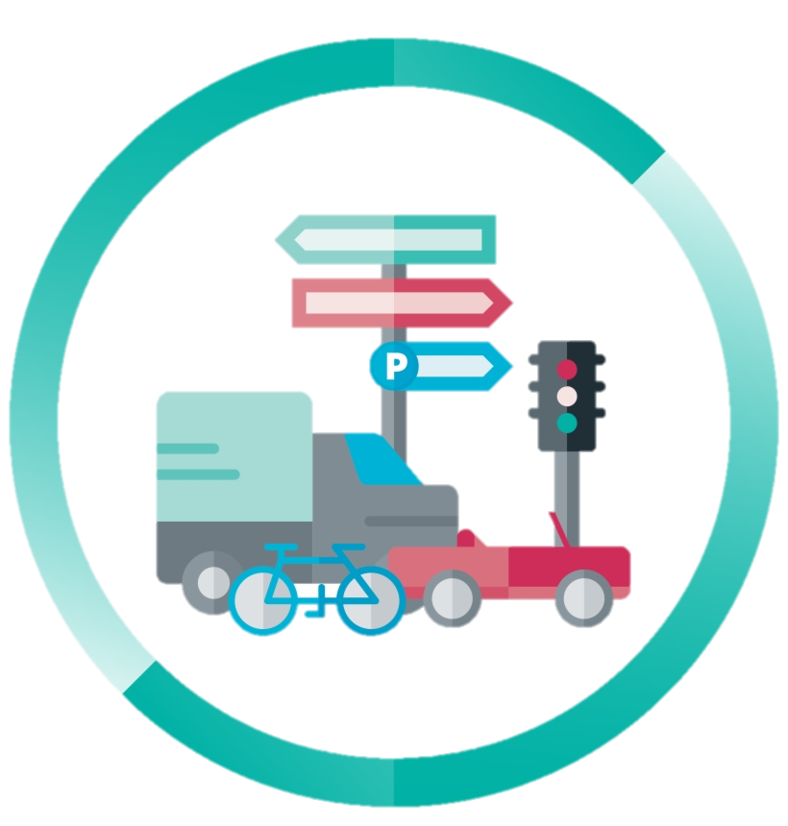

TLP: Some key priorities
Zero Emission Mobile Assets | Public Transport | Alternative Fuel Infrastructure
Resilient Infrastructure & TEN-T infrastructure | Traffic management (ERTMS, ITS, RMS, ATM) | Road Safety

Slide 8
What have we recently done?
Some great transport projects
Notes:
@

Slide 9


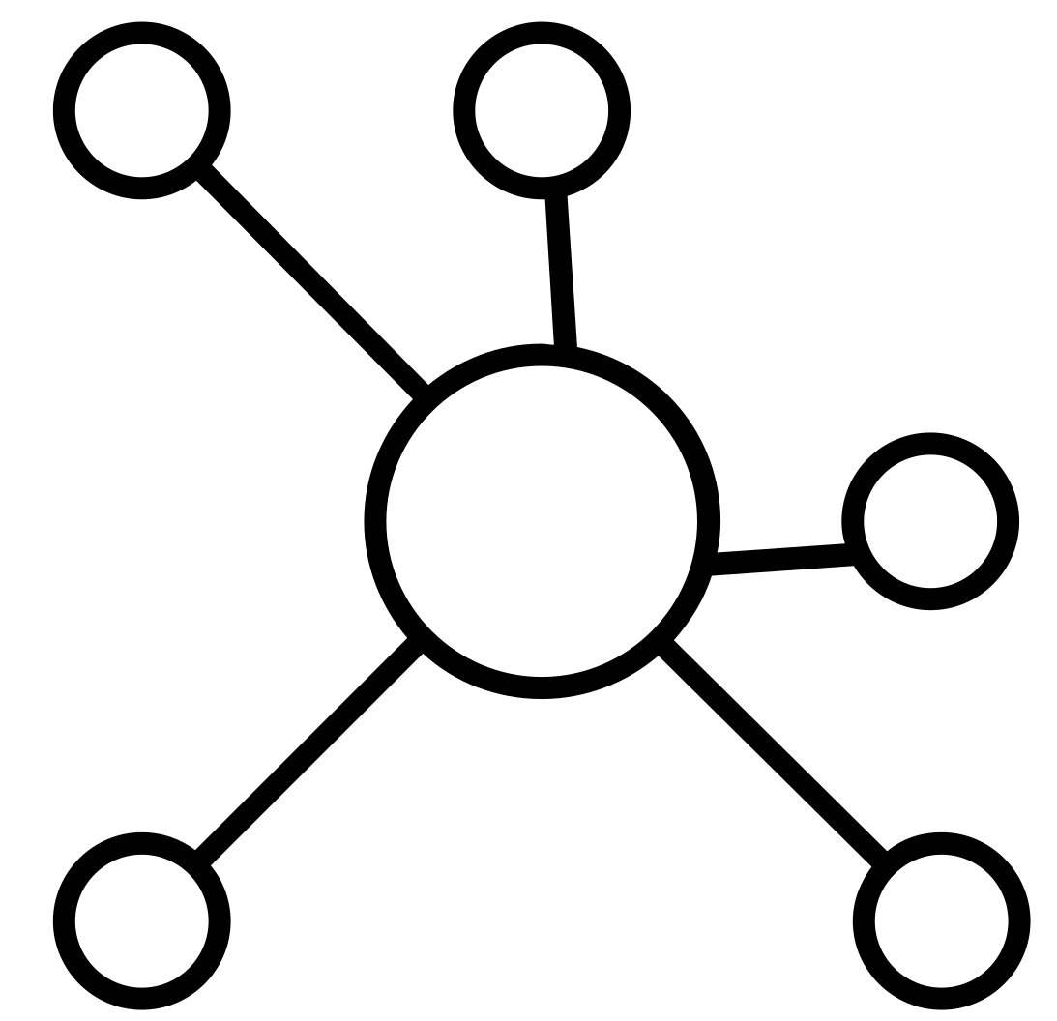

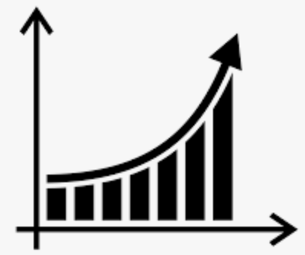


High Speed Rail connection Napoli – Bari
Upgrading of 121 km of railway line
part of the TEN-T Network
fast and efficient rail link
passengers and freight
Connection of Italy’s 3rd and 6th largest metropolitan areas
Increase of max. speed to 200 km/h and line capacity
6.3bn
EUR
Increases in demand volumes expected (~3 times)
Greener
Boost economic development and social integration in Campania and Puglia
Italy
JASPERS supported the project with a TA
Notes:
Upgrading of 121 km of railway line connecting Napoli with Foggia and Bari (part of the TEN-T Network) to provide a fast and efficient rail link between major centres of population in Campania and Puglia, for both passengers and freight.
Increase of max. speed to 200 km/h and line capacity (from 84 pax trains and 3 freight trains per day to 209 and 11 respectively)
Important increases in demand volumes expected (from 3.4 M to 9.3 M pax/year; from 0.4M t to 1.3M tonnes/year)
Greener: about 158 kton CO₂ avoided

Slide 10



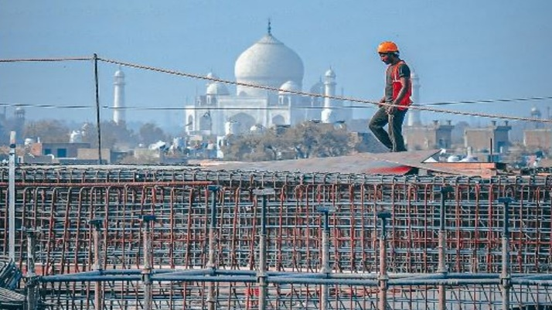
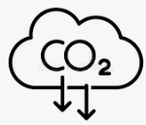

Agra Metro Rail Project
two interconnected urban metro rail lines
30 km long with 27 stations
rolling stock
Historic city of Agra – Home to the Taj Mahal and Agra fort
Construction near 12 nationally protected monuments, incl. 2 UNESCO World Heritage Sites
Access to safe, affordable, accessible and sustainable transport (2.3 million citizens + 9 million visitors/tourists)
908M
EUR
Reduction of congestion, road accidents air and noise pollution and GHG emissions
Promotion of Gender Equality
India
Notes:
The project concerns the construction of two interconnected urban metro rail lines, in aggregate 30 km long with 27 stations and the acquisition of the related rolling stock, in the historic city of Agra, in the state of Uttar Pradesh in Northern India.
Construction in the vicinity of 12 nationally protected ancient monuments, including two UNESCO World Heritage Sites (Taj Mahal and Agra Fort)
Access to safe, affordable, accessible and sustainable transport systems for the 2.3 million citizens and the 9 million visitors/tourists (per annum)
Promotion of Gender Equality - (quantitative targets for women employment), design and operational features enhancing access, safety and security for women

Slide 11

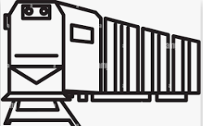

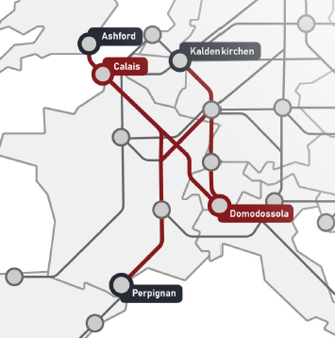
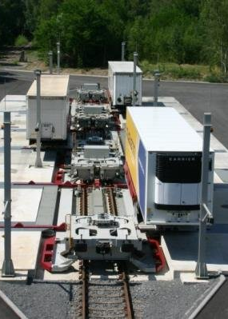


Cargobeamer
three rail terminals in Calais, Kaldenkirchen and Domodossola
216 specialised combined rail wagons
Develop a network of "rail motorway" transport service in Europe
Form 5% to 80% road semi-trailers can be moved to rail; more modal shift
Avoid road congestion
100M
EUR
Opex savings for shippers
Greener
Italy/France/ Germany
Potential for growth
Notes:
Only 5% of road semi-trailers can be loaded onto trains with cranes (conventional combined transport) vs 80% with the use of Cargobeamer; hence, unlocking benefits of modal shift
Avoid road congestion (86,142 trucks off the road)
Opex savings for shippers (no overnight drivers, less fuel costs, less tolls, etc.)
Greener: about 50 kton CO2 avoided
Huge potential for growth throughout Europe (up to 30 terminals and 6,000 wagons planned)

Slide 12
Thank you!
Notes:
@

