Slide 1
Interreg IPA South Adriatic and Youth
INTERREG IPA EUSAIR YOUTH CONFERENCE
“On a meaningful involvement of youth in European Cooperation”
Tirana, 9 December 2022 Hotel
Mauro Novello
JS of the Interreg IPA South Adriatic

Slide 2
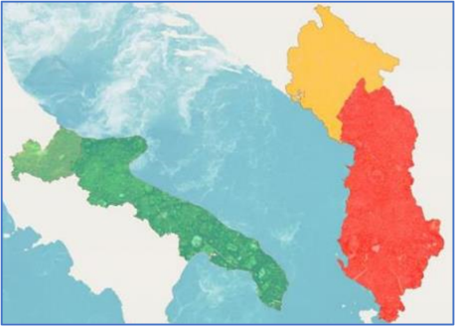
PROGRAMME AREA
Italy: Puglia + Molise
Albania & Montenegro
(whole territory)
*+ art. 22 ETC flexibility esp. for Italian Regions

Slide 3
SPECIFIC OBJECTIVES

Slide 4
ACTIONS
For all Specific Objectives, following possible actions:
1) Public services
2) Digital services
3) Small investments
4) Innovative experimental applications
5) Agreements
6) Joint models / processes
7) Capacity building / trainings

Slide 5
BENEFICIARIES AND TARGET GROUPS
2014-2020 approach with beneficiaries, who participate in calls with project proposals, is confirmed:
Their target groups, using/benefitting from their actions:
SMEs, public, private and non-profit organisations
Citizens

Slide 6
TARGET GROUPS: YOUNG CITIZENS
Young people explicitly targeted:
S.O. 1.1 SMEs: Measures for local SMEs contrast unemployment + migration of younger population to more attractive locations;
S.O. 4.1 SKILLS: Targeting vulnerable groups, incl. unemployed young citizens and NEETs;
S.O. 4.2 Inclusive TOURISM: Targeting more skilled and young population

Slide 7
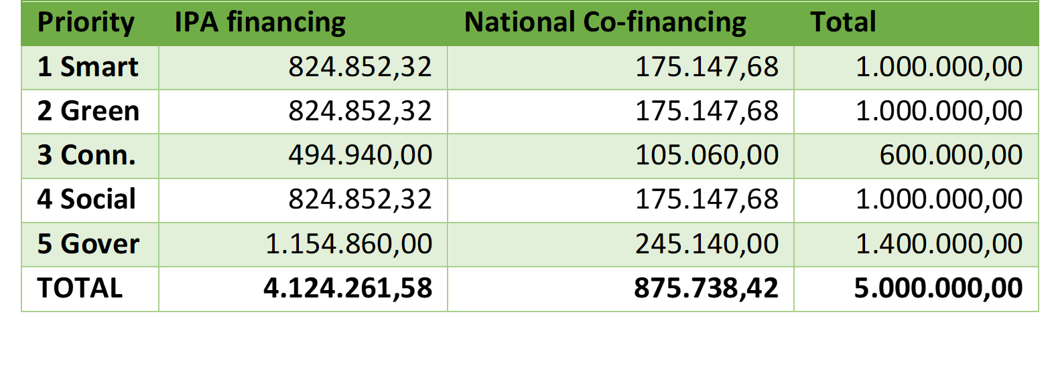
FIRST CALL OPEN - MID DECEMBER 2022

Slide 8
FIRST CALL FOR SMALL-SCALE PROJECTS
Small-scale projects (Simplified cost options only, 200.000 €, 1 year)
Costs include “Trainings” and “Actions accompanying start-ups”, expected to involve many young citizens
On-going partner search, see website
Additional points for: NGOs, EUSAIR
CHECK OUR WEBSITE:
www.italy-albania-montenegro.eu

Slide 9
2014-2020 ACTIONS WITH YOUNG CITIZENS Financed examples / 1
S.O. 2.1 Cultural and creative industries
CIRCE - short movies directed by under 35 persons, internationally awarded
https://circe.italy-albania-montenegro.eu/
FAME - young bands created within Tirana Capital of Youth
https://fame.italy-albania-montenegro.eu/
MONET - residential experiences with young artists
https://monet.italy-albania-montenegro.eu/
HAMLET - literary contest for young people
https://hamlet.italy-albania-montenegro.eu/
EARPIECE – studies on folk music at music conservatories
https://earpiece.italy-albania-montenegro.eu/

Slide 10
2014-2020 ACTIONS WITH YOUNG CITIZENS Financed examples / 2
S.O. 1 SMEs & 2.1 Environment
HISTEK - technical qualifications for young people
https://histek.italy-albania-montenegro.eu/
WELCOME - beach cleaning with young people
https://welcome.italy-albania-montenegro.eu/
CrossWater - awareness campaigns on water in schools
https://crosswater.italy-albania-montenegro.eu/
LASPEH - awareness campaigns on biodiversity in schools
https://laspeh.italy-albania-montenegro.eu/

Slide 11
Thanks for your
attention
Contacts:
Joint Secretariat
js@italy-albania-montenegro.eu
www.italy-albania-montenegro.eu

