Slide 1
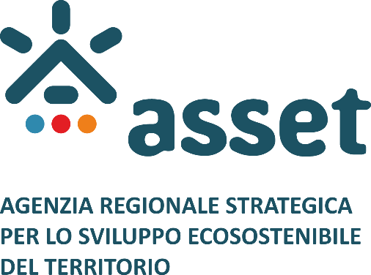
Blue Balkans: Maritime Connectivity in South Adriatic
“Aleksandër Moisiu” University
Durrës, December 19, 2022
THE MAIN PORTS IN PUGLIA REGION: A GLIMPSE INTO THEIR FUTURE

Slide 2
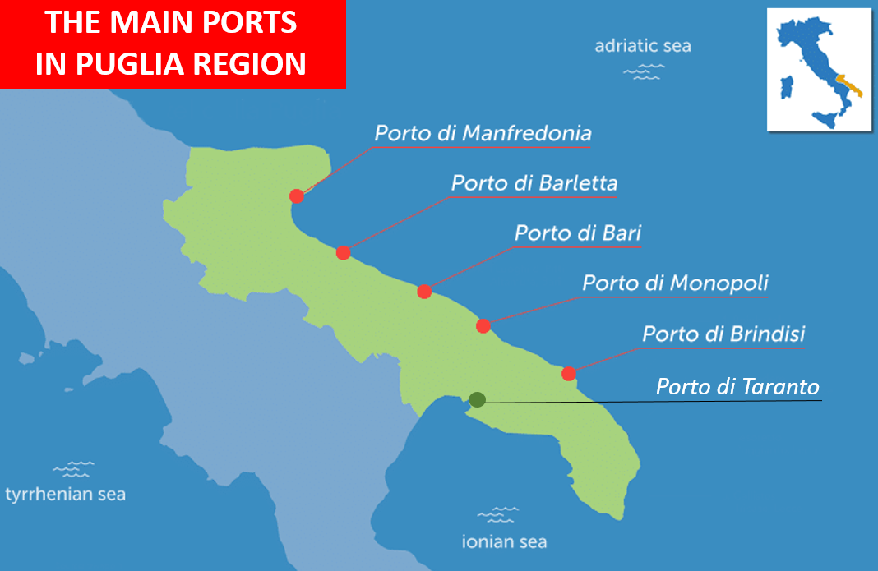
Porto di Taranto

Slide 3
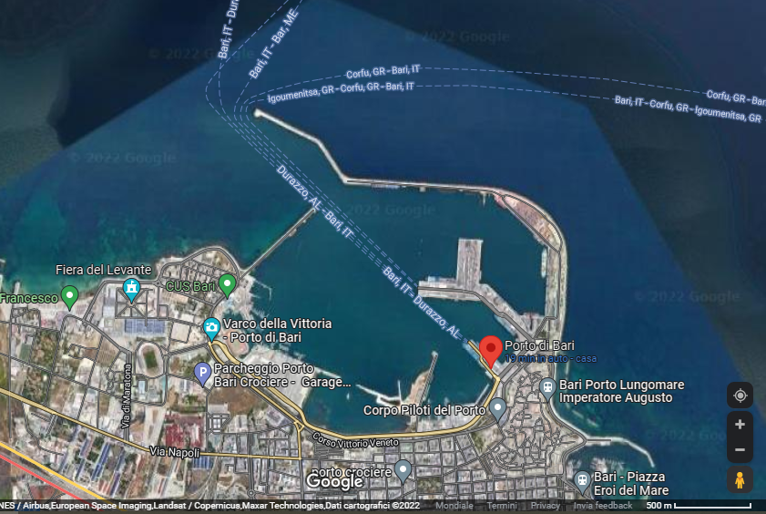
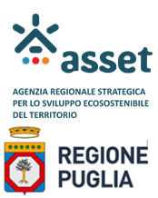
PORT OF BARI
Porto di Taranto
The main access node to the Bari-Durres-Tirana-Skopje-Sofija-Burgas-Varna
Trans-European Corridor 8, connecting Southern Italy to the Black Sea regions
Strategic location: excellent connections to the urban, industrial and agricultural areas
Heavily used for both goods and passengers

Slide 4
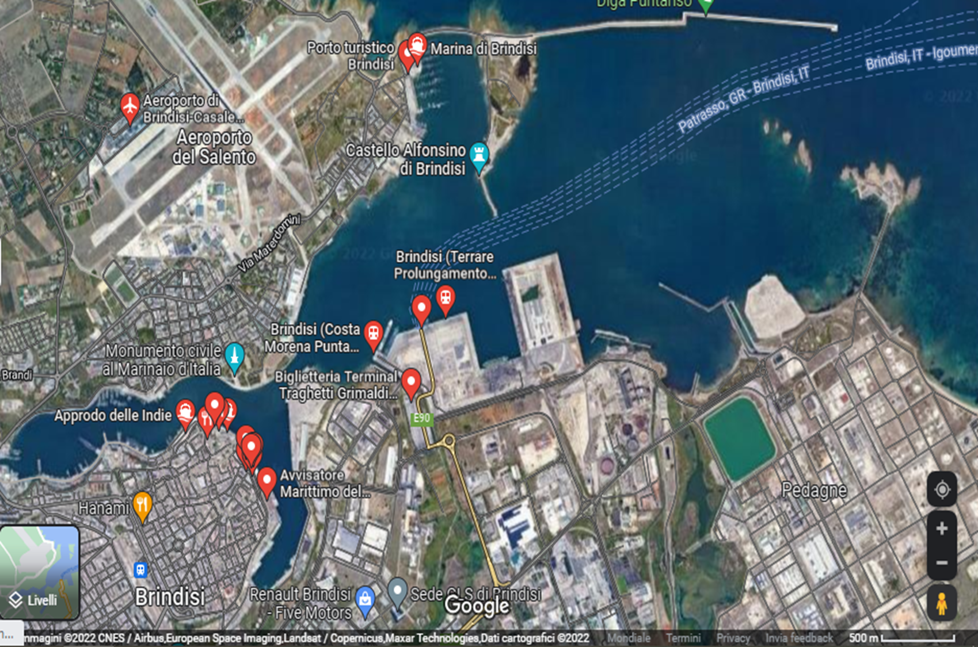
PORT OF BRINDISI
Multi-purpose node, serving commercial, industrial and tourist traffic
Playing a central role in connections to Eastern Europe, especially to Greece and Turkey
Facilities are developed in three separate basins
One of the safest ports in the lower Adriatic

Slide 5
PORT OF BARI
PASSENGERS (2018): 1,517 K
YEARLY GROWTH RATE: +30.9%
ITALIAN PORTS GROWTH RATE: + 15,6%
PASSENGERS (2020): 366 K
Porto di Taranto
YEARLY GROWTH RATE: -73.7%
ITALIAN PORTS GROWTH RATE: -36.3%
PASSENGERS (2021): 843 K
YEARLY GROWTH RATE: + 130.3%
ITALIAN PORTS GROWTH RATE: + 5.0%

Slide 6
PASSENGERS (2018): 568 K
YEARLY GROWTH RATE: +13.4%
ITALIAN PORTS GROWTH RATE: + 15,6%
PASSENGERS (2020): 207 K
Porto di Taranto
YEARLY GROWTH RATE: -60.2%
ITALIAN PORTS GROWTH RATE: -36.3%
PASSENGERS (2021): 262 K
YEARLY GROWTH RATE: + 26.6%
PORT OF BRINDISI
ITALIAN PORTS GROWTH RATE: + 5,0%

Slide 7
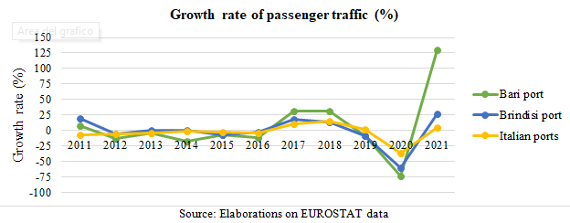
Porto di Taranto

Slide 8
SECTION III/4: PRIORITY INTERVENTIONS FOR THE DEVELOPMENT OF THE COUNTRY
EXCERPT FROM SECTION III/4: PORTS OF PUGLIA REGION

Slide 9
Maintenance of public state property
Last/Second-to-last Mile Railway and Port Network Connections

Slide 10
Maritime Accessibility

Slide 11
Energy and environmental efficiency
Waterfront and cruise and passenger services
Selective increase in port capacity

Slide 12
ITALIAN MINISTRY OF ECONOMY AND FINANCE
INVESTMENT PLAN (PORTS) - PUGLIA REGION
Maintenance of public state property EUR 89.05 M
Last/Second-to-last Mile Railway and Port Network Connections EUR 479.14 M
Maritime Accessibility EUR 171.80 M
Energy and environmental efficiency EUR 25.66 M
Waterfront and cruise and passenger services EUR 10.00 M
Selective increase in port capacity EUR 118.50 M
TOTAL EUR 894.15 M

Slide 13
“Ten years to transform Italy”
(and to improve the Puglia Port System):
IS THIS A REASONABLE TIME FRAME?
‘Ten years to transform Italy’ may seem like a long time, but it is not;
today, we are facing an epochal challenge,
and the effects of the climate crisis are already visible and tangible,
with potentially disruptive impacts on infrastructures and mobility systems.
TRANSFORMATION – IN THE FRAMEWORK OF WHAT STRATEGY?

Slide 14
A JOINT ITALIAN-ALBANIAN TRANS-ADRIATIC DEVELOPMENT STRATEGY
IN THE FRAMEWORK OF THE “ASI” PARADIGM
“A”: AVOID substitutable trips
“S”: SHIFT to more efficient modes of transport
“I” – IMPROVE the efficiency and safety of transport systems
Paving the way to the transformation of the
MULTIMODAL TRANSPORT CORRIDORS
into MULTI-SERVICE CORRIDORS (mobility + energy + telecommunications)
RELATED FEATURES:
REDUCTION OF LAND USE
IMPROVEMENT OF MAINTENANCE SUPERVISION
ACCELERATION OF THE PROCESS OF STRENGTHENING INDIVIDUAL NETWORKS
THE ASI PARADIGM, A DRIVING VISION FOR…

Slide 15
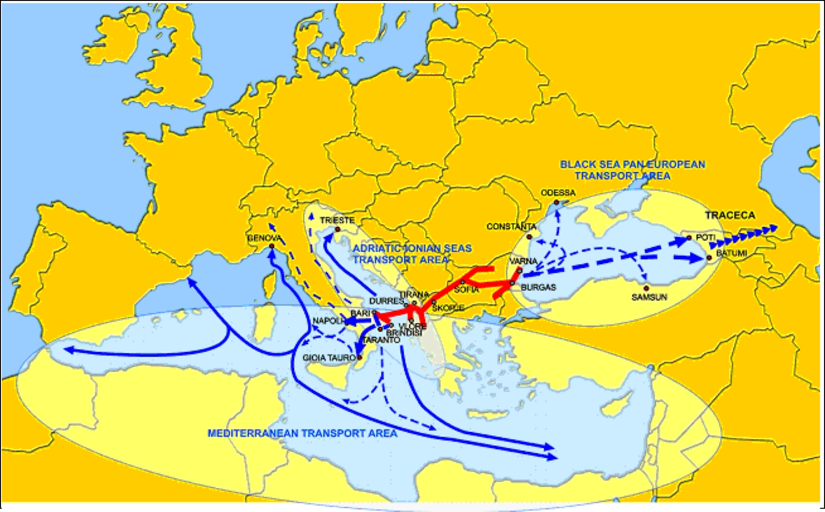
…THE NEW CORRIDOR VIII: A WIDER PERSPECTIVE
The Lower Adriatic Area:
the Hub linking the EU to the Mediterranean and the Caucasic Region

Slide 16
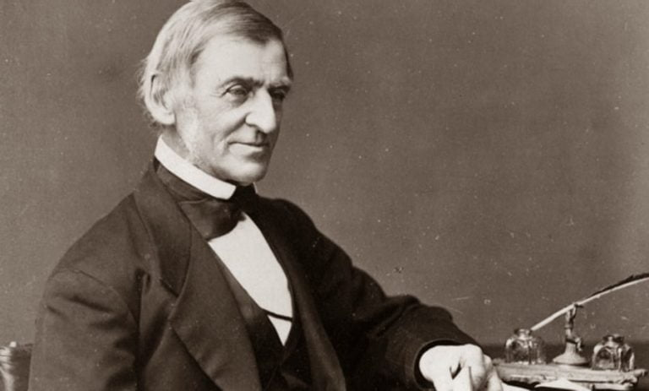
Blue Balkans: Maritime Connectivity in South Adriatic
‘Nothing great
was ever achieved
without enthusiasm’
THANK YOU
FOR YOUR ATTENTION,
COMPETENCE,
COMMITMENT -
- AND ENTHUSIASM.
Ralph Waldo Emerson (1803-1882)

