Slide 1
The past, the present and the future of the
Port of Saranda

Slide 2
The table of contents
01
General information about the Port of Saranda
02
The developments and the investment’s plans

Slide 3
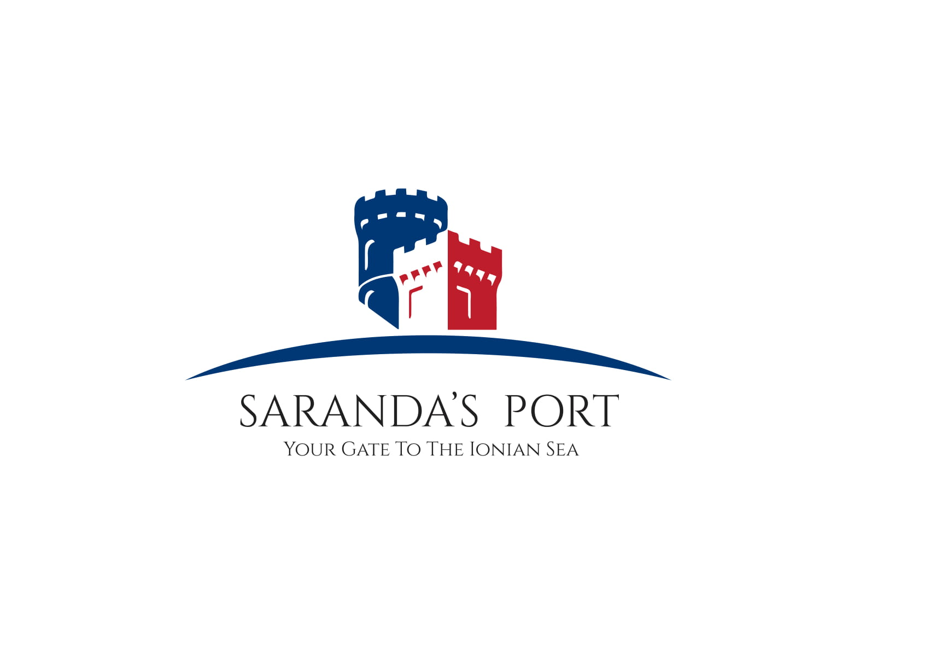
The port of Saranda
.
The Porti of Saranda is the located in the south of Albania and has an area of 18.000 m2
PORTI I SARANDES
It is 300 m far from the city center , and dates since 1935, years when the development of the city had not yet reached the dimensions of today
Today, the Port has 49 employees, specifically in the administration, in the security force and in the maintenance.
The Port is considered to be a touristic port, because almost 90% of the passagers who arrived there are tourists

Slide 4
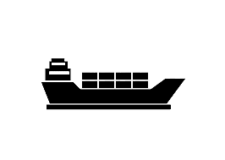
The job indicators in the last 5 years in the Port of Saranda
Year 2019
Year 2021
46 cargo ships
292 cruise ships
1590 yachts
516.188 passagers
12 cruise ships
720 yachts
62.609 passagers
2018
2019
2020
2021
2022
Year 2018
Year 2020
Year 2022
19 cargo ships
172 cruise ships
1330 yachts
482.216 passagers
21 cargo ships
1 cruise ship
81 yachts
5589 passagers
101 cruise ships
763 yachts
363.456 passagers

Slide 5
The current issues in the Port of Saranda
1
3
The area of the current Terminal is not enough for the amount of passagers who pass there. Also the Border Police Station which operate in the first floor of the Terminal face with a lot of problems due to this fact.
The cruise ship dock which is 180 m, does not allow the anchoring of the ships that are over 180 m
2
The entry and the exit from the Port is only in one direction, which causes chaos and traffic during the tourist season
4
The lack of the yacht marine, determine us not to approve the requests from the yachts which want to stay in the Port just for pleasure. They only take the services and leave.

Slide 6
The investments in the Port of Saranda
3
Also, the entrance of the Port will be a new one, modern and contemporary, with advanced electronic systems, digital systems, thermal cameras etc. All of these will transform the current image of Port’s entrance
1
In 2021, the construction of the RoRo dock was completed sucesfully. This dock is used only by the ferries which operate daily in the line Sarande-Korfuz and inverse. They stay there vertically one after the other
4
The next seassion which starts in April 2023 in our Port, will find the passagers and the tourists with a InfoPoint Service, which will help them to discover all the city, touristic areas, beaches, restaurants/bars, history etc.
2
This month will start the reconstruction of the Terminal of Passagers. Its project aims to improve all the facilities inside the Terminal such as: new escalator on both sides, new toilets, new entry and exit for the passagers to the control area etc.
5
We are also waiting for the funds from the Albanian government about the project of the “Building of Facilites”, which is a great investment for the Port and for whole the city. It will include a lot of offices, bars, shops, yacht’s restaurants, VIP zone, etc

Slide 7
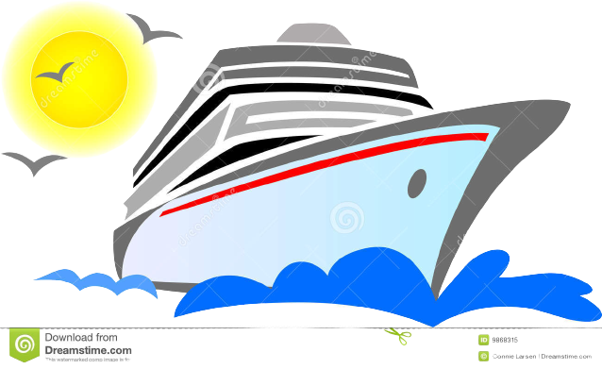
THE MOST IMPORTANT INVESTMET IS THE LENGTH OF THE CRUISE DOCK.
IT IS 180 M AND DOES NOT ALLOW THE ANCHORING OF THE CRUISES WHICH ARE OVER IT
15 from 38 cruises, are over 180 m, so they will not be anchored in the Port.
One simple calculation: (285 m)
If M/V OOSTERDAM
would be anchored, the dock’s fee would be:
GT* 0.07= 82.305 * 0.07= 5700€/24h
And the total for 15 cruises:
~5700€ * 15= 85.500 euro
For 2023, until now in our calendar we have 38 cruise ships that will arrive in our Port !!

Slide 8
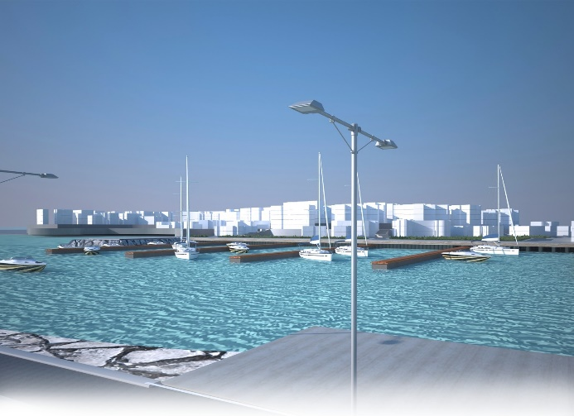
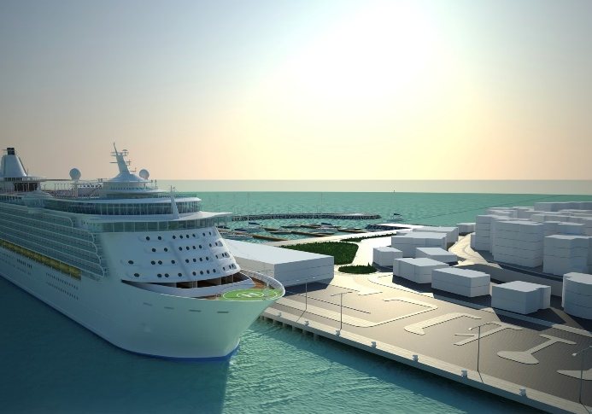
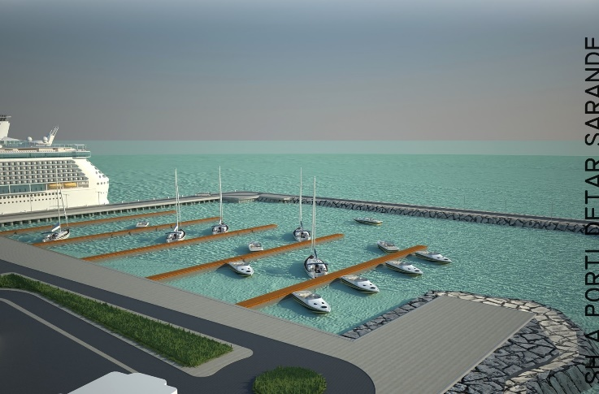
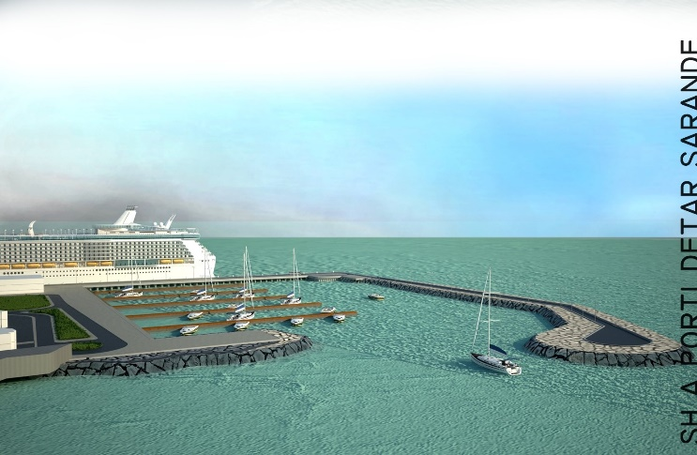
THE PROJECT’S PHOTOS OF THE CRUISE DOCK’S LENGTH AND YACHT’S MARINE

Slide 9
SILVERCLOUD

Slide 10
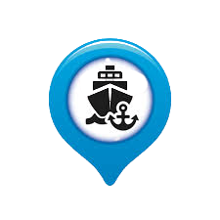
Our objectives !
01
02
03
We aim to transform our Port in the nodal point to the Ionian and Adriatic sea
We aim to enter into new markets, so we try hard to make a good marketing
We aim to create new jobs in our Port
04
05
We aim to increase the number of passagers and tourists, offering good services and competitive rates
We aim to develop all the city and its around areas

Slide 11
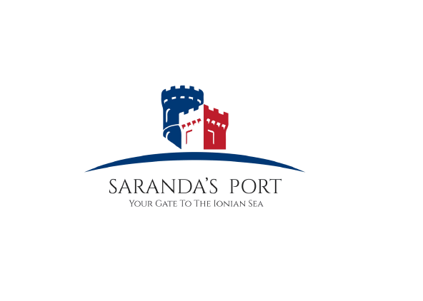
THANK YOU !

