Slide 1

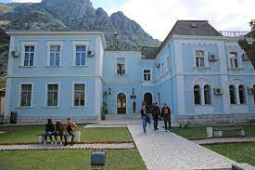
MARITIME EDUCATION AND TRAINING IN MONTENEGRO
CEMA Conference
Durres, 6 March, 2023

Slide 2
MET History in Montenegro
9 centuries-old maritime tradition in the Boka Bay- southwest part of Montenegro.
First "schools" for seamen between 16th and the middle of 19th century.
1849 - Nautical School in Kotor
1959 – First higher maritime education institution – Faculty of Maritime Studies Kotor, University of Montenegro
More than 6,000 seafarers Montenegro

Slide 3
MET QUALITY CONTROL
Maritime Navigation Safety Law
maritime education programmes and curricula must comply with the regulations of the STCW Convention and referent IMO model courses
A recognized classification society certification on the implementation of the IMO model courses in the teaching plans and programs
Training courses accredited by the competent Ministry

Slide 4
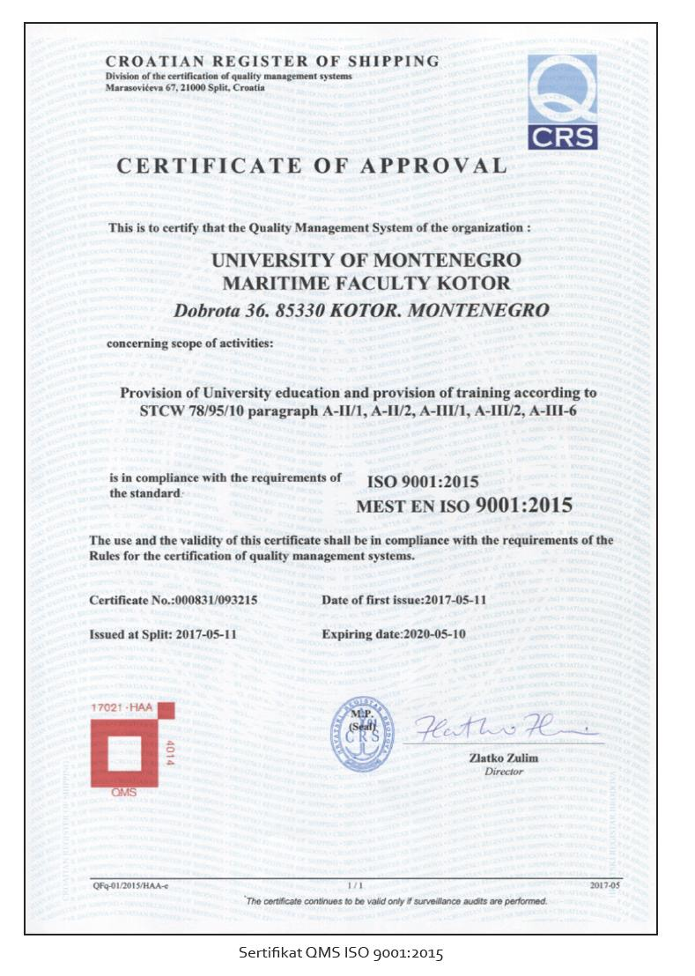
Faculty of Maritime Studies Kotor
Croatian Register of Shipping (CRS) Certificate
- Nautical Studies and Maritime Transport
(STCW A–II/1, IMO MODEL COURSE 7.03, STCW A–II/2, IMO MODEL COURSE 7.01),
Marine Engineering
(STCW A–III/1, IMO MODEL COURSE 7.04, STCW A–III/2,
IMO MODEL COURSE 7.02)
Marine Electrical Engineering
(STCW A–II/1, IMO MODEL COURSE 7.03, STCW A–III/6, IMO MODEL COURSE 7.08)

Slide 5
QMS Certification
Bureau Veritas Certificate of Compliance of Quality for Training Centre for Seafarers, valid through 2025.

Slide 6
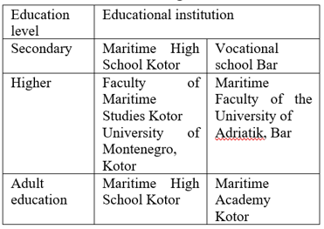
Maritime Education in MNE
Ministry of Education
Ministry of Science and Technological Development

Slide 7
Maritime Training in MNE
Ministry of Capital Investments, Directorate for Maritime Transport, Navigation Safety, Protection from Pollution and Maritime Economy
Rulebook on vocation and certification of seafarers in Montenegro, conditions for acquiring competencies and certificates for crew members
Training centres:
Faculty of Maritime Studies Kotor of the University of Montenegro,
Azalea Maritime – Bijela
Maritime High School Kotor,
Faculty of Mediterranean business studies and BMV Shipping Services – Center for seafarers training and Training Centre of the Maritime Faculty

Slide 8
FMSK studies
3 study levels
UNDERGRADUATE STUDIES
3 years (6 semesters)
180 ECTS
MASTER STUDIES
2 years (4 semesters)
120 ECTS
PHD STUDIES
3 years (6 semesters)
180 ECTS

Slide 9
STUDY PROGRAMMES
Nautical Sciences and Maritime Transport (80)
Marine Engineering (60)
Marine Electrical Engineering (60)
Maritime Management and Logistics (60)
FMS
K

Slide 10
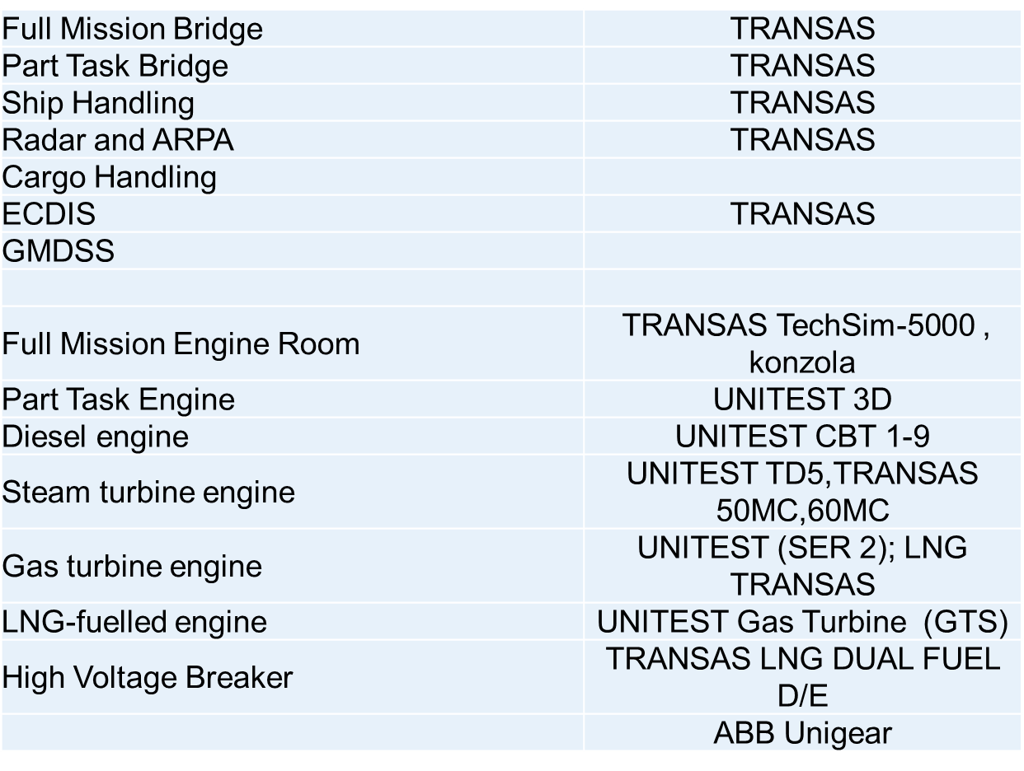
FMSK SIMULATORS

Slide 11
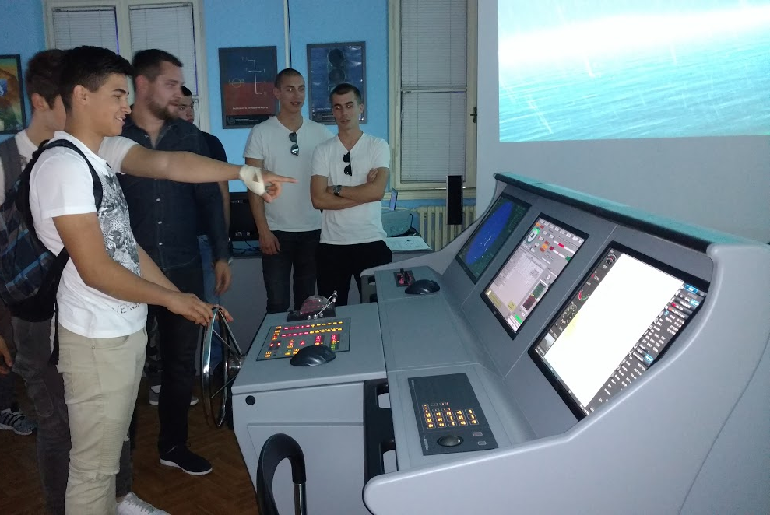
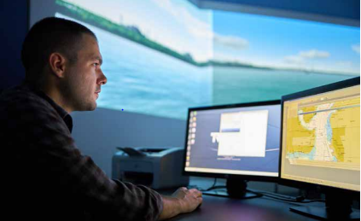
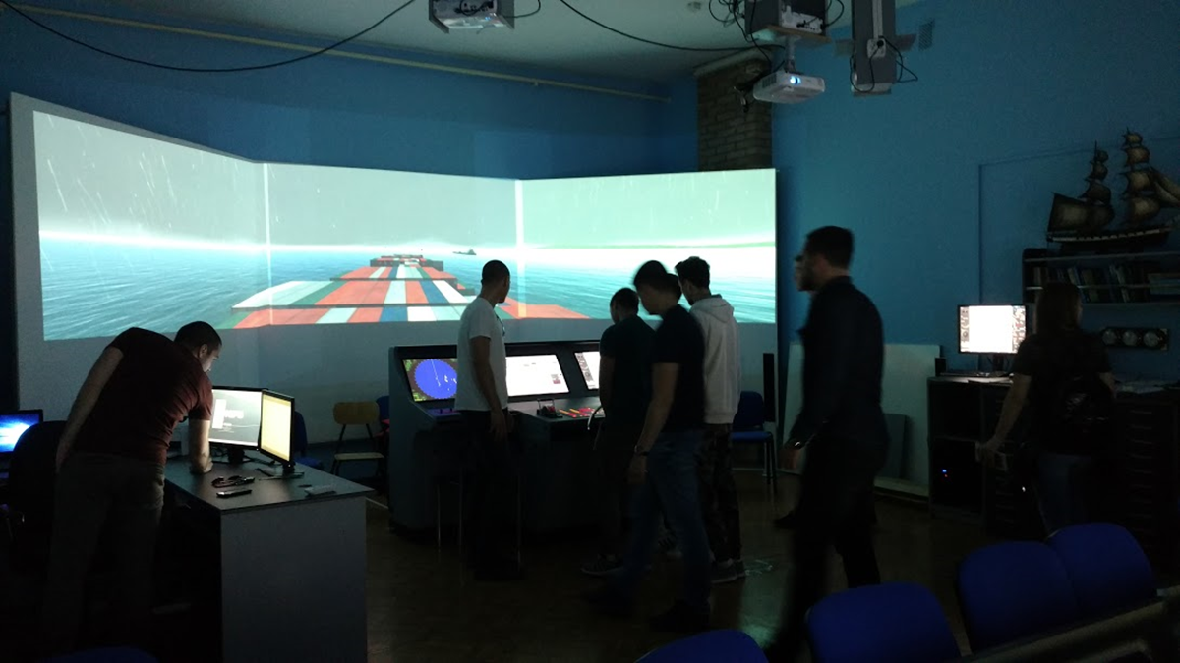
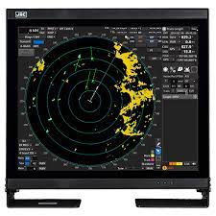
Nautical simulator

Slide 12

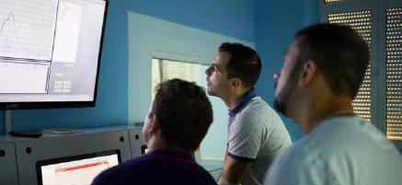
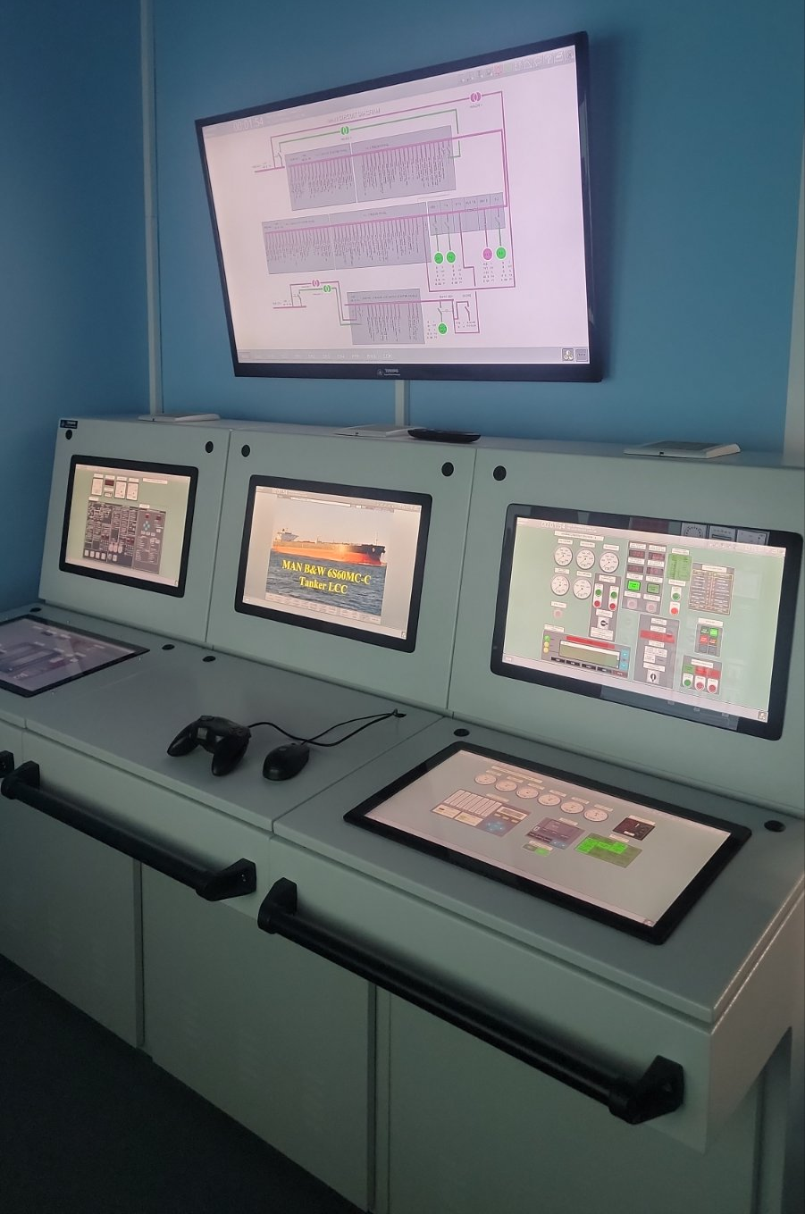
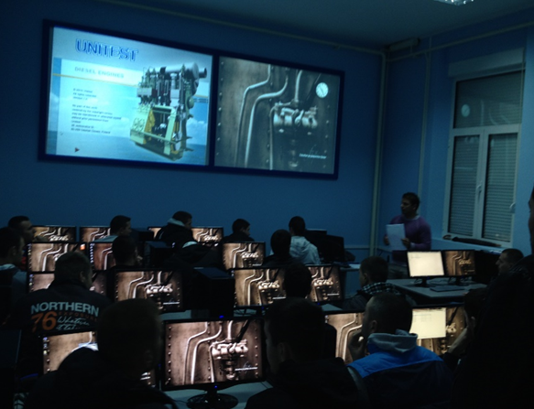
Marine Engineering simulator

Slide 13
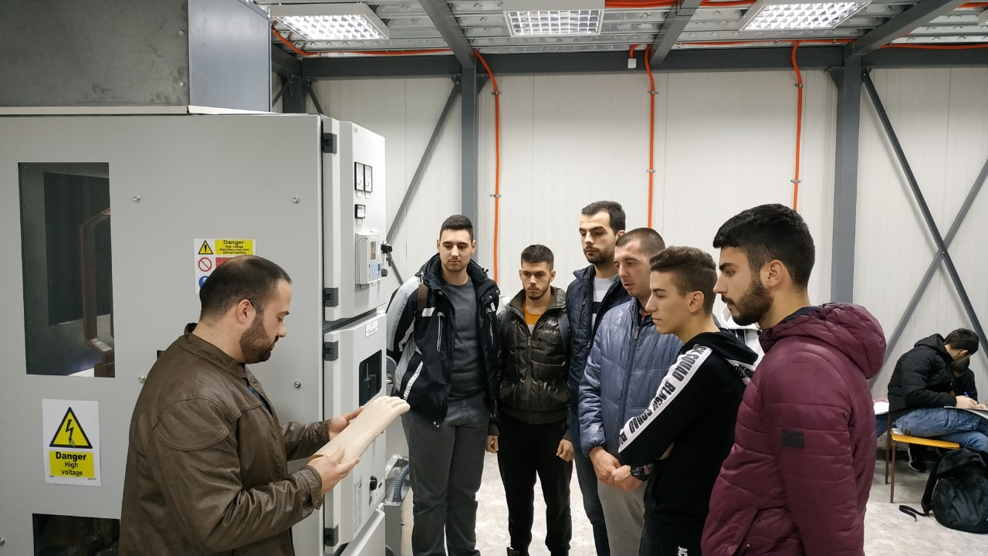
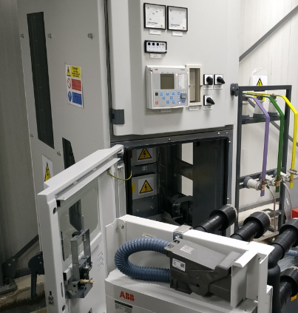
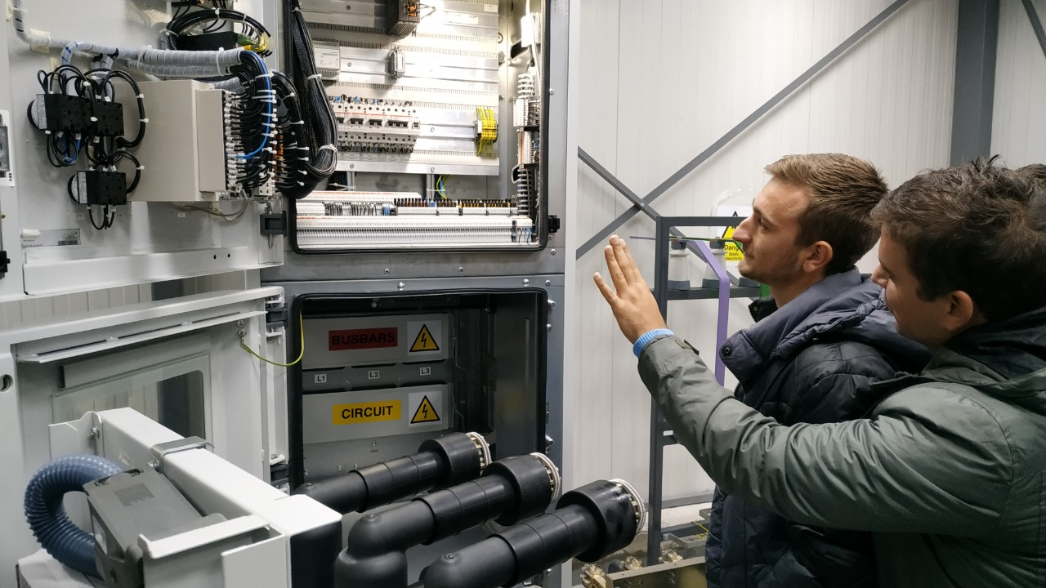
High-Voltage Simulator

Slide 14
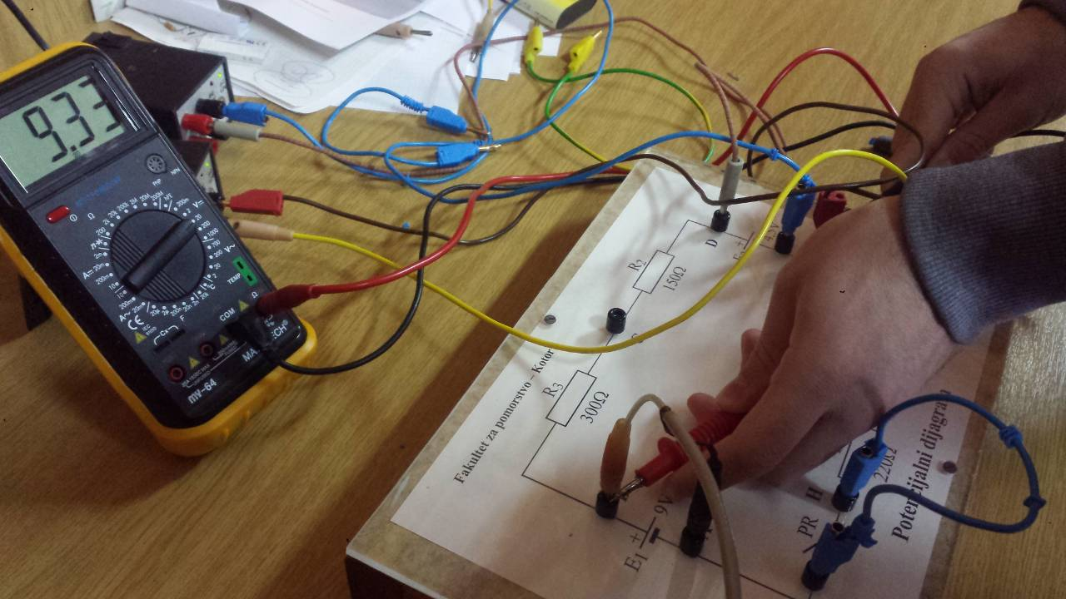
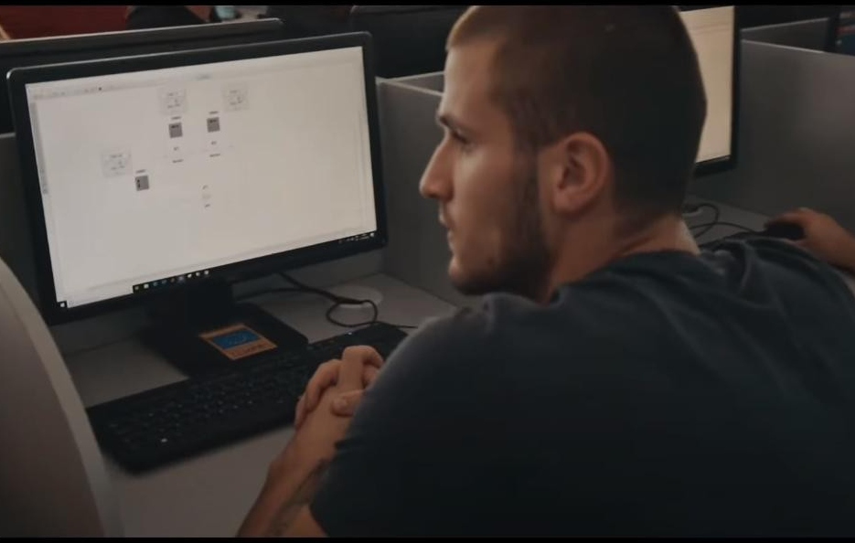
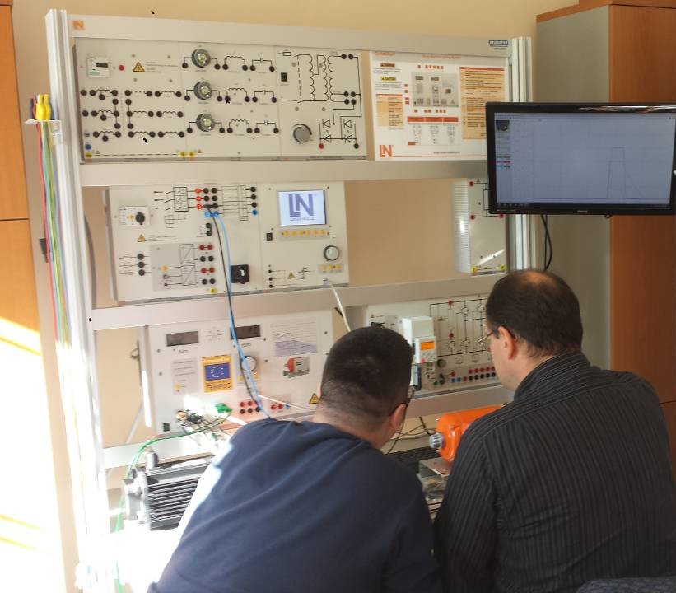
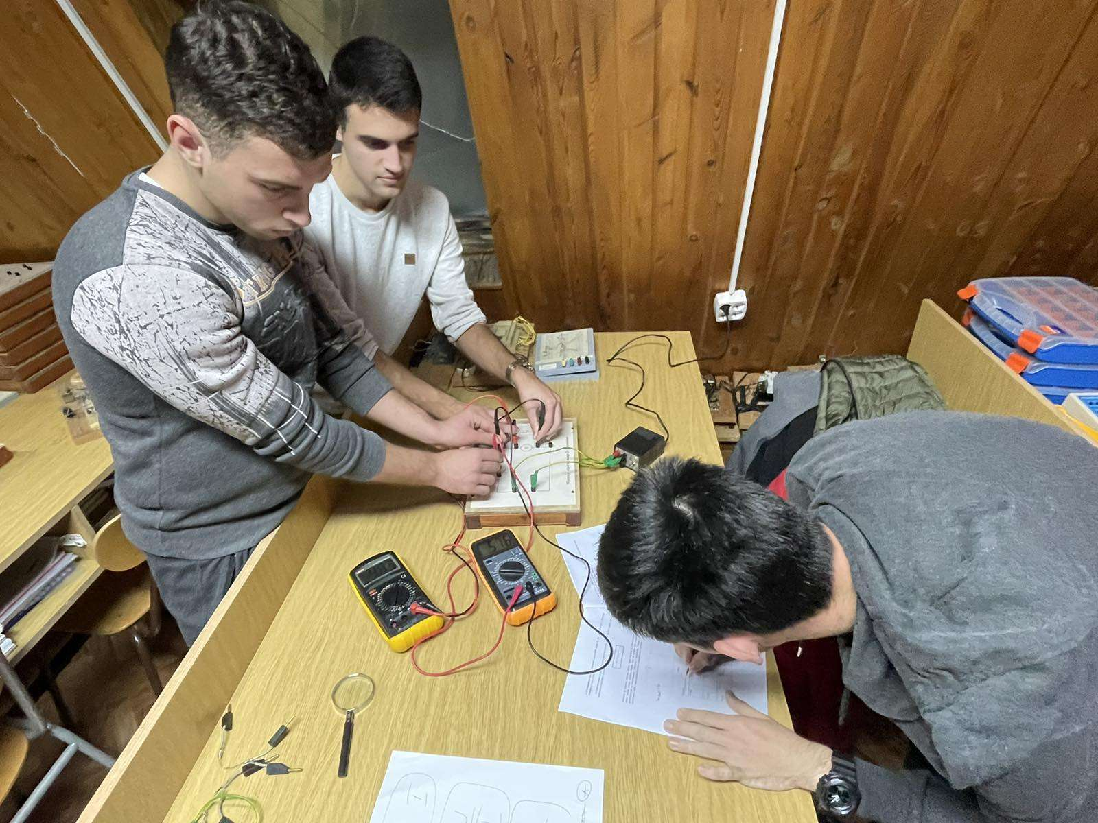
Lab for Electrical Engineering

Slide 15
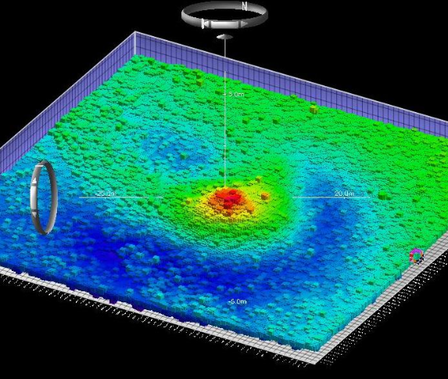
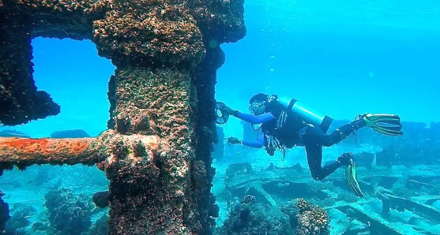
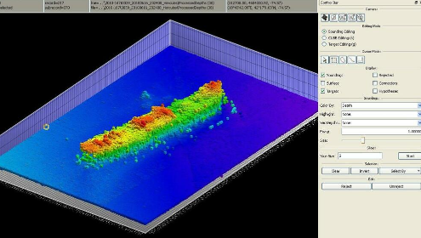
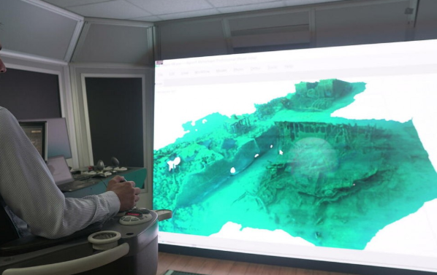
Lab of Maritime Archeology

Slide 16
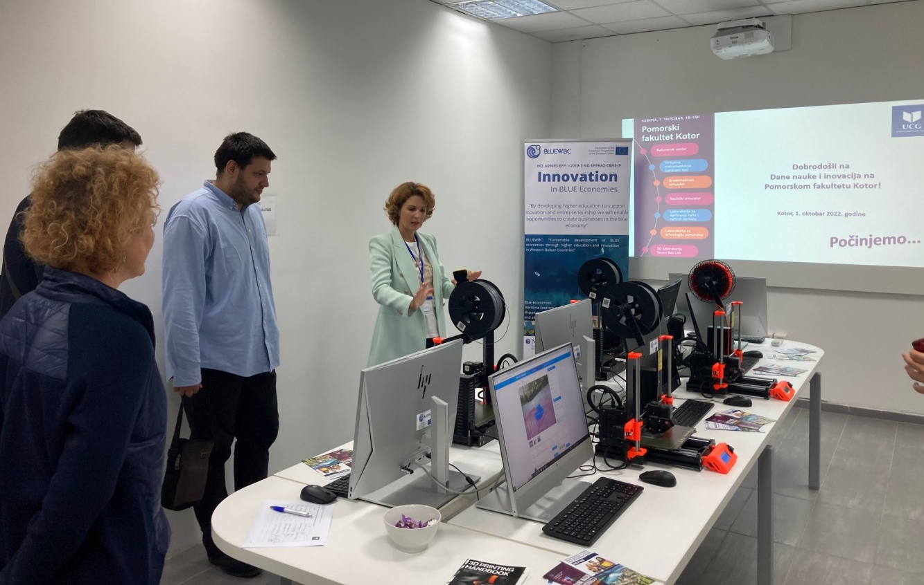
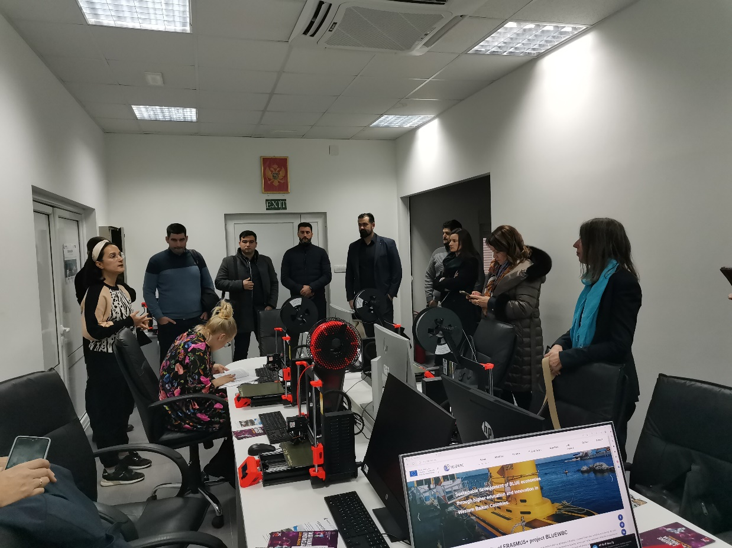
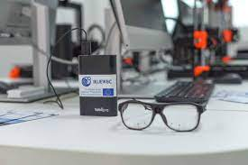
3D Printing Centar
Centre for Research, Innovation
and Entrepreneurship

Slide 17
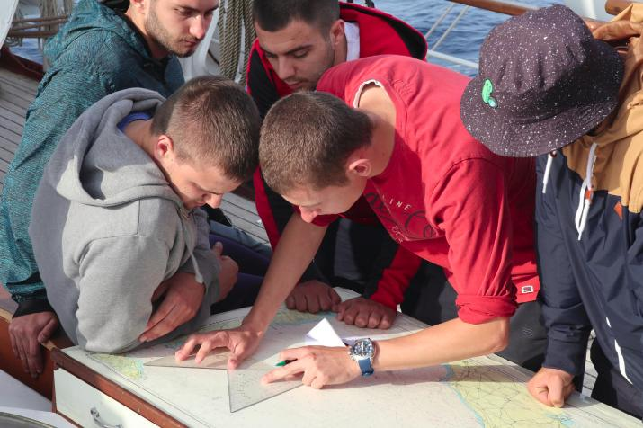
Educational cruises on a S/V

Slide 18
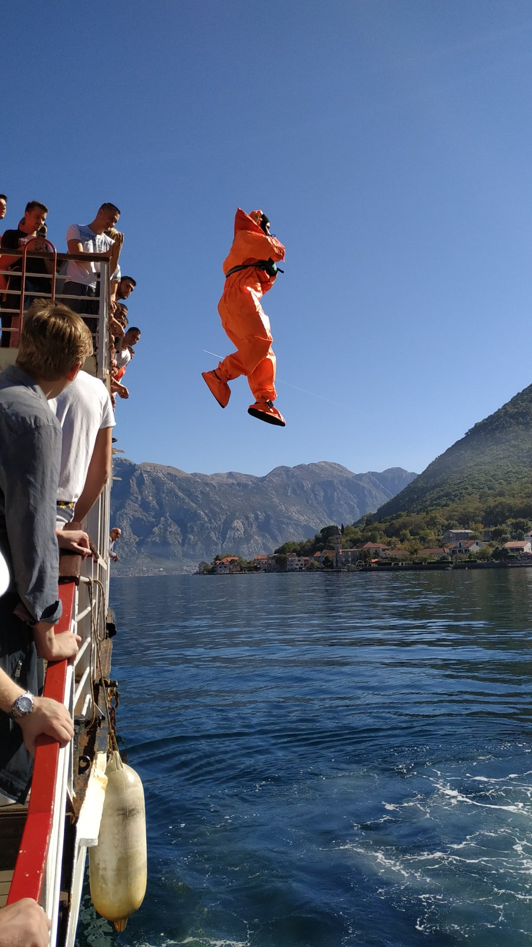
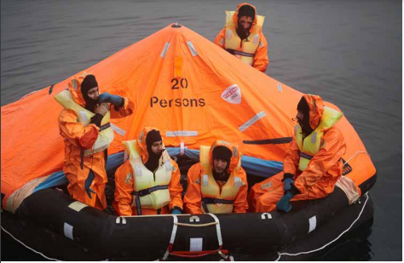
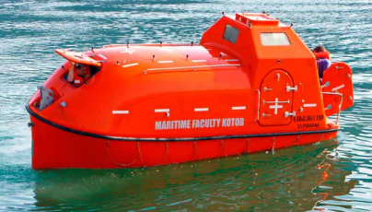
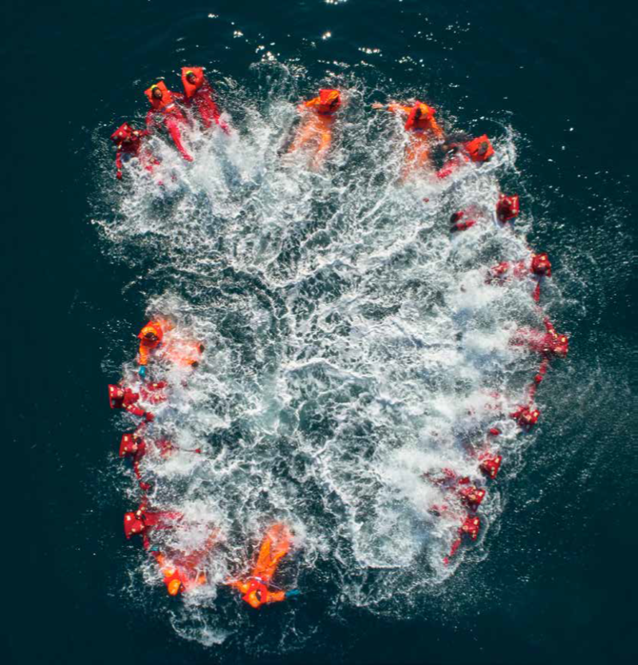
Search and Rescue

Slide 19
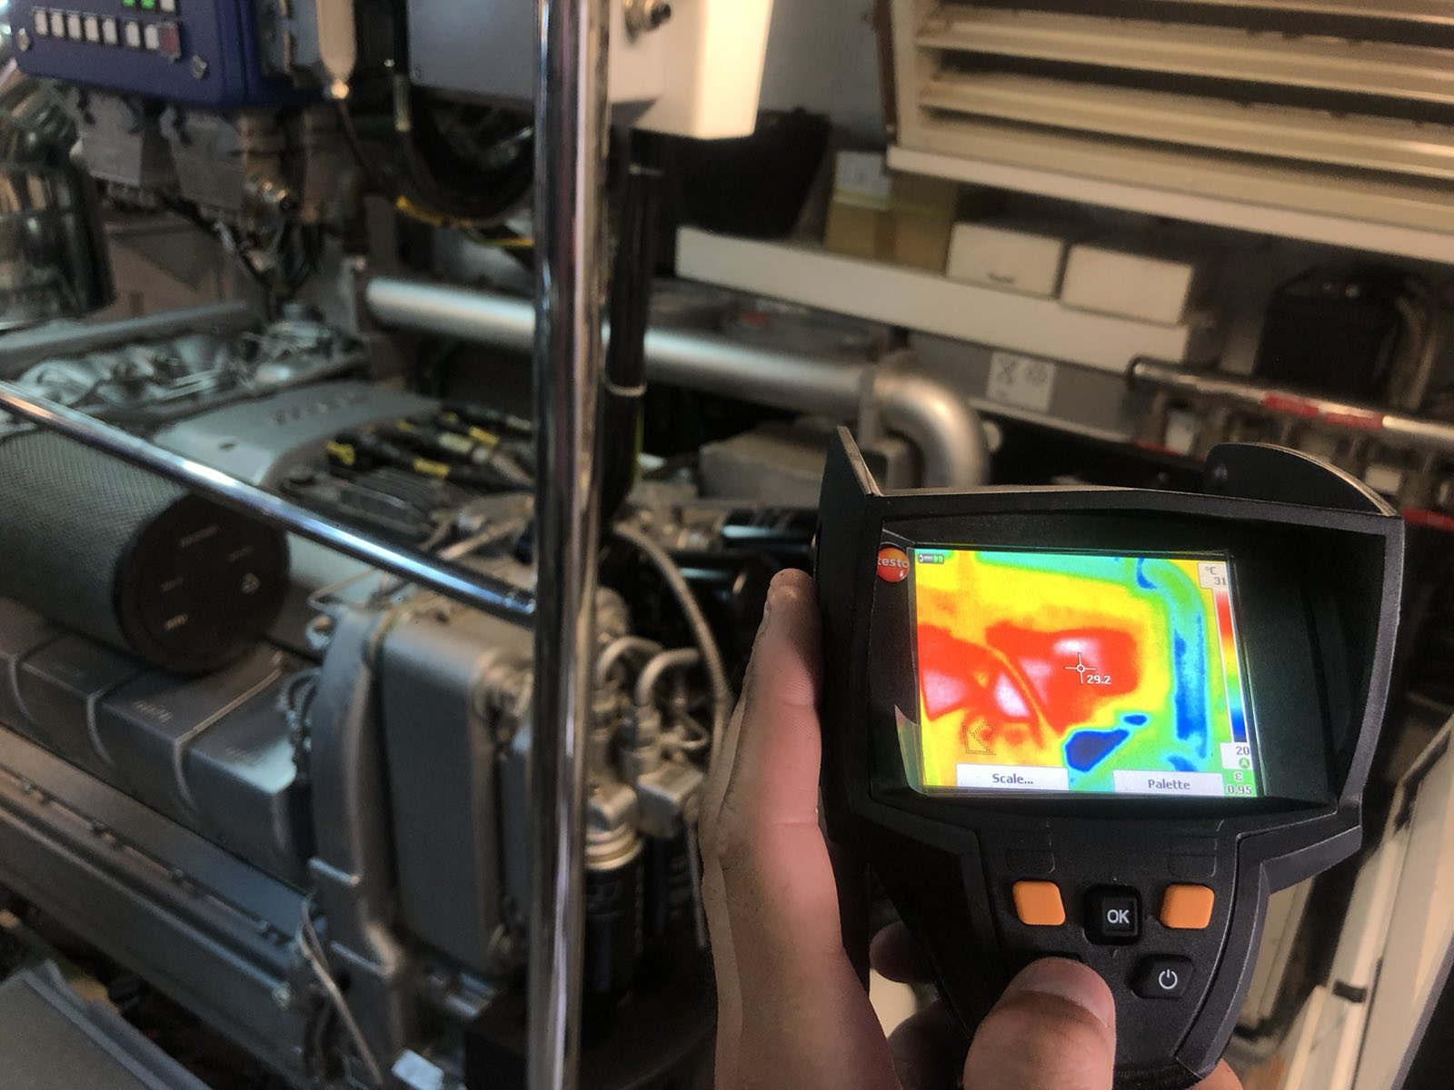
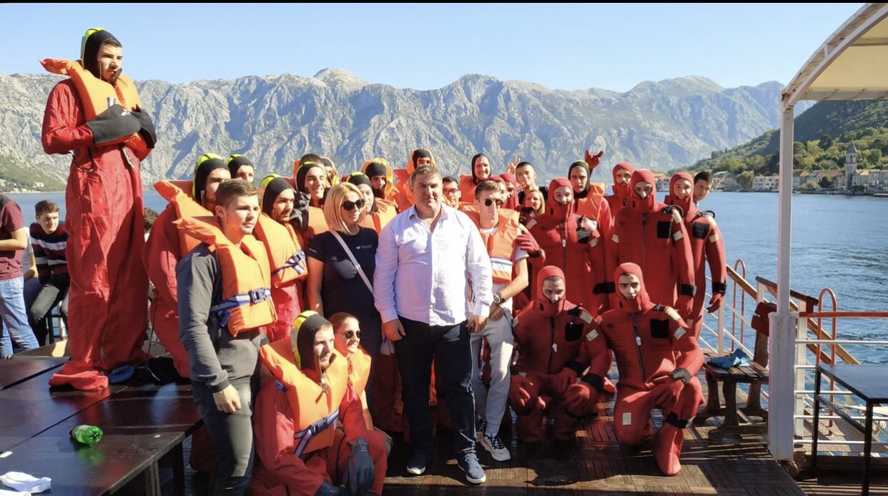
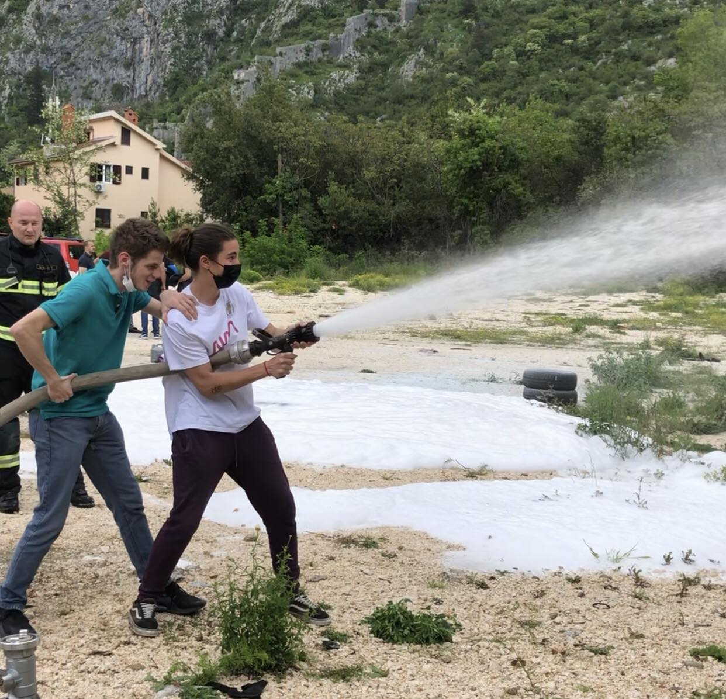
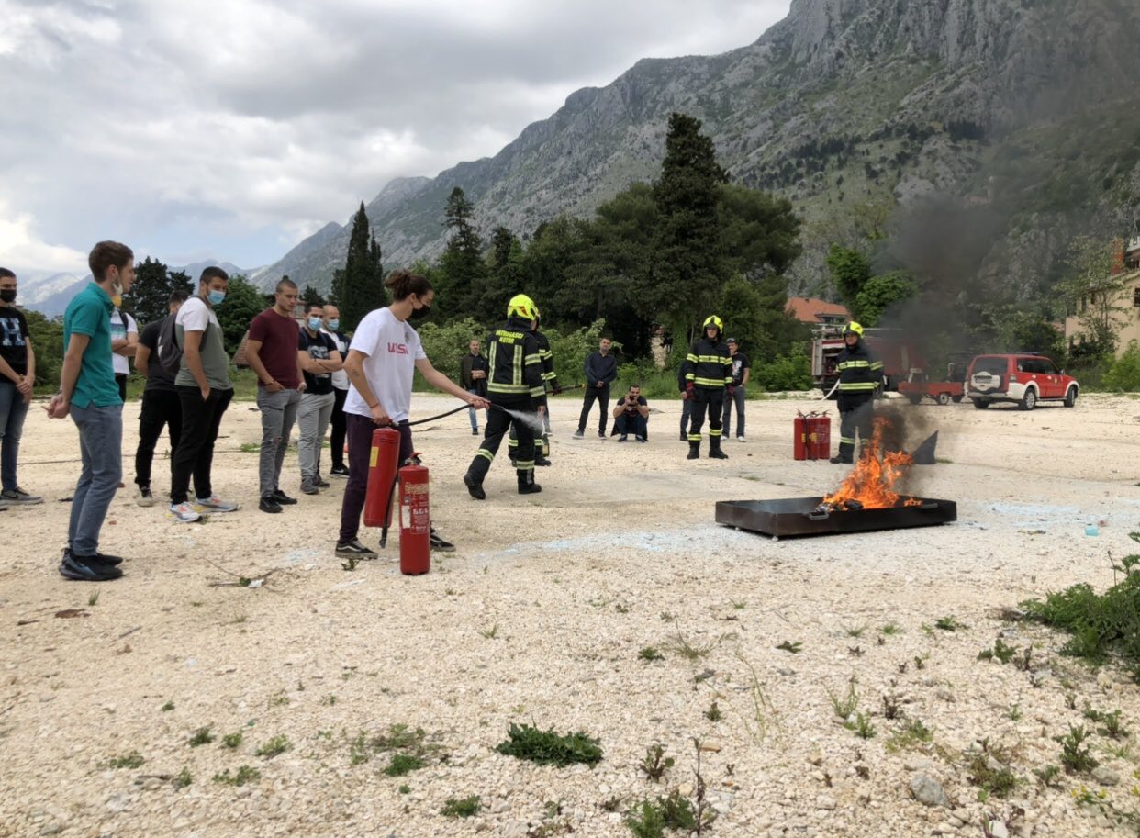
TUTORIALS

Slide 20
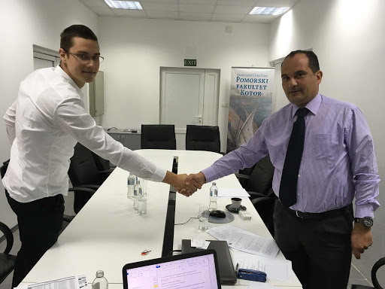
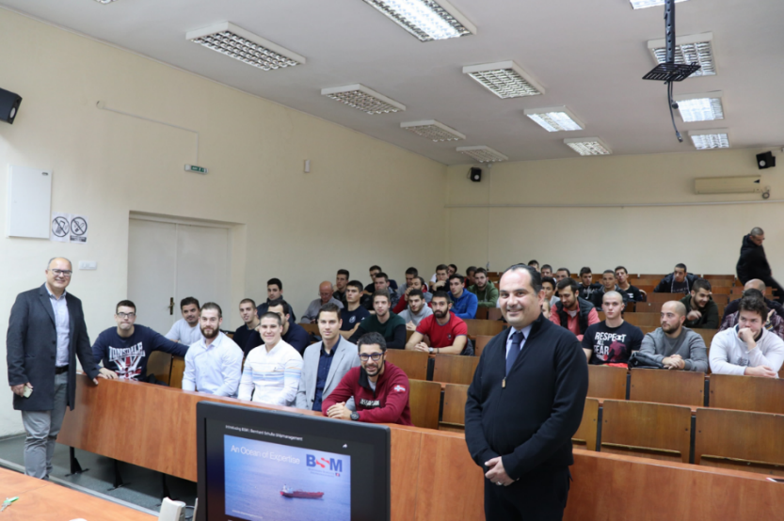
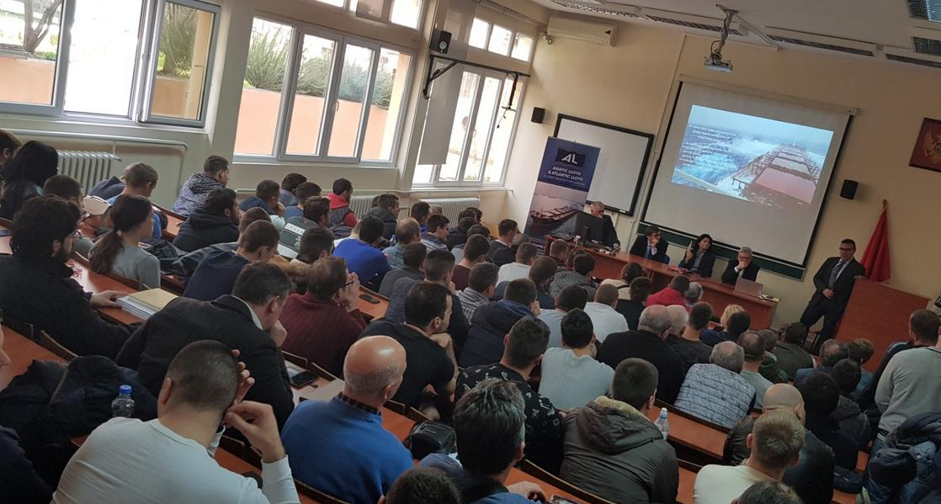
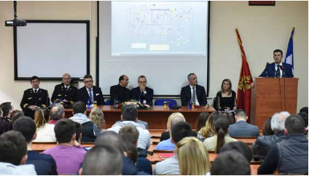
STUDENTS AND COMPANIES

Slide 21
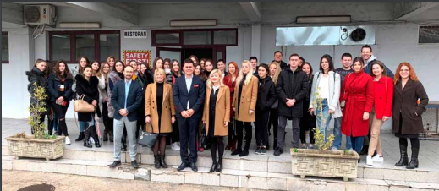
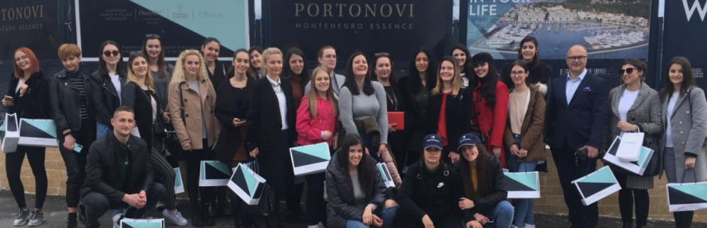
Students and Blue Economy
Port of Adria
Portonovi Resort and Marina

Slide 22
ERASMUS + mobility programs
Latvian Maritime Academy (Riga, Letonija)
Lijepaja Marine College (Lijepaja, Litvanija)
Lithuanian Maritime Academy (Klaipeda, Litvanija)
Middle East Technical University – METU (Ankara, Turska)
Mircea Cel Batran Naval Academy (Constanca, Rumunija)
National Technical University of Athens (Grčka)
Norwegian University of Scienece and Technology - NTNU (Alesund, Norveška)
Óbuda University, Donát Bánki Faculty of Mechanical and Safety Engineering (Budimpešta, Mađarska)
Philipps-Universitat (Marburg, Njemačka)
Politehnica University Timisoara (Temišvar, Rumunija).
University of Economics (Varna, Bugarska)
University of Szczecin (Poljska)
University of the Aegean, Department for Shipping, Trade and Transportation (Chios, Grčka)
Univerzitet u Dubrovniku, Pomorski odjel (Hrvatska)
Univerzitet u Splitu, Pomorski fakultet (Hrvatska)
Univerzitet u Zagrebu (Hrvatska), Fakultet prometnih znanosti (Hrvatska)
Tehnički fakultet Čačak, Univerzitet u Kragujevcu (Srbija)
Univerzitet u Mariboru, Mašinski fakultet (Slovenija)
Batumi Navigation Teching University (Gruzija)

Slide 23
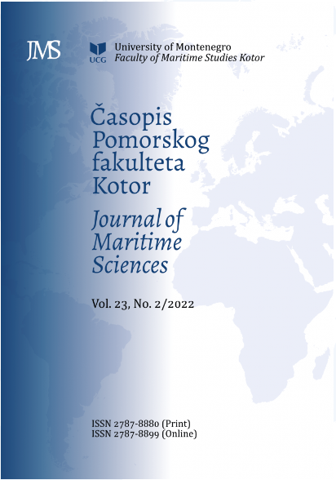
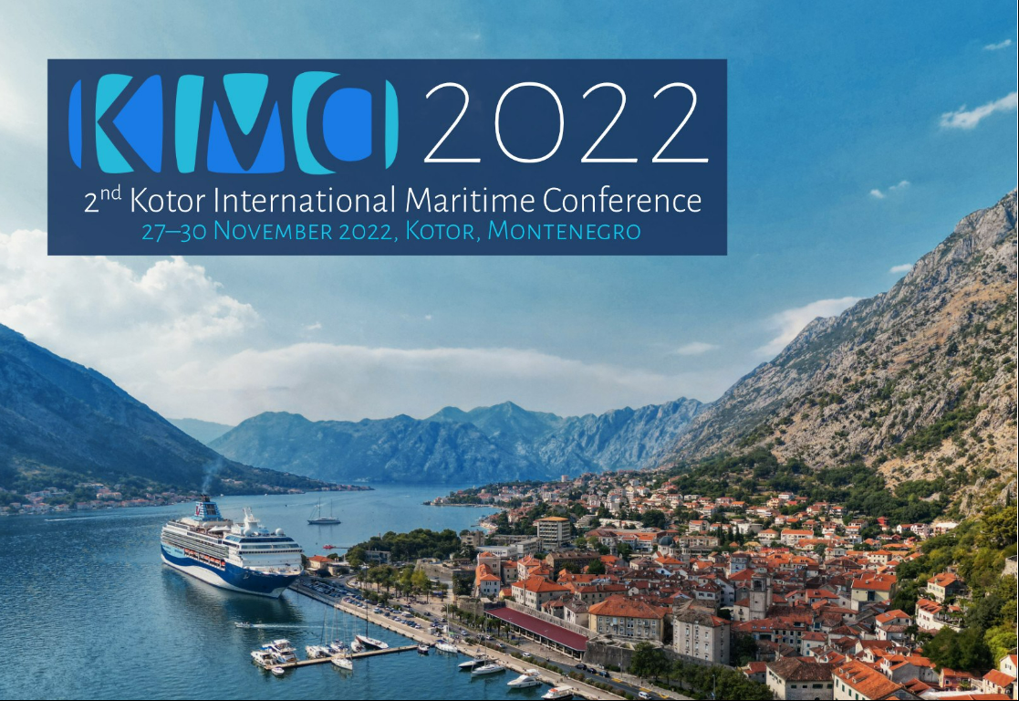
KIMC and JMS

Slide 24
INTERNATIONAL PROJECTS
FMSK/UoM – Albania - Puglia
Erasmus+ | Development of a regional joint Master’s program for the protection and management of the marine environment | MEP&M (2021-2024)
Erasmus+ | Sustainable development of BLUE economies through higher education and innovation in Western Balkan Countries | BLUE WBC (2020-2023)
IPA INTERREG ITA-ALB-CG | Innovative Systems to enhance Antifraud Customs Controls | ISACC (2020-2021)
IPA INTERREG ITA-ALB-CG | Partnership for the promotion of a maRiTime cross-border Strategy | PORTS 4.0 (2020-2021)
IPA | Partnership for the study and study of new routes and trans-national maritime routes | PORTS (2018-2020)
IPA INTERREG ITA-ALB-CG | Partnership in observing and studying new routes and transnational maritime corridors | PORTS (2018-2020)

Slide 25
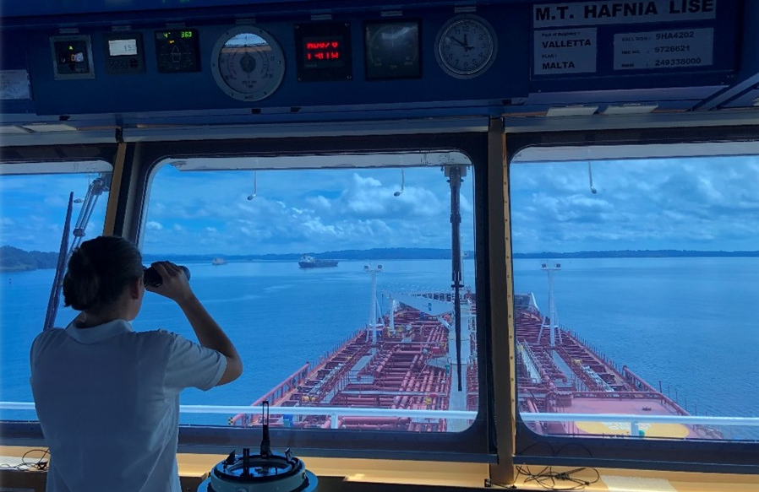
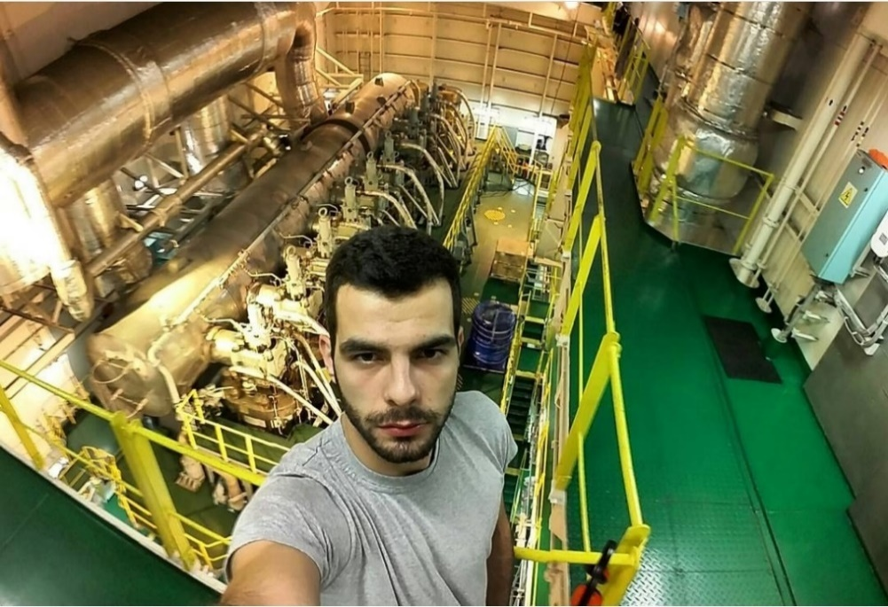
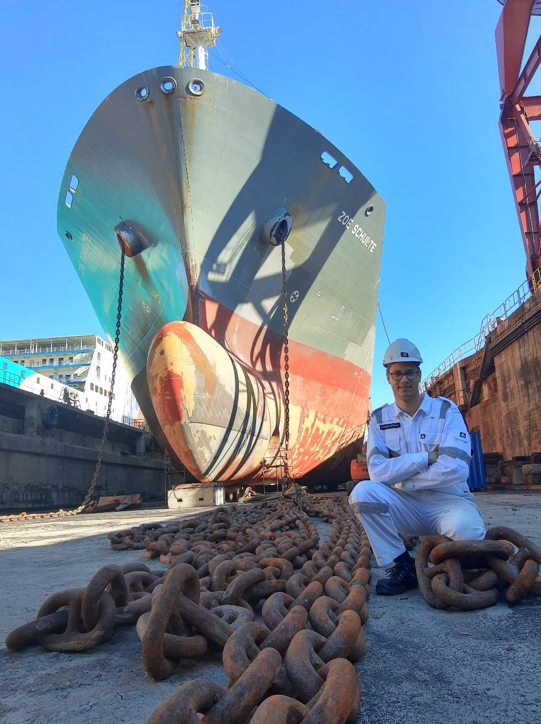
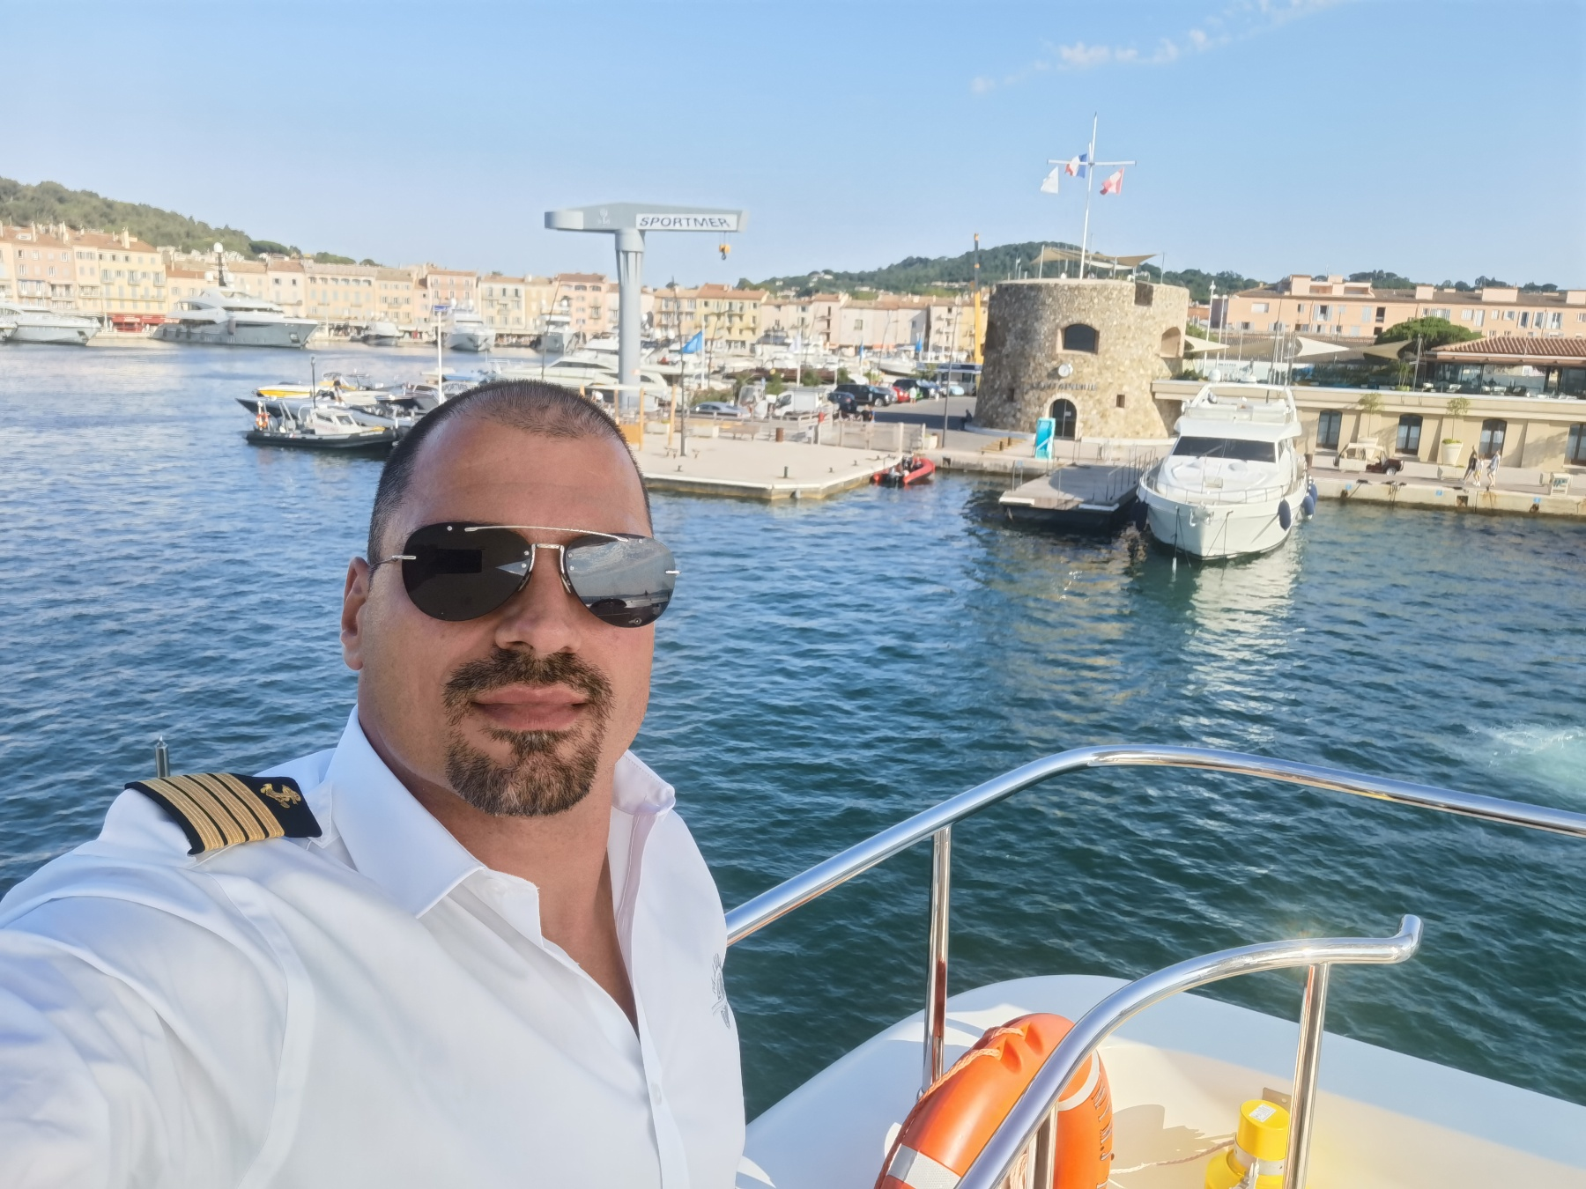
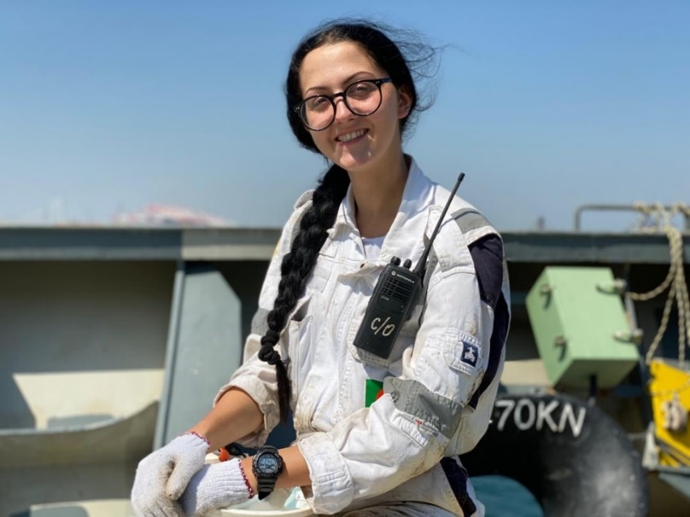
OUR BEST AMBASSADORS
Matija Rašković
Isidora Jovanović
Lazar Pajović
Tomislava Krstić
Đorđe Lakonić

Slide 26

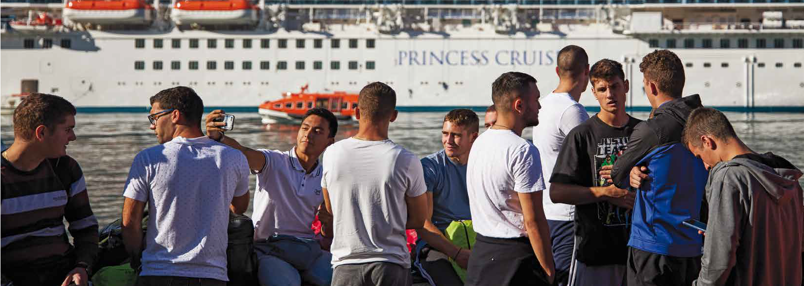
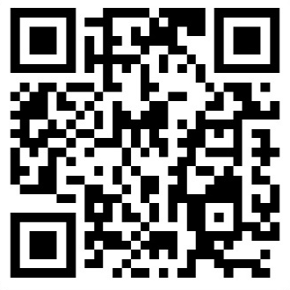
Thank you for your attention! zoricag@ucg.ac.me
www.ucg.ac.me/pfkotor
Facebook: @pomorski.fakultet.kotor
Instagram: @pomorski.fakultet.kotor
Youtube: Pomorski fakultet Kotor

