Slide 1


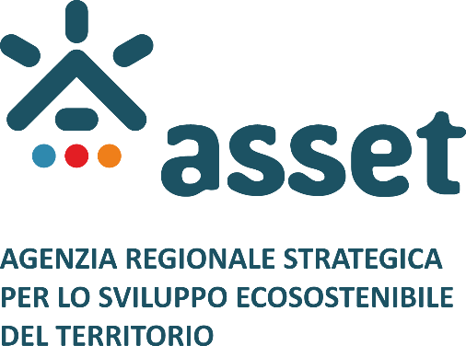
Development of Port Infrastructure
and TEN-T Compliance Indicators
Polytechnic University of Tirana
Tirana, March 21, 2023
DIVING INTO THE PORTO ROMANO PORT:
PORTO ROMANO IN THE FRAMEWORK OF CORRIDOR VIII

Slide 2
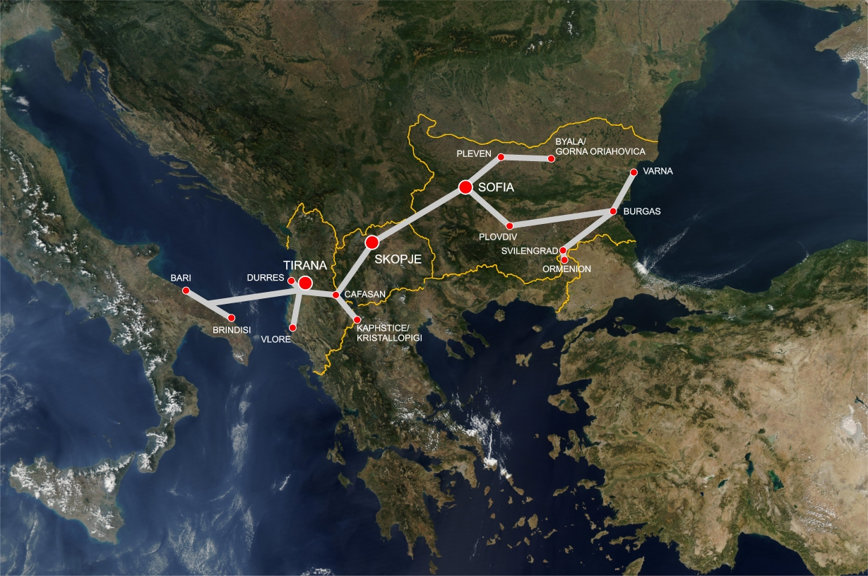
BACK TO THE ROOTS!
Italian
Government
THE PAN-EUROPEAN CORRIDOR VIII
Roadway: km 960
BOTTLENECKS IN ALBANIA AND MACEDONIA
Railway: km 1,270
MISSING LINKS IN ALBANIA AND MACEDONIA

Slide 3
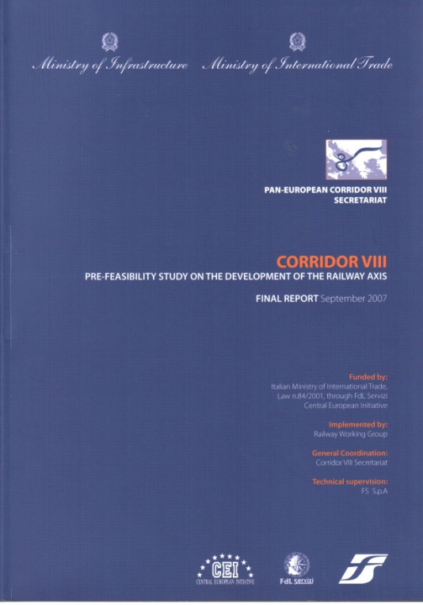
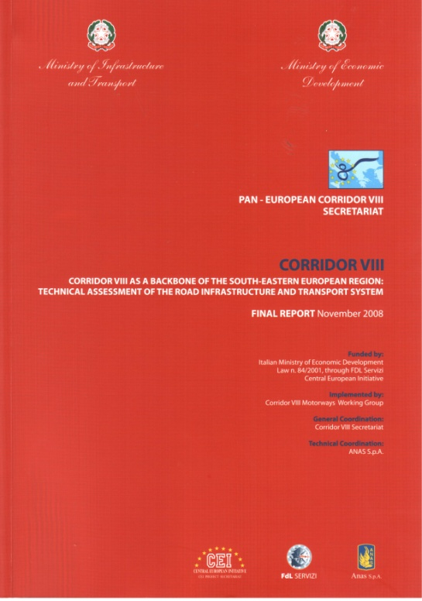
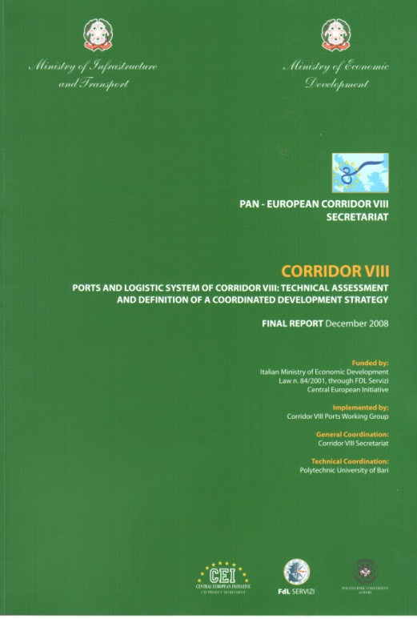
3 STUDIES ON THE C8 TRANSPORT SYSTEM
Carried out by the Technical Secretariat of C8,
including Representatives of the Ministries of Transport of Italy, Albania, Macedonia and Bulgaria
1: Study on the development of the Railway Axis, 2007
2: Technical assessment of the Road Infrastructure System, 2008
3: Technical assessment of the Ports and Logistic System, 2009

Slide 4
FINDINGS BY THE C8 SECRETARIAT
“C8 DSS Rail Project”: Railway Axis Durres-Skopje-Sofija
Technical support:
RFI - Italian Rail Network Infrastructure / ITALFERR - Italian National Railroad Engineering Company
LOGISTIC
The management of the Durres-Skopje-Sofia section will breakeven
by transporting 1.5-2 million tons of freight for an average distance of 500 km.
ECONOMIC
The C8 DSS Rail Project brings a huge impact on the socio-economic integration
in the South Balkans, as well as important economic impacts on national economies.
POLITICAL
The C8 DSS Rail Project contributes to pursue the stabilization and integration
of the South Balkans, fostering the intraregional development of the area.

Slide 5
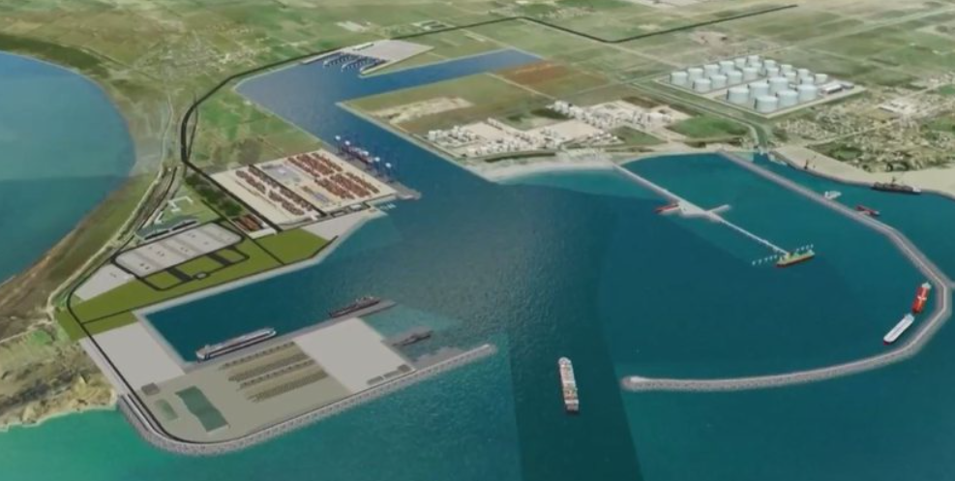
“Porto Romano will be a function of a common regional market, which integrates the Durrës-Prishtina railway and the dry ports in Kosovo and North Macedonia”
Sot.com.al, December 2022
“Porto Romano in Durrës, Dry Port in Prishtina, railway in the middle”
Albin Kurti, Prime Minister of Kosovo, June 2022
“This project will process the goods from the port of Durrës to Kosovo
and other countries in the Western Balkans”
Belinda Balluku, Minister of Economy of Albania, June 2022
“This railway from the Drini valley has a lighter slope, a higher speed of circulation and will reach faster Skopje and Sofia through Shkodra and Prishtina”
Liburn Aliu, Minister of Infrastructure of Kosovo, June 2022
“The connection to the terrestrial infrastructures will be guaranteed, in particular the Corridor 8 (Durrës–Skopje-Bulgaria) and the Corridor Porto Romano–Prishtina”
euriskon.org, February 2023

Slide 6
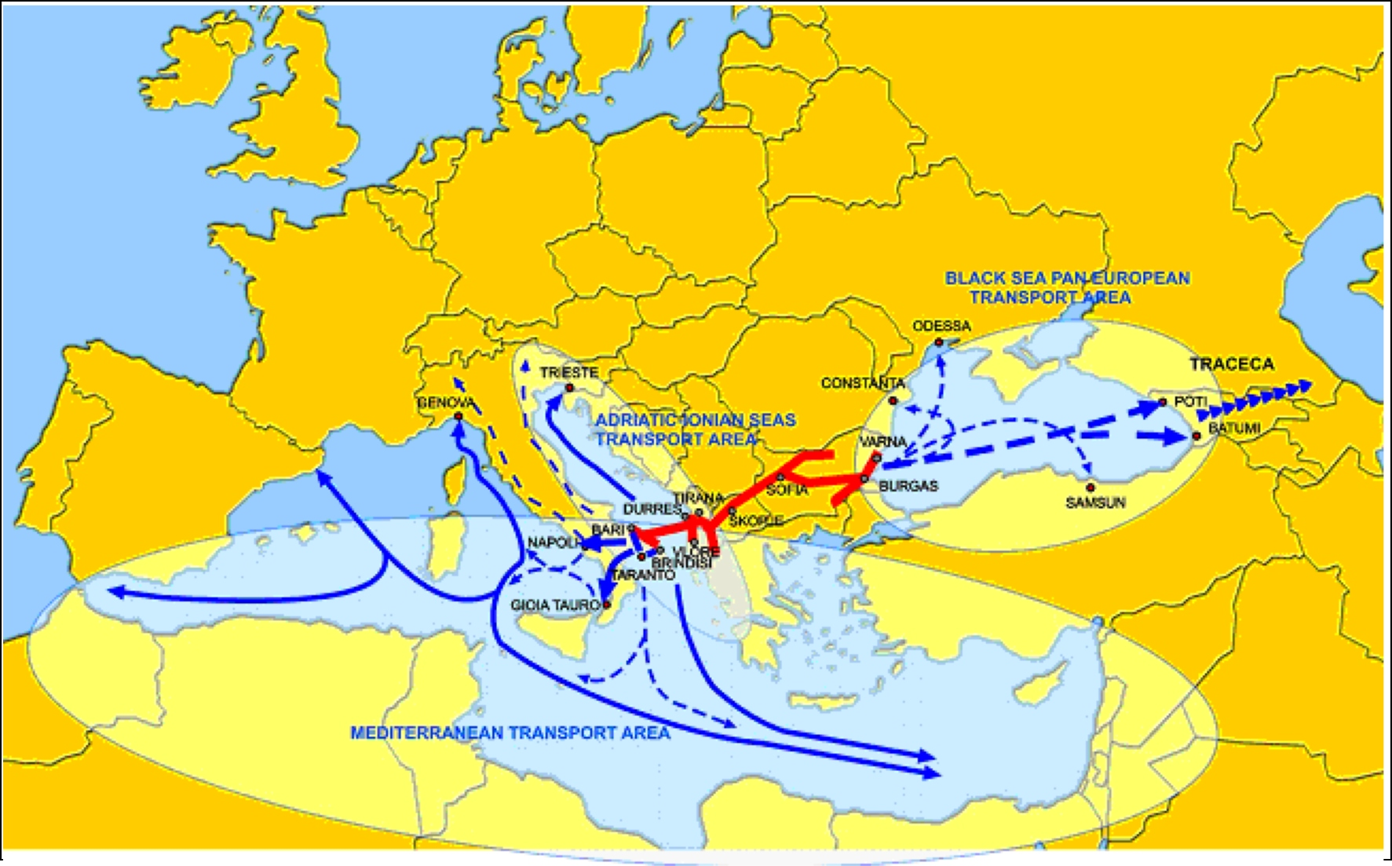
THE NEW CORRIDOR VIII: A WIDER PERSPECTIVE
The Lower Adriatic Area:
the Hub linking the EU to the Mediterranean and the Caucasus Region

Slide 7

“The implementation of Rail Corridor VIII, in the general framework of the SEE Transnational Axis, will contribute to an efficient and environmentally friendly East-West transport Corridor in the Southern Balkans, a more satisfying transport mode balance in the development of EU transport networks, a bridge between Europe and Far East and a factor for peace and development of the intraregional economies.
This joint effort constitutes both a political achievement and a step towards the completion of South Eastern European Transnational Transport Axis, whose constitution is crucial for all future relationships between Italy and the Balkan regions, as well as for the wider Euro-Mediterranean basin.”
Antonio Di Pietro, 2007
Former Minister of Transport, Italian Government

Slide 8


Development of Port Infrastructure
and TEN-T Compliance Indicators
DIVING INTO THE PORTO ROMANO PORT:
PORTO ROMANO IN THE FRAMEWORK OF CORRIDOR VIII
GOOD LUCK, PORTO ROMANO!

