Slide 2
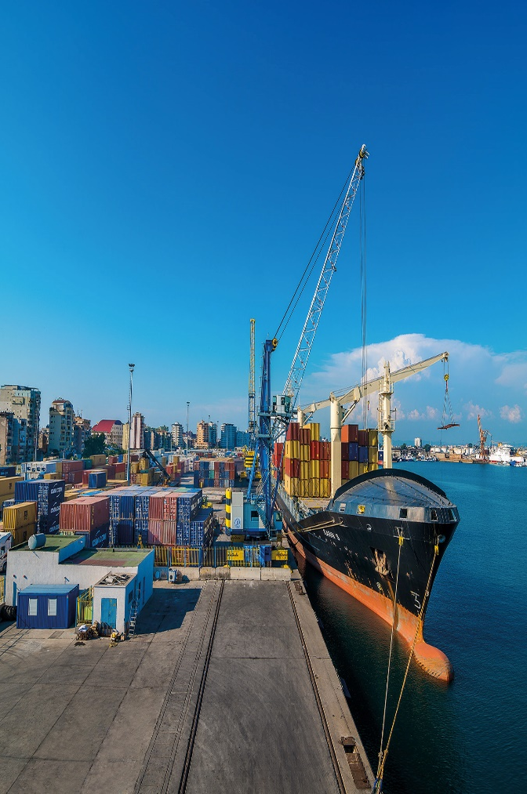
Mariner Adriatic – Human Capital
Data
People | 100
Area Quay length | 60,000 sqm 330 metres
Depth | 8.0 metres
Storage capacity | 1,550 ground slots
Reefer plugs | 312
Equipment | 3x Mobile harbour cranes 4x Reach stackers 1x Empty container handler 4x Terminal tractors 2x Forklifts
Capacity | 150,000 TEUs per annum
TOS | Real time cargo operations control system NAVIS N4Saas

Slide 3
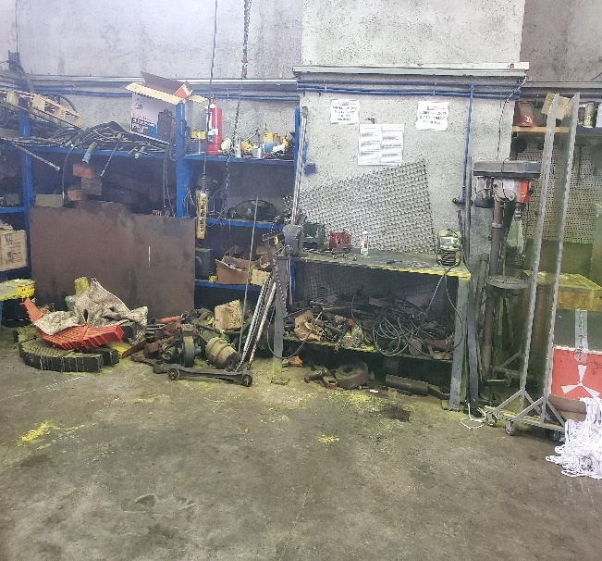
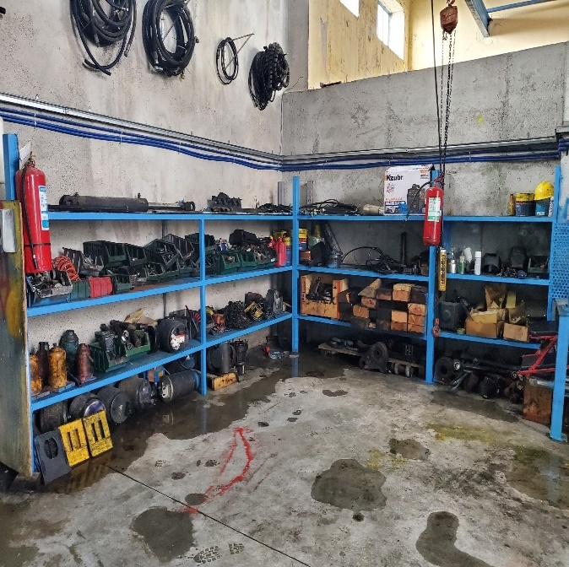
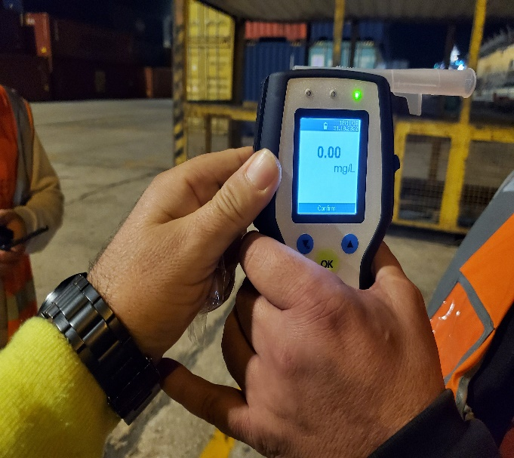
Mariner Adriatic – Human Capital
BEHAVIOUR
Before
After
Control

Slide 4
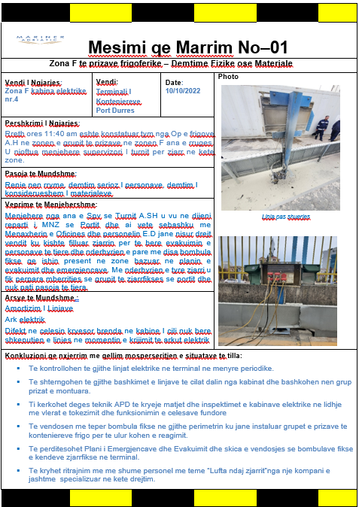
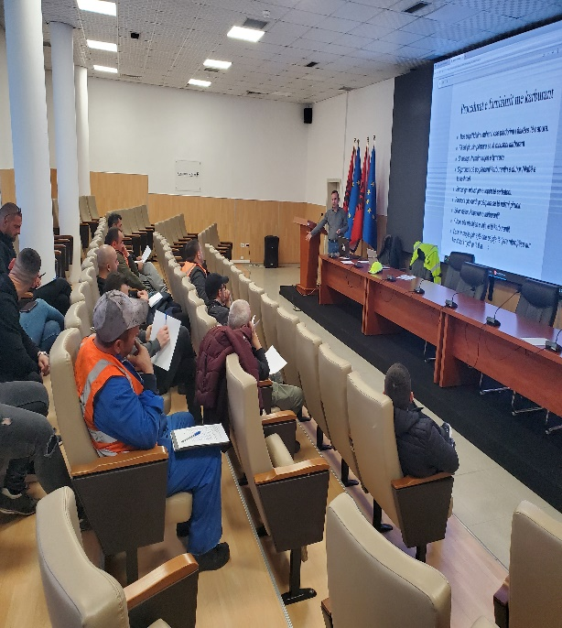
Mariner Adriatic – Human Capital
KNOWLEDGE
Identify
Learn

Slide 5
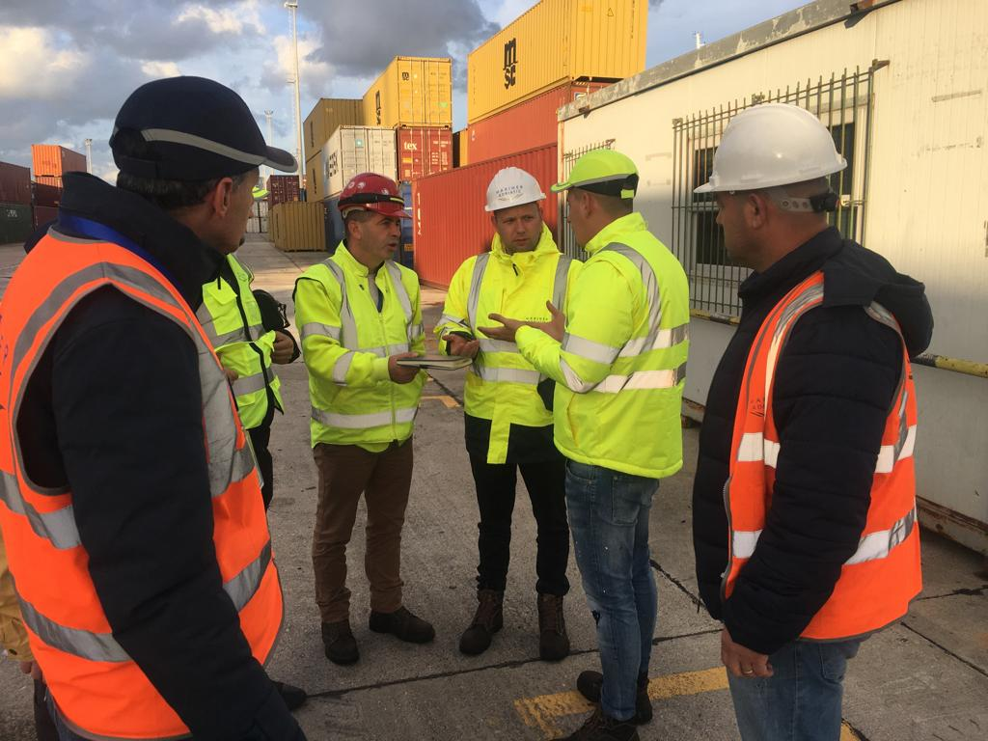
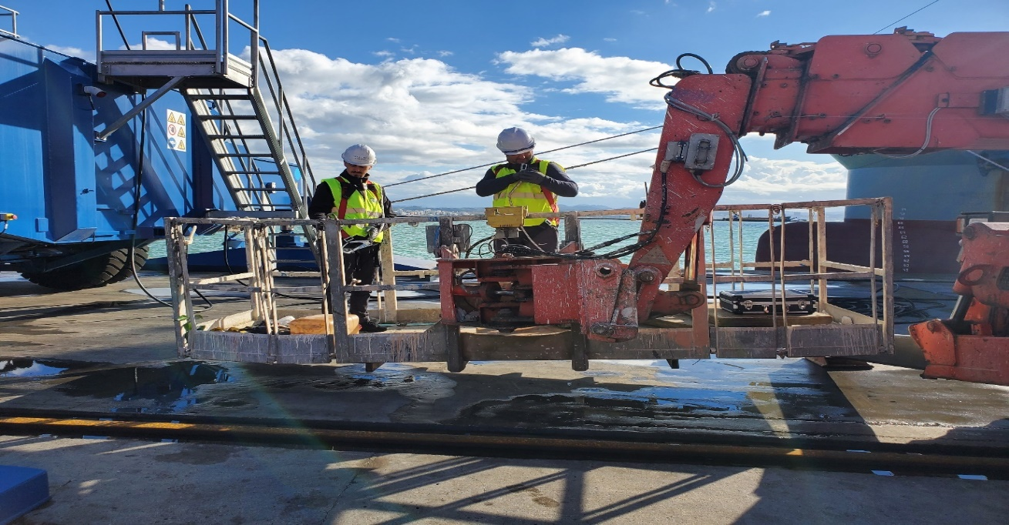
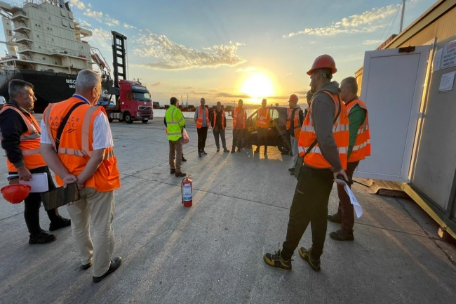
Mariner Adriatic – Human Capital
SKILLS
Individual
Group

Slide 6
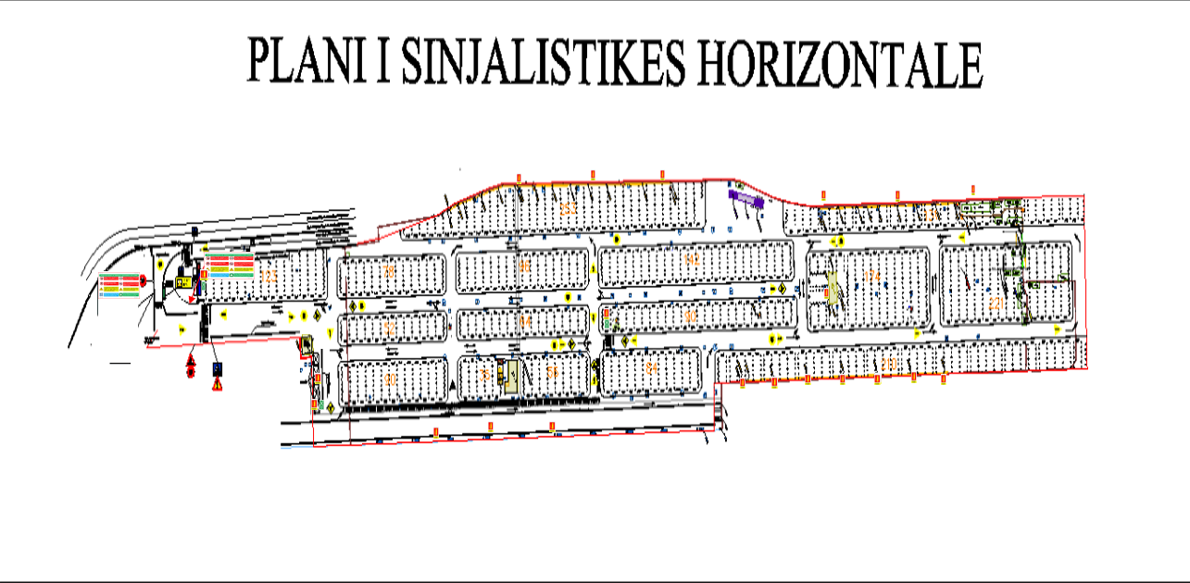
Mariner Adriatic – Human Capital
HEALTH AND SAFETY
Our Human is our main capital, together with skilled, knowledgeable and healthy team we can do everything!

Slide 7
Thank you
Mariner Adriatic| Lagjia Nr.3, Rr.H.Troplini, Shk.1, K.12, Ap.74, Durres, Albania | +355 52 706 676 | info@marineradriatic.com
www.mariner.com.mt

