Slide 1
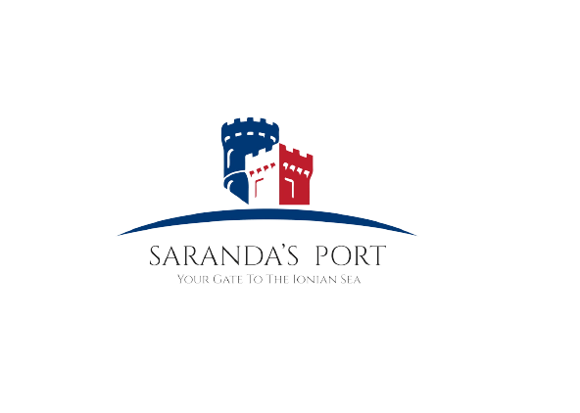
CRUISE TERMINAL
The important need of human capital !
The Port of Saranda
March, 2023

Slide 2
CONTENTS OF THIS TEMPLATE
1. The importance need in the Port of Saranda
2. What does the Cruise Terminal means for us?
3. What kinds of services will be offered there?
4.The importance of Human Capital
5. The conclusions

Slide 3
Since June 2020, the Port of Saranda is the port of cruises, ferry lines, yachts, and sailing boats.

Slide 4
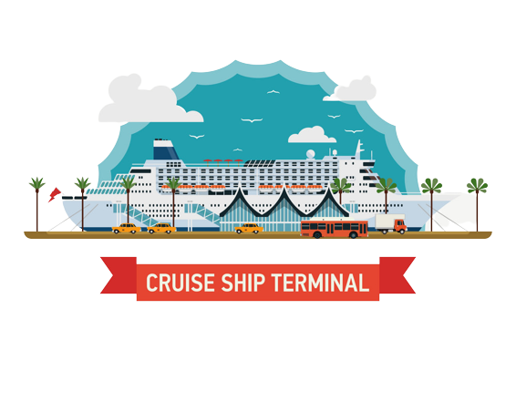
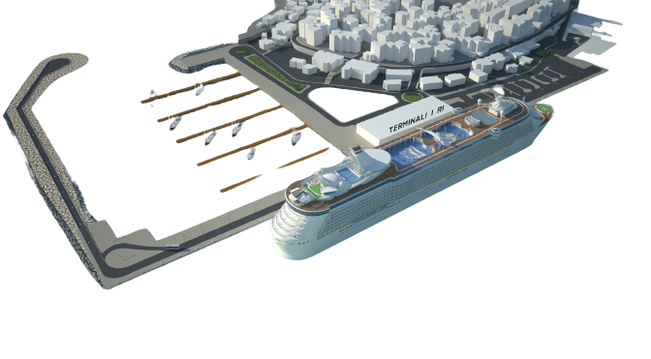
WHAT DO WE NEED IN OUR PORT?
FACT:
The number of the passengers and tourists which visit our port and our city, is increased year after year.
In 2021 there were 64.202 passengers in total, and in 2022 there were 286.411 in total.
SOLUTION:
In order to be more productive, more competitive, more flexible, more innovative, our immediate need is a
ESTABLISH A NEW CRUISE TERMINAL

Slide 5
BENEFITS OF THE CRUISE TERMINAL
More cruises
More passengers
Better service, Better reviews
More human capital More jobs
More income, More well-being

Slide 6
PURPOSE
The main operating cost items are:
the staff for managing the terminal,
security,
and luggage handling.
Cruise terminals are designed to serve the requirements of cruise vessels and their passengers.
At the same time, they have to be integrated with transport, tourism, and the urban planning strategies of the port city and nearby destinations.

Slide 7
Embarkation and Disembarkation Processes

Slide 8
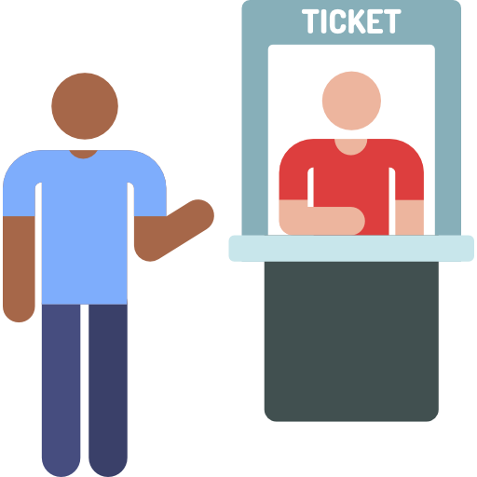
EMBARKATION PROCESSES
The embarkation process of cruise passengers begins upon arrival at the cruise terminal. The services during this process are:
Entrance space is a gathering space for passengers arriving at the terminal, a place to seek information, and a place to queue for the next step in the process.
Ticketing where passengers pick up their tickets before check-in if not available through prior arrangements
Bag drop space where bags are brought for the security check and organizing prior to loading onto the ship.
Check-in area The use of new technologies like mobile applications or bar-coded wristbands in the check-in process is already bringing changes in the layout of this area.

Slide 9
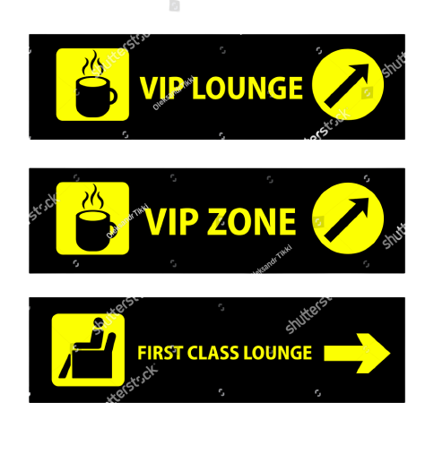
EMBARKATION PROCESSES
Waiting areas for checked-in ticketed passengers to wait until boarding can begin. This space is large enough as well as space for cruise information
Staff offices for cruise operator staff, cruise line staff, and port security
Other spaces, such as spaces where passengers can have their pictures taken, VIP lounge, and even wedding and other special group spaces.

Slide 10
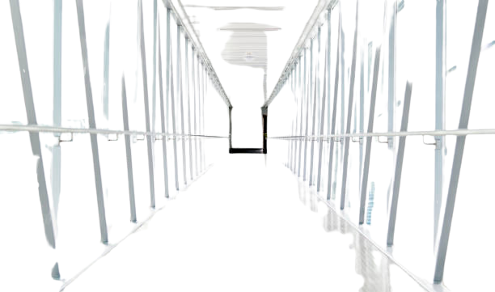
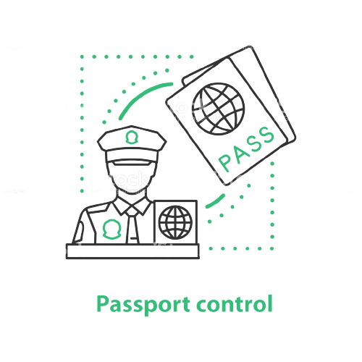
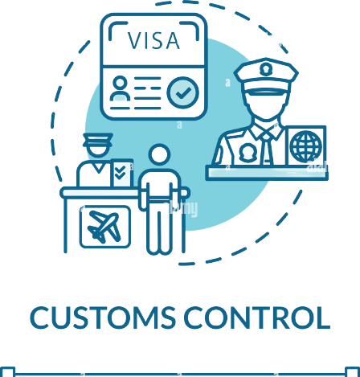
DISEMBARKATION PROCESS aims to reduce the processing time to a minimum and maximizing this final experience for the passenger
01
3
Boarding corridors
Baggage lay down
Customs, immigration, quarantine, and police
Customs areas
Meeting spaces

Slide 11
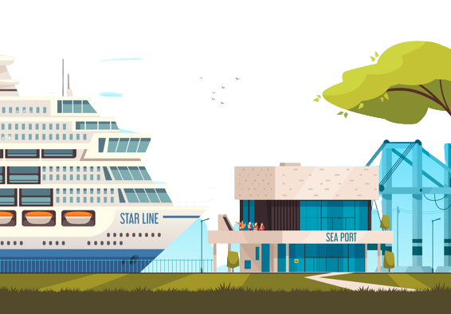
NEEDS…
Government or EU funds for the new building
Human Capital to provide better and more productive services
THE BUILDING
CRUISE
TERMINAL
HUMAN
CAPITAL

Slide 12
THE IMPORTANCE OF HUMAN CAPITAL IN THE CRUISE TERMINAL
01
02
03
BETTER SERVICES
Trained people offer better service for the passengers
BETTER REVIEWS
If the requirements and conditions of the passengers will be met, our port and our city, will have high rates
FASTER SERVICES
The portual services will be faster , if we have human capital for all the facilities that cruise terminal offers

Slide 13
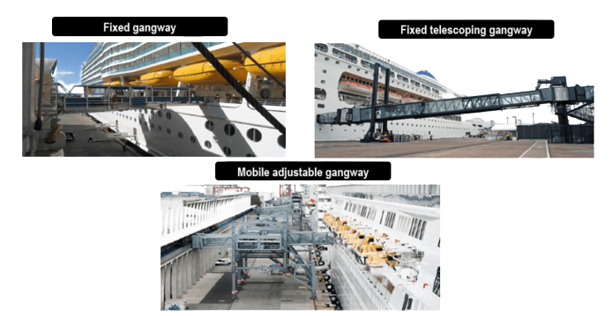
OTHER SERVICES WHERE HUMEN CAPITAL IS IMPORTANT
The Gangway
The gangway (also known as seaport passenger boarding bridge) is the means of getting on and off a ship. In general shipping terms, it refers to a walkway or bridge connecting the vessel to land

Slide 14
The conclusions:
1. Need to take neccesary measures to have trained, qualified, specialized staff for providing specific services
2. Potential collaboration with the Centre of Exellence of Maritime Affairs

Slide 15
THANK YOU !

