Slide 1
CONFERENCE DEVELOPMENT OF PORT INFRASTRUCTURE AND TEN-T COMPLIANCE INDICATORS 21 March 2023
THE NEED FOR A NATIONAL COASTAL PLAN FOR THE DEVELOPMENT OF TOURISM AND THE ECONOMY
PROF. ING. PAOLO VIOLA - WIP ARCHITETTI
UNIVERSITÀ FEDERICO II° - NAPOLI

Slide 2
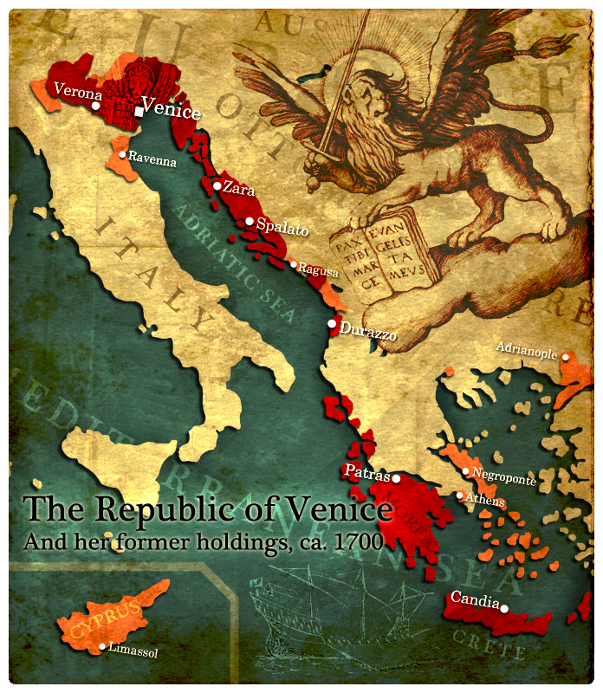
The Adriatic Sea, thanks to Venice, has played a significantly central role in history, while Albania, which would have deserved to be the guardian pier, the control tower of this sea, has been peripheral to empires turned elsewhere for centuries.

Slide 3
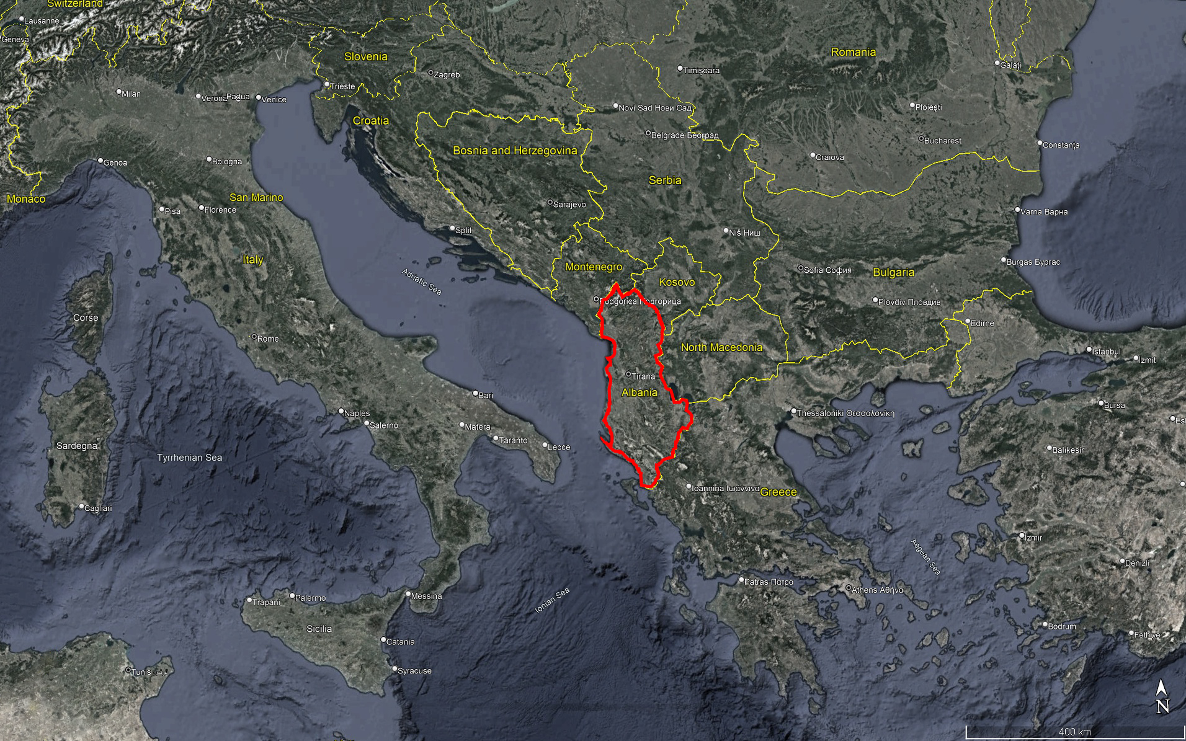
For thirty years, the country has taken control of its own destiny and rediscovered its centrality in the wider Mediterranean Sea,
in a strategic position between the Adriatic and the Ionian, between Western Europe and the Balkans.
This centrality becomes even more evident when looking at the development of international nautical tourism in the Mediterranean;
Albania is the last part of Europe where an enormous historical and environmental heritage can still be discovered.

Slide 4
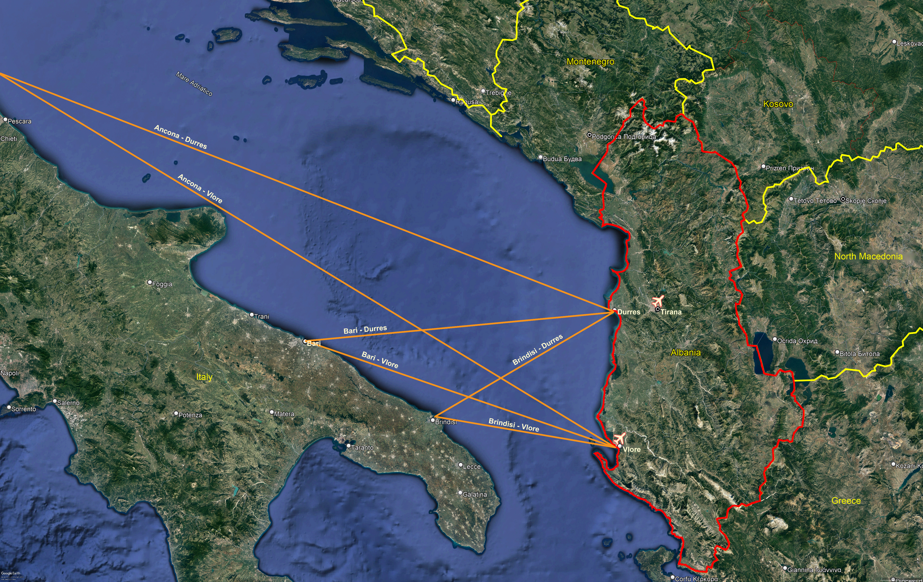
But what is needed is a wide-ranging, international plan, written together with the other coastal countries - Italy, Slovenia, Croatia, Montenegro - which places the Adriatic at the center and finds in Albania and the Puglia region the gateway and tourist reception points.
The Plan must provide not only a rational network of ports and their standard of services for people and boats, but also a network of connections with the cultural and landscape heritage of the hinterland and with the related services to build a "world to be discovered".

Slide 5
This "Adriatic world" can renew the golden age of the "Republic of Venice", expanding it on one hand to the new Balkan Europe and on the other to those eastern regions of Italy (Marche, Abruzzo, Molise, Basilicata) that are currently less developed in tourism.
Albania, being the youngest and "freshest" country politically, could therefore take the initiative, and starting from a plan for its coasts, ask the other coastal countries to integrate into a broader and international area plan.
Once the structure of such a plan is defined, possibly with the collaboration of several universities, it could be proposed to the European Union by the governments as a "Pilot Urbanistic Plan for interregional integration and development of a wide area".

Slide 6
THANK YOU FOR YOUR ATTENTION

