Slide 1






“On a meaningful youth participation in INTERREG IPA & EUSAIR”
Interreg VI-A IPA CBC Croatia - Bosnia and
Herzegovina - Montenegro
Budva, 2 March 2023
Podgorica, 3 March 2023

Slide 2

Interreg IPA Cross-border Cooperation Programme Croatia-Bosnia and Herzegovina-Montenegro 2014-2020
Overview of past results and achievements

Slide 3
Programme and Calls
67 million EUR total Programme, 57 million EU available fund
4 priority axes → 5 specific objectives
2 Calls for project proposals
325 project proposals received
59 contracted projects (45 projects with ME partners)
EUR 368.4 million requested
EUR 62.2 million contracted (47,9 million for projects with ME partners)
EUR 12,5 million (EUR 10,6 EU) contracted budgets for 55 project partners from ME
Total 249 partners in cross-border cooperation
+ Technical assistance for programme bodies

Slide 4
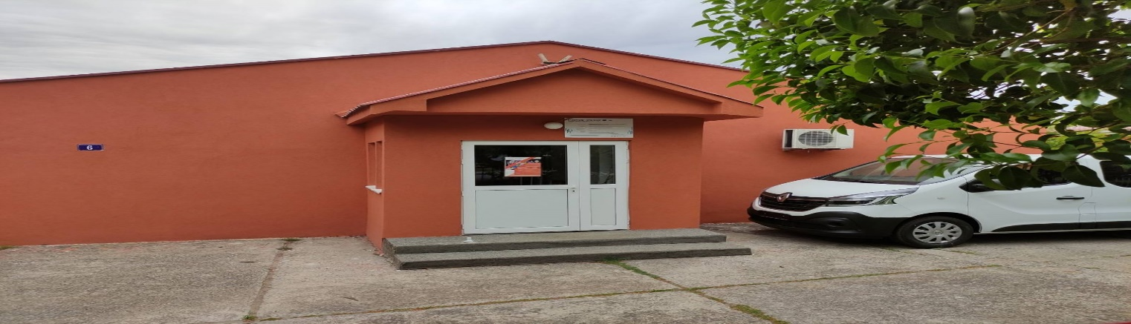
Specific objective 1.1 To improve the quality of the services in public health and social care sector across the borders
ASIQ project Improving Accessibility and Availability of Health and Social Services to Enhance Social Inclusion Quality for Children and Youth with Developmental Disabilities https://www.interreg-hr-ba-me.eu/project/asiq/

Slide 5
Specific objective 1.1 To improve the quality of the services in public health and social care sector across the borders
ER2 = S2 Equality, Respect, Rights = Social Satisfaction https://www.interreg-hr-ba-me.eu/project/er2s2/ Sportske igre Tešanj

Slide 6
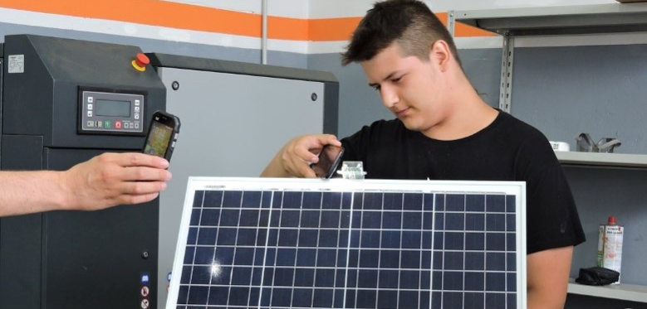


SMART SCHOOLS
SMART SCHOOLS 2
SMART SCHOOLS
SMART SCHOOLS 2

Slide 7
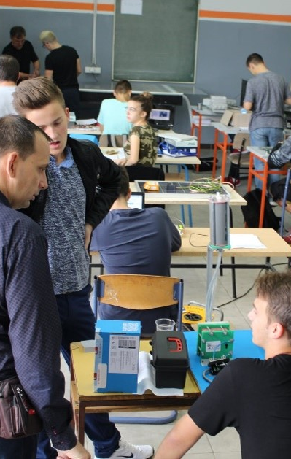
SMART SCHOOLS
Innovative minds for smart schools
https://www.interreg-hr-ba-me.eu/project/smart-schools/
Total budget: EUR 1,644,127.82 | EU co-financing: EUR 1,395,864.49

Slide 8
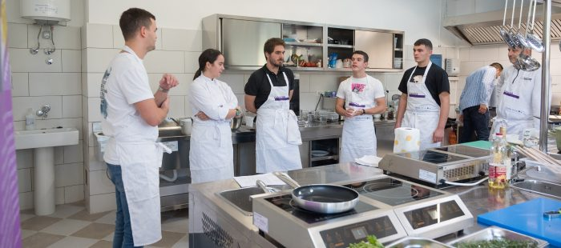
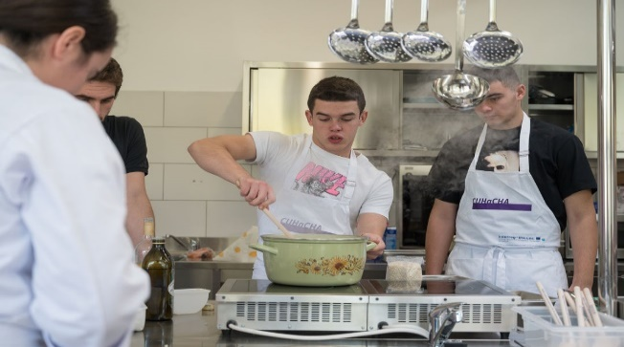
CUHaCHa
EnhanCing Sustainable ToUrism Development througH Culinary HeritAge
The total budget of the project is €710,946.94, while the amount intended for the Municipality of Tivat is €173,823.6
Tivat Municipality
-reconstructed and equipped with professional equipment kitchen of Srednje mješovita
škole „Mladost“, Tivat -culinary heritage showroom for practical exercise and educations
(Culinary workshops) for students

Slide 9
2CODE and CODE
Cooperation for Development of Cross Border Business Environment Enhanced
https://www.interreg-hr-ba-me.eu/project/code/ CODE HUB Nikšić
https://www.interreg-hr-ba-me.eu/project/2code/ 2CODE promo video projekta
CODE total budget EUR 883.555 Tehnopolis EUR 176.486
2CODE total budget EUR 929.745, Tehnopolis EUR 259.462

Slide 10
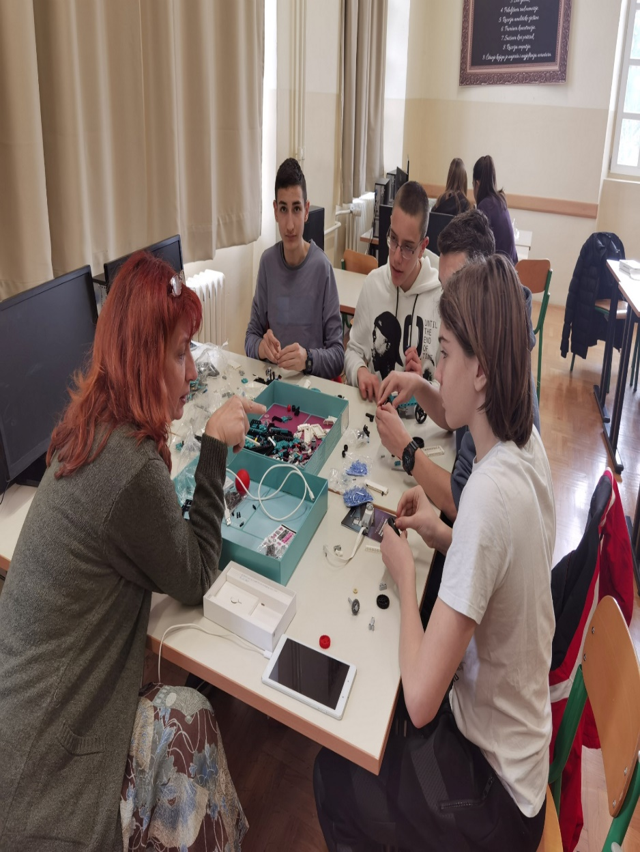
iNnovaNet Innovative technologies for stronger businesses and improved business environment
-equipment of cabinets for robotics, mechatronics, electrical engineering, programming and energy for practical classes, preparing students for competitions, develop innovative products, thus increasing their competitiveness on the labor market and further education.
-First vocational high school of Niksic and Gymnasium Slobodan Skerovic Podgorica – 2 3D printer, 10 educational robots, 2 educational coding set, 6 educational robotic hands, 1 solar micro power plant, 1 micro wind power plant,
-Trainings for professors who were additionally educated and perfected their knowledge
-total budget EUR 1.320.785, Tehnopolis EUR 289.048.

Slide 11
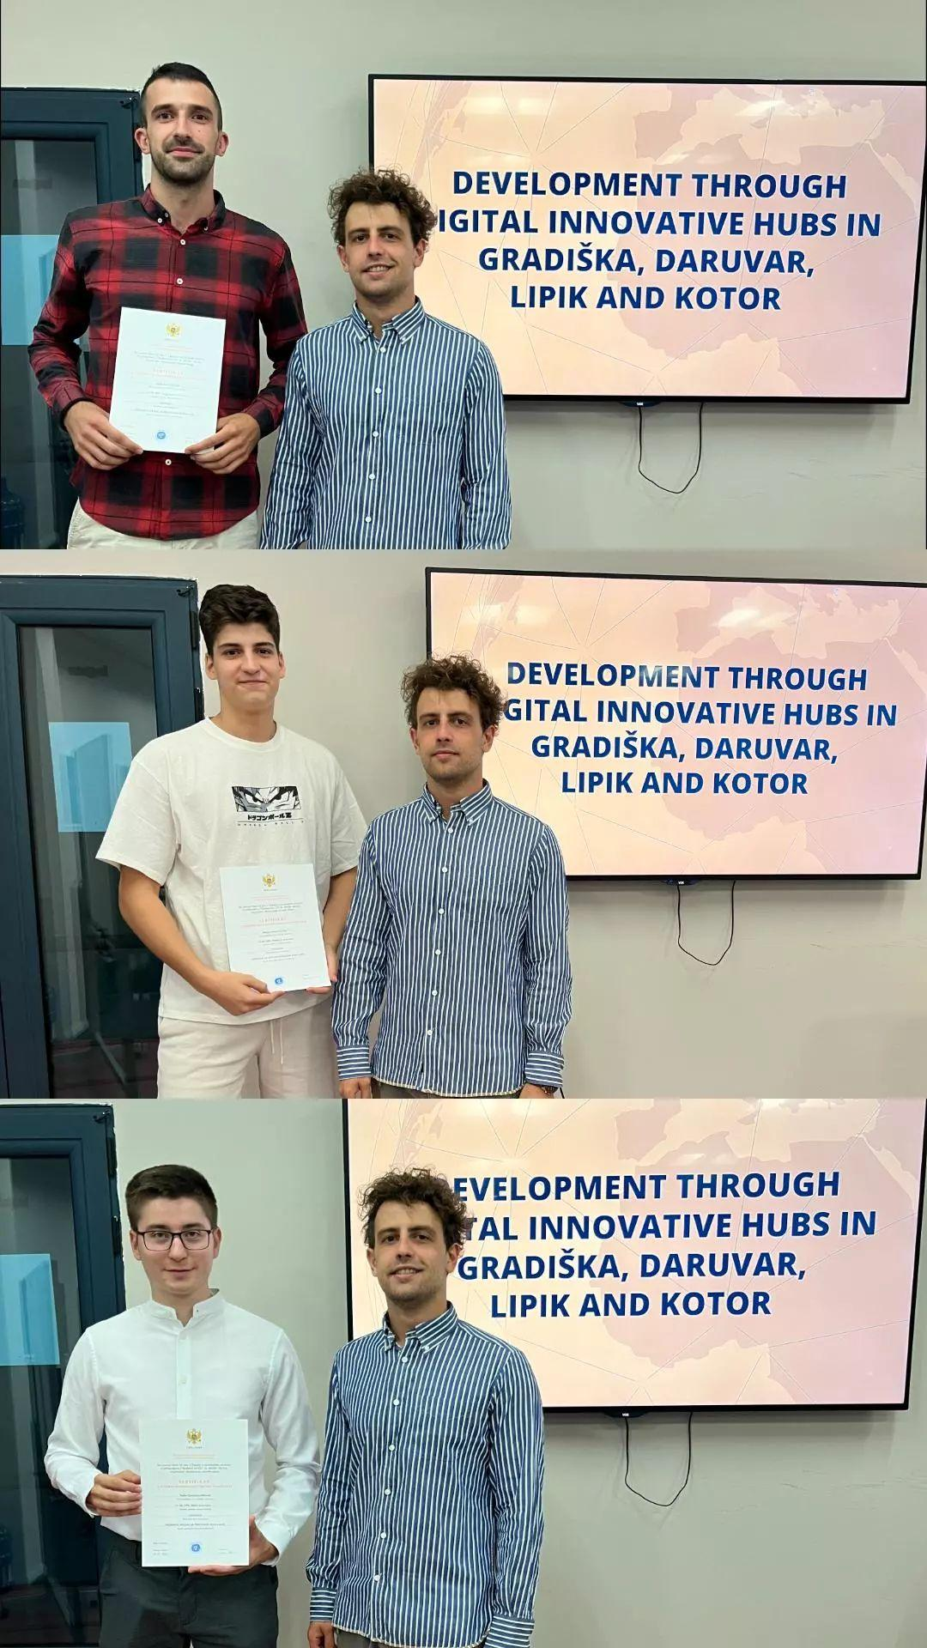
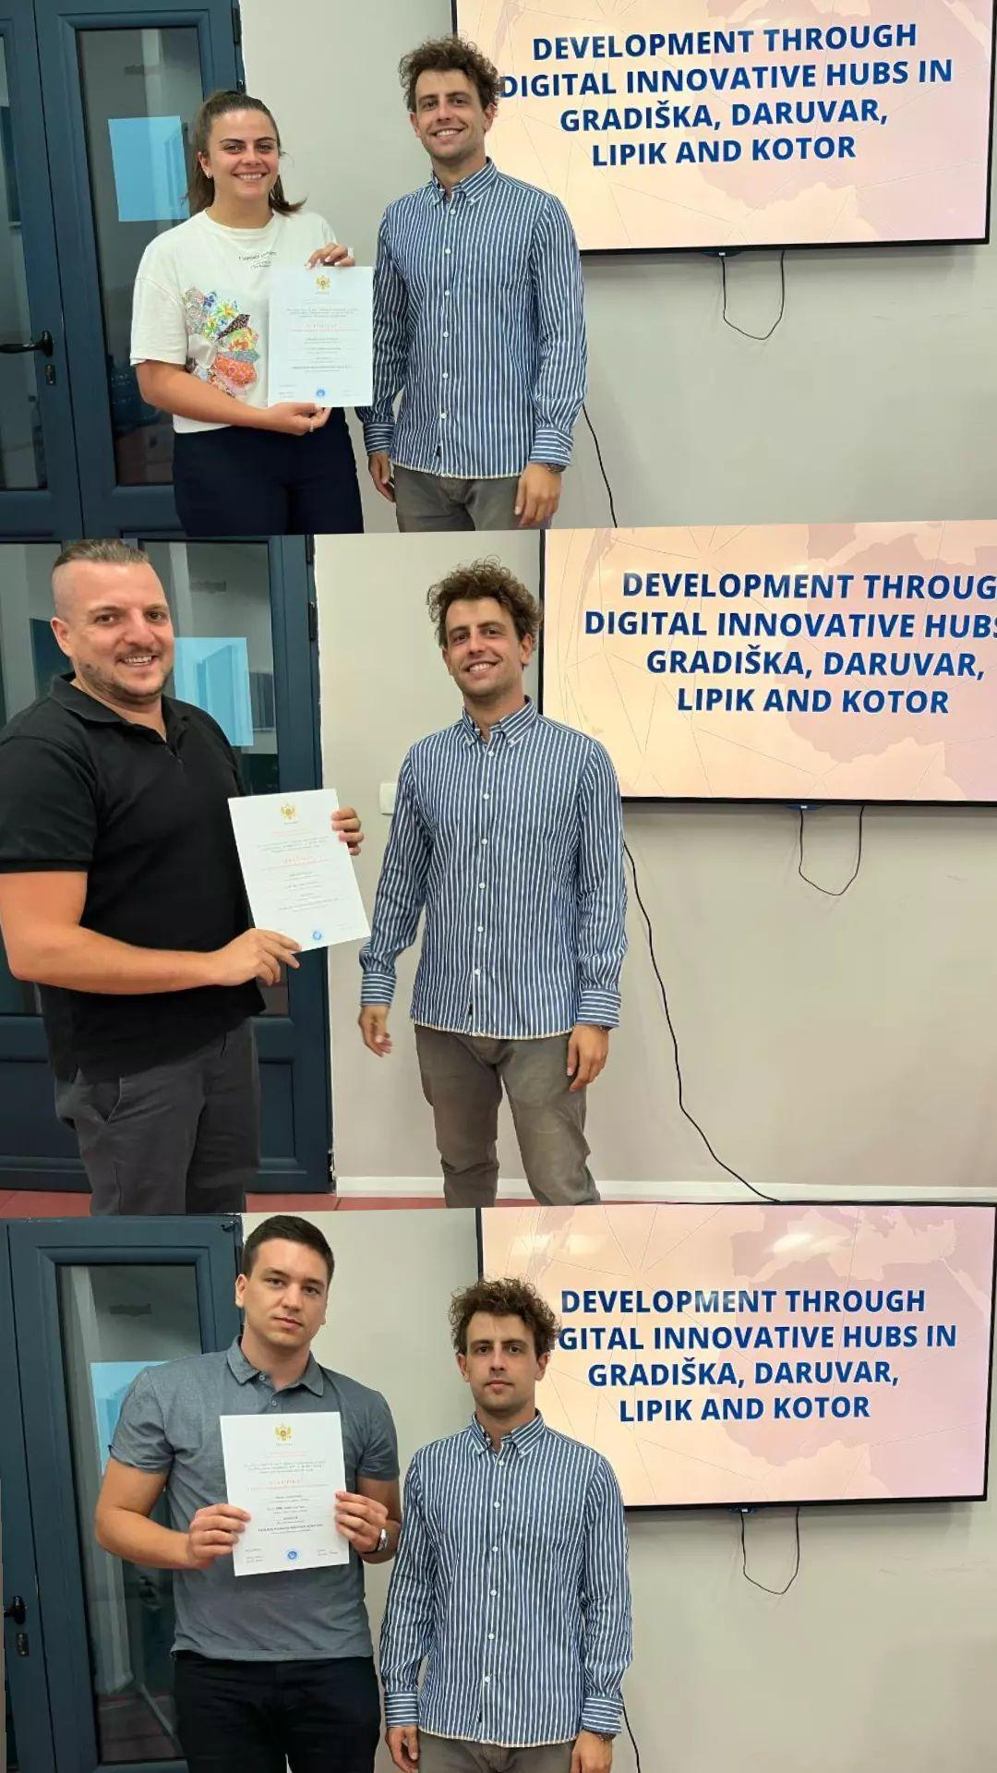
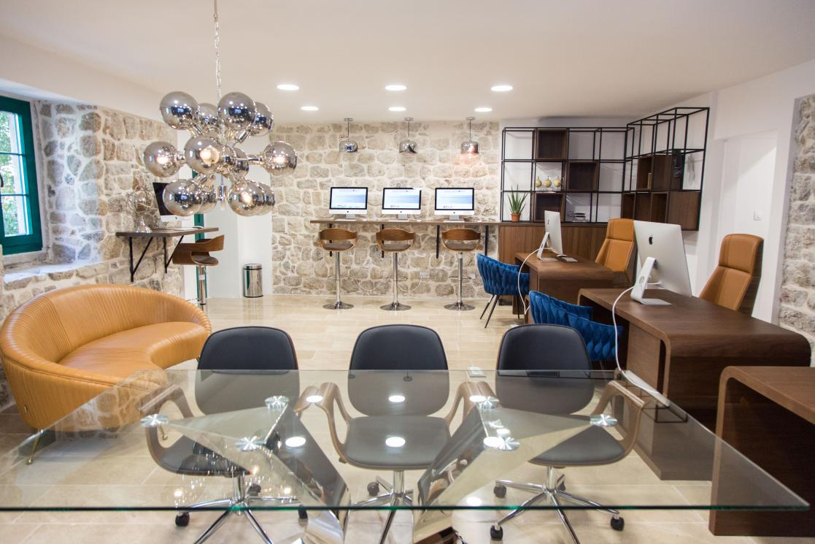
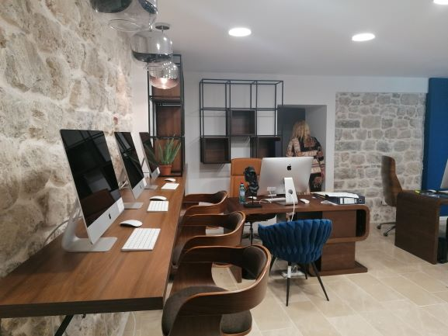
Development through DIHs Development through Digital Innovative Hubs in Gradiška, Daruvar, Lipik and Kotor
-Digital Innovative Hubs (DIHs) in Gradiška, Daruvar, Lipik and Kotor IT equipment, furniture and adaptation works for four (4) DIHs is over EUR 1.000.000,00.
8 educations organized in Gradiška, Daruvar, Lipik and Kotor for future start-up or existing start-up/entrepreneurs for 52 participants in the field of: Front-End development and programming languages used in Java developer and robotics.
Municipality of Kotor organized 1 training, 7 participants. 6 participants received a JAVA certificate.
-total budget EUR 1.487.795, Municipality of Kotor EUR 164.146

Slide 12
CREATIVE@CBC
Development of Cross-Border Cooperation Network of Creative Industries
https://www.interreg-hr-ba-me.eu/project/creativecbc/
-(3) Creative Centers are established and equipped in Prijedor (BA), Sisak (HR) and Podgorica (ME)
know-how, targeted services, new technologies (3D printing, CNC prototyping etc.)
-best practice methodologies to all the stakeholders relevant for development of creative industries in the target area.
Association for Democratic Prosperity – ZID

Slide 13
Introducing the main features of the 1st Call for Proposals
Interreg VI-A IPA CBC Croatia - Bosnia and
Herzegovina - Montenegro

Slide 14
1st Call for Proposals, budget and co-financing
Total EU program allocation available to projects: EUR 106,987,000.00
Funds available for the 1st call: EUR 41,095,300.00
Maximum rate of EU co-financing: 85% of the total project budget
Minimum national co-financing per partner: 15% of the total project budget
Program pre-financing (advance): 25% of the total project budget
The budget of an individual partner - at least 10% of the total project budget
Cost recovery model - periodic reporting on project progress

Slide 15
1st Call for proposals: eligible applicants, examples
Ministries, local and regional self-government units
Public bodies (institutions, agencies) established by state or local, regional (regional) self-government, such as: research and development institutions, educational institutions, health care institutions, institutions for the protection of nature and cultural heritage, local and regional development agencies, business centers, incubators, public utility companies, tourist boards/organizations, etc.
Civil society organizations, NGOs, foundations, etc.
Chambers (e.g. economic, agricultural, craft, industrial, etc.), clusters registered as non-profit legal entities, sector associations, etc.
2 to 6 partners from HR, BA ME, at least one must be from Croatia

Slide 16
1ST Call for Proposals: budget and co-financing / duration
PRIORITY AXIS / SPECIFIC OBJECTIV | 1ST CfP– EU PART (EUR) | PROJECT BUDGET-EU PART (EUR) | DURATION (MONTHS)
PO 1 / SO 1.1. Research and Innovation | 5.416.000,00 | 400.000 – 1,5 MIL | 18 – 30
PO 2 / SC 2.1. Energy efficiency | 5.751.250,00 | 500.000 – 2 MIL | 18 – 30
PO 2 / SC 2.4. Climate change adaptation and disaster risk prevention | 9.202.000,00 | 500.000 – 2,5 MIL | 18 – 36
PO 2 / SC 2.6. Circular and resource efficient economy | 5.751.250,00 | 500.000 – 2 MIL | 18 – 30
PO 3 / SC 4.5. Accessible health services | 7.700.000,00 | 400.000 – 2 MIL | 18 – 30
PO 4 / SC 4.6. Sustainable and inclusive tourism and culture | 7.724.800,00 | 400.000 – 2 MIL | 18 – 30

Slide 17
Thank you for your attention!
Joint Secretariat, Branch Office in Podgorica, Montenegro
https://www.interreg-hr-ba-me.eu/
https://www.facebook.com/InterregHRBAME
https://www.linkedin.com/in/interreg-ipa-cbc-hr-ba-me-384068151/
https://twitter.com/HRBAME
https://www.youtube.com/channel/UCbIxOzpfk1uH2Udfe7oKy4Q

