Slide 1
A meaningful youth participation in Interreg IPA:
How to enable young people to take action?
How can young people get involved in Interreg IPA programmes?
Besiana Ninka/ Interact office Vienna / 02.03.2023

Slide 2
Interreg IPA programmes in Montenegro
Interreg IPA South Adriatic
Programme area: Italy (Puglia & Molise Region), Albania & Montenegro (whole territory)
PA 1. A smarter South Adriatic programme area, by promoting innovative and smart economic
transformation (SMART)
PA 2. A greener South Adriatic programme area, by promoting clean and fair energy transition, green and blue investment, the circular economy, climate adaptation and risk management (GREEN)
PA 3. A more connected South Adriatic programme area by enhancing mobility and regional connectivity (CONNECTED)
PA 4. A more social South Adriatic programme area (SOCIAL)
PA 5. A better governance in the South Adriatic programme area (GOVERNANCE)

Slide 3
Interreg IPA South Adriatic 1/4
First call for proposals
Key aspects of the call:
Capitalisation Small-Scale Projects (open to all the specific objectives);
29 December 2022 (open for 90 calendar days from the day of publication);
Max. EUR 200.000 (IPA + National co-financing);
Shall not be longer than 12 months duration;
Implemented only through Simplified Cost Options;
Pre-financing 30%.

Slide 4
Interreg IPA South Adriatic 2/4
First call for proposals
Fields of actions:
- Public services
- Digital services
- Small investments
- Innovative experimental applications
- Agreements
- Joint models/processes
- Capacity building/trainings

Slide 5
Interreg IPA South Adriatic 3/4
First call for proposals
Beneficiaries and target groups
Public authorities such as ministries, regions and local municipalities;
Public bodies such as agencies, bodies governed by public law, universities and research centres;
Social partners such as chambers of commerce, NGOs, associations and foundations’;
Their target groups, using/benefitting from their actions:
SMEs, public, private and non-profit organisations
Citizens

Slide 6
Interreg IPA South Adriatic 4/4
First call for proposals
Zoom in: young citizens
S.O. 1.1 SMEs: Measures for local SMEs contrast unemployment and migration of younger population to more attractive locations;
S.O. 4.1 SKILLS: Targeting vulnerable groups, including unemployed young citizens and NEETs;
S.O. 4.2 Inclusive TOURISM: Targeting more skilled and young population

Slide 7
Interreg IPA programmes in Montenegro
Interreg IPA HR-BA-ME
Programme area:
- 12 counties from Croatia,
- 109 municipalities and Brčko District in Bosnia and Herzegovina
- 11 municipalities from Montenegro
Priority 1. Smart investments in research, innovation and competitive entrepreneurship
Priority 2. Green investments in environmental protection and efficient risk management
Priority 3. Accessible and resilient health services
Priority 4. Sustainable and inclusive tourism and culture
1st call for proposals: 1st quarter 2023

Slide 8
Interreg IPA programmes in Montenegro
Interreg IPA ADRION
Programme area:
Croatia, Greece, Italy (part of), Slovenia, Albania, Bosnia-Herzegovina, Montenegro, Serbia
New entry: North Macedonia and San Marino
Priority 1. supporting a smarter Adriatic Ionian region
Priority 2. supporting a greener and climate resilient Adriatic Ionian region
Priority 3. supporting a carbon neutral and better connected Adriatic Ionian region
Priority 4. supporting the governance of the Adriatic Ionian region
1st call for proposals: 1st quarter 2023

Slide 9
Interreg IPA ADRION
Bridging two periods
5th EXTRAORDINARY CALL FOR PROPOSALS
Open to Universities and research centres, as well as business institutions to raise competences and skills in domains considered of strategic relevance for the Adriatic-Ionian programme area, namely:
Blue Economy
Social Innovation
Renewable Energy
Circular Economy
and with the aim to develop preparatory measures for the activation of joint Master Programmes to be running in the 2021-2027 programming period.

Slide 10
How can you engage with young people?

Slide 11
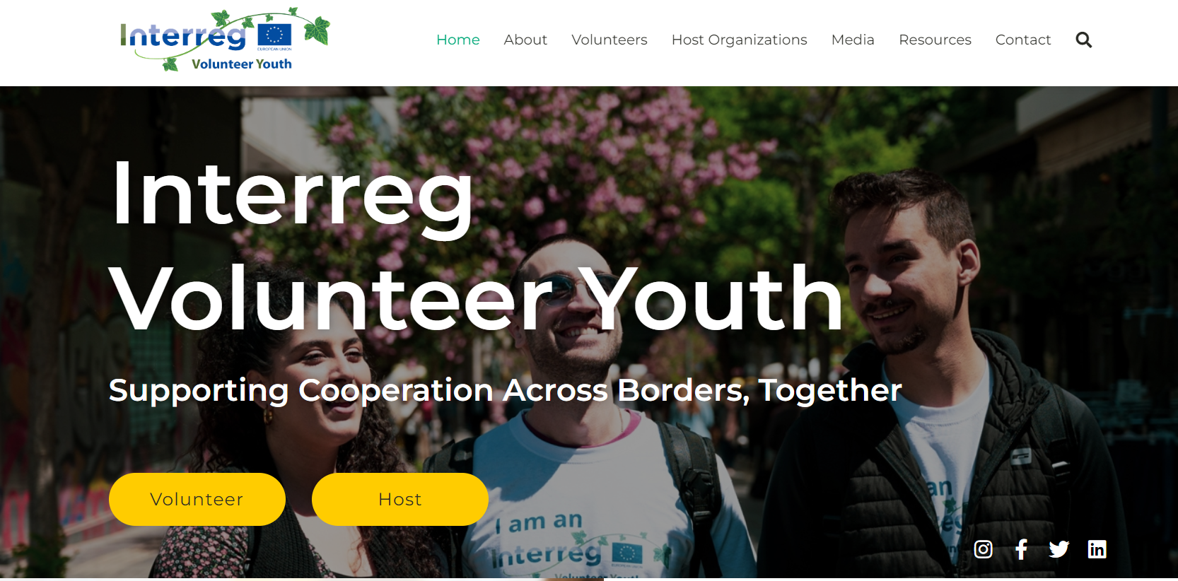
IVY

Slide 12
ASOC

Slide 13
What do we do in Interact

Slide 14
Inclusive growth network
This network focuses on making available relevant data,
facilitating the exchange of practices and gaining
knowledge about the current experiences and themes,
with the aim to support a common Interreg response
to the EU Inclusive Growth policy.

Slide 15
Interact online learning platform
This platform enhances knowledge delivery and learning experiences within the Interreg community.
The courses are tailor-made for the Interreg community, allowing you to be flexible in what, how, when and where you learn.
We bring together expertise from all over Europe and
from different types of stakeholders.
You are very welcome to join our online courses and meet other learners from all around Europe.

Slide 16
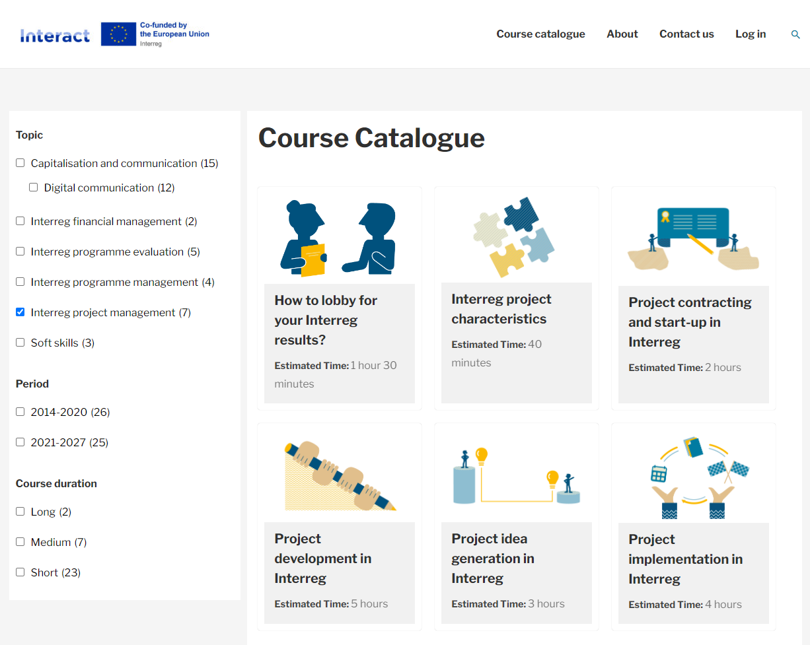
Interact online learning platform

Slide 17
Some reflections
Embrace the challenges
Design a genuine framework
Managing expectations
Keep the momentum

Slide 18
IPA CBC programmes in Montenegro
IPA CBC Montenegro – Albania
IPA CBC Bosnia and Herzegovina – Montenegro
IPA CBC Serbia – Montenegro

Slide 19
Cooperation works

